Slide 1
Observing users in the field
Lorrie Faith Cranor
September 2011

Slide 2
Why observe users in the field?

Slide 3
Example of Design Failure
BART “Charge-a-Ticket” Machines
  allow riders to buy BART tickets or add fare
  takes ATM cards, credit cards, & cash

Slide 4
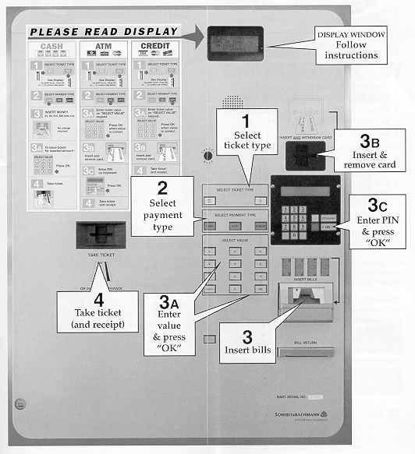

Slide 5
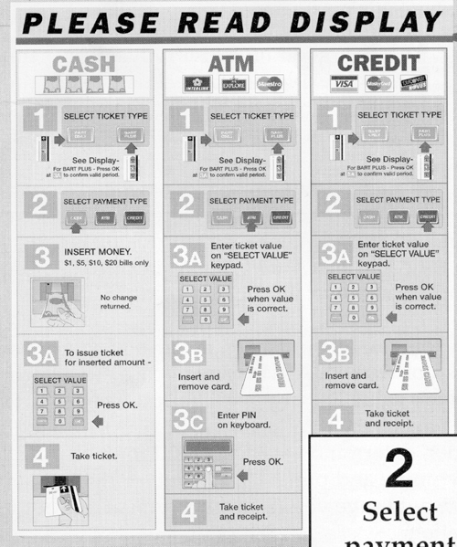

Slide 6
Example of Design Failure
BART “Charge-a-Ticket” Machines
  allow riders to buy BART tickets or add fare
  takes ATM cards, credit cards, & cash
Problems (?)
  no visual flow (Where do I start? Where do I go next?)
  one “path” of operation
    ticket type −> payment type −> payment −> ticket
  BART Plus has minimum of $28, no indication of this until after inserting >= $1
    can’t switch to regular BART ticket
  too many instructions
  large dismiss transaction button does nothing

Slide 7
Lessons from the BART machine
Can’t we just define “good” interfaces?
  “good” has to be taken in context of users
    might be acceptable for office work, not for play
    infinite variety of tasks and users
  guidelines are too vague to be generative
    e.g., “give adequate feedback”
How can we avoid similar results?
  “What is required to perform the user’s tasks?”

Slide 8
Task Analysis
Find out:
  who users are
  what tasks they need to perform
Observe existing work practices
Create scenarios of actual use
This lets us try new ideas before building software!
  Get rid of problems early in the design process
  while they are still cheap to fix!

Slide 9
Task Analysis Questions
Task
Analysis
Who is going to use the system?
What tasks do they now perform?
What tasks are desired?
How are the tasks learned?
Where are the tasks performed?
What’s the relationship between user & data?

Slide 10
Task Analysis Questions (cont.)
What other tools does the user have?
How do users communicate with each other?
How often are the tasks performed?
What are the time constraints on the tasks?
What happens when things go wrong?

Slide 11
Who?
Identity
  in-house or specific customer is easy
  need several prototypical users for broad product
Background
Skills
Work habits and preferences
Physical characteristics

Slide 12
Who (BART)?
Identity?
  people who ride BART
    business people, students, disabled, elderly, tourists
Background?
  may have an ATM or credit card
  have used other fare machines before
Skills?
  may know how to put cards into ATM
  know how to buy BART tickets

Slide 13
Who (BART cont.)?
Work habits and preferences?
  Some people: use BART 5 days a week
  Others: first time use
Physical characteristics?
  varying heights −> don’t make it too high or too low!

Slide 14
What Tasks?
Important for both automation and new functionality
Understand relative importance of tasks
Example: on-line billing
  small dentists office installed new billing system
  assistants became unhappy with new system
  old forms contained hand-written margin notes
    e.g., patient A’s insurance takes longer than most

Slide 15

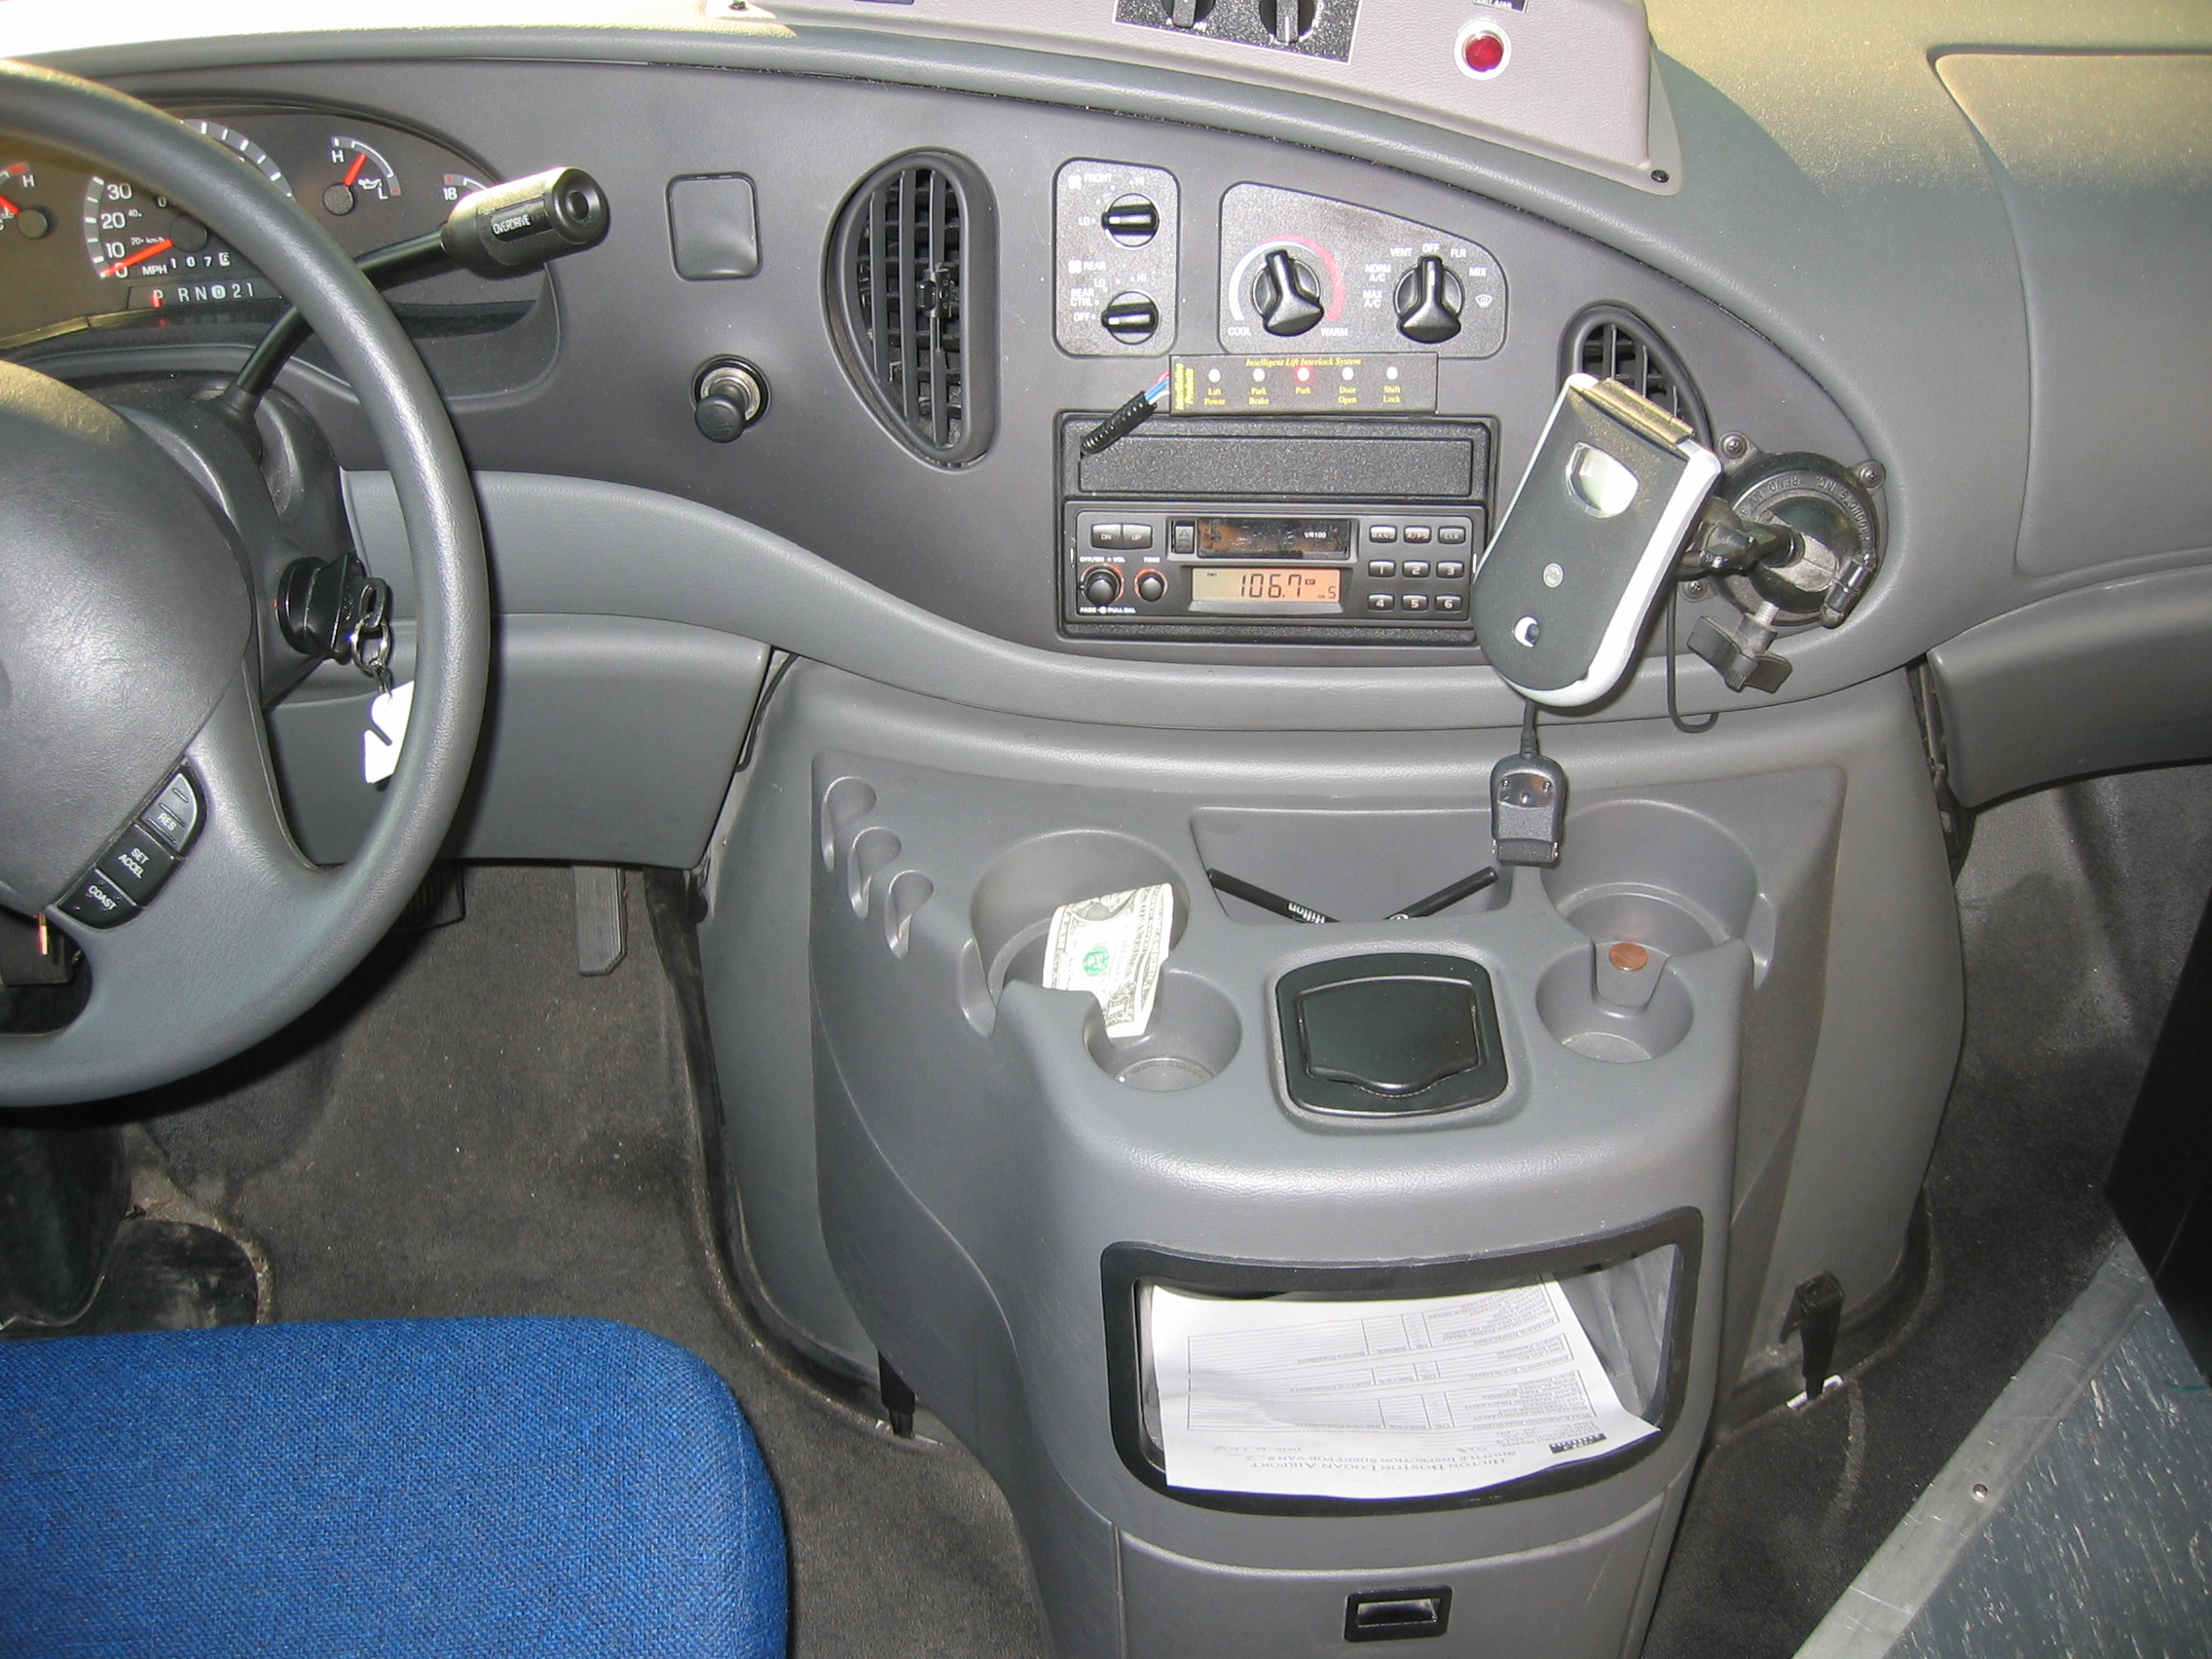
Where is the Task Performed?
Office, laboratory, point of sale?
Effects of environment on users?
Users under stress?
Confidentiality required?
Wet, dirty, or slippery hands?
Soft drinks?
Lighting?
Noise?

Slide 16
What Other Tools Does the User Have?
More than just compatibility
How user works with collection of tools to get things done
Example: automating lab data collection
  how is data collected now?
  by what instruments and manual procedures?
  how is the information analyzed?
  are the results transcribed for records or publication?
  what media/forms are used and how are they handled?

Slide 17
How Often Do Users Perform the Tasks?
Frequent users remember more details
Infrequent users may need more help
  even for simple operations
  make these tasks possible to do
Which function is performed
  most frequently?
  by which users?
  optimizing system for these tasks will improve perception of good performance

Slide 18
Involve Users to Answer
Task Analysis Questions
Users help designers learn:
  what they do and how they do it
Developers reveal technical capabilities
  builds rapport and ideas of what is possible
  users can comment on whether ideas make sense
How do we do this?
  observe & interview prospective users in work place!

Slide 19
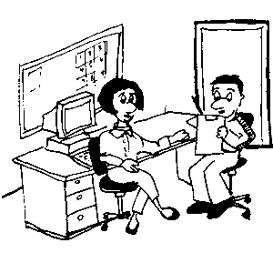
Design from Data
Heated arguments with others on design team
  Over what tools, skills, and knowledge users have
  These tend to generate lots of heat, little light
Go out to real users and get real data from them
  find out what they really do
  how would your system fit in
Are they too busy?
  buy their time (t-shirts, coffee mugs)
  find substitutes (medical students)
Notes:
Master apprentice in contrast to other kinds of relationships, ex. scientist-observer or parent-child

Slide 20
Can’t we just ask users what they want?
Not familiar with what is possible with technology
Not familiar with design constraints
  Budget, legacy code, time, etc
Not familiar with good design
Not familiar with security and privacy
Sometimes users don’t know what they want
  Ex. Remote controls
Contextual inquiry is an important method for understanding users’ needs
  Also, attitude vs actual behavior
Notes:
Master apprentice in contrast to other kinds of relationships, ex. scientist-observer or parent-child

Slide 21
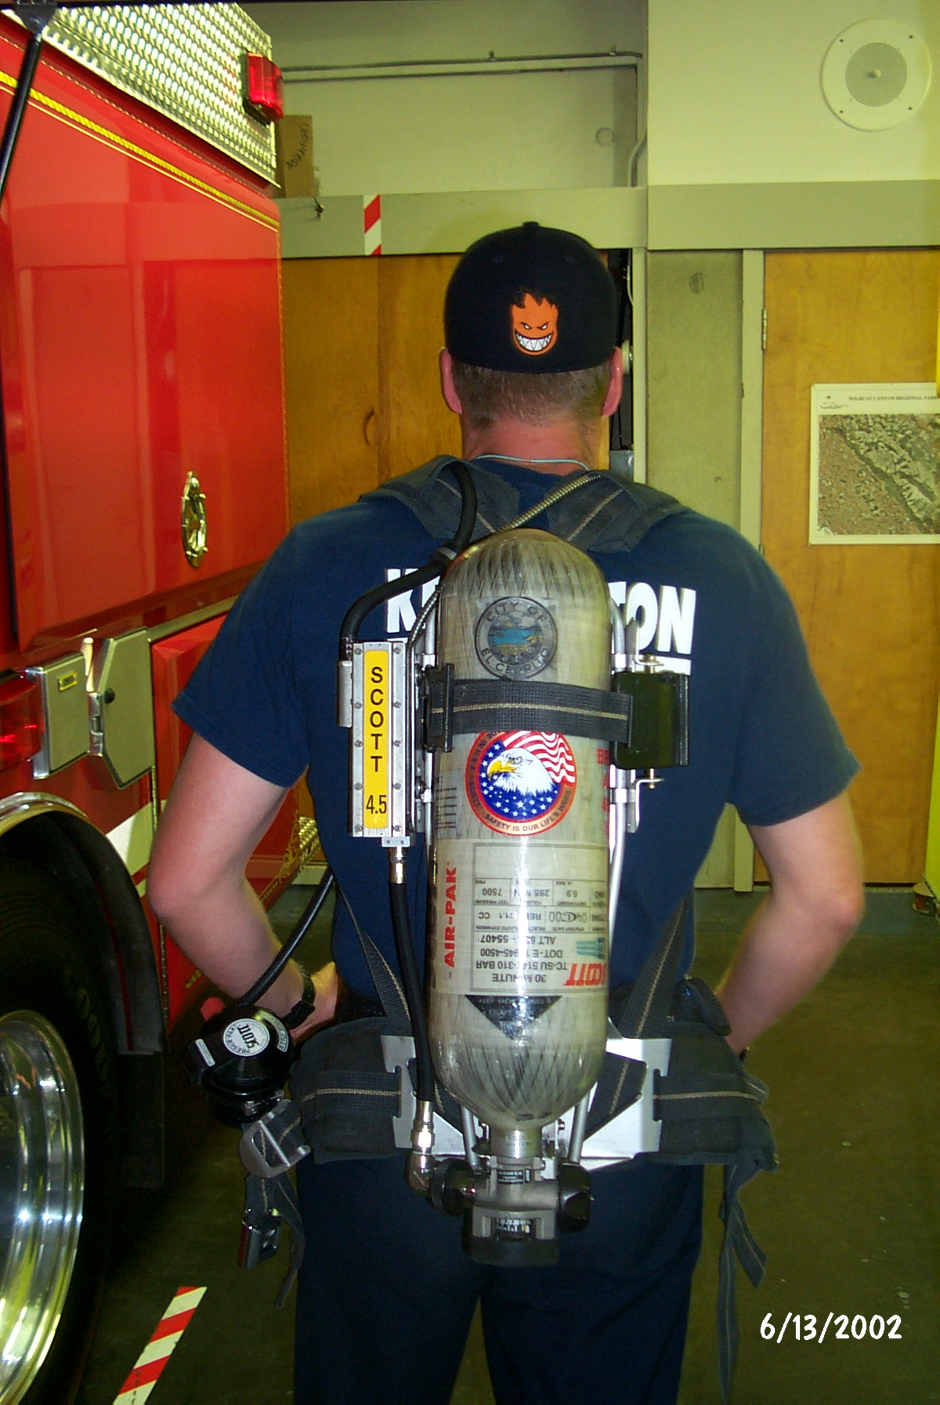
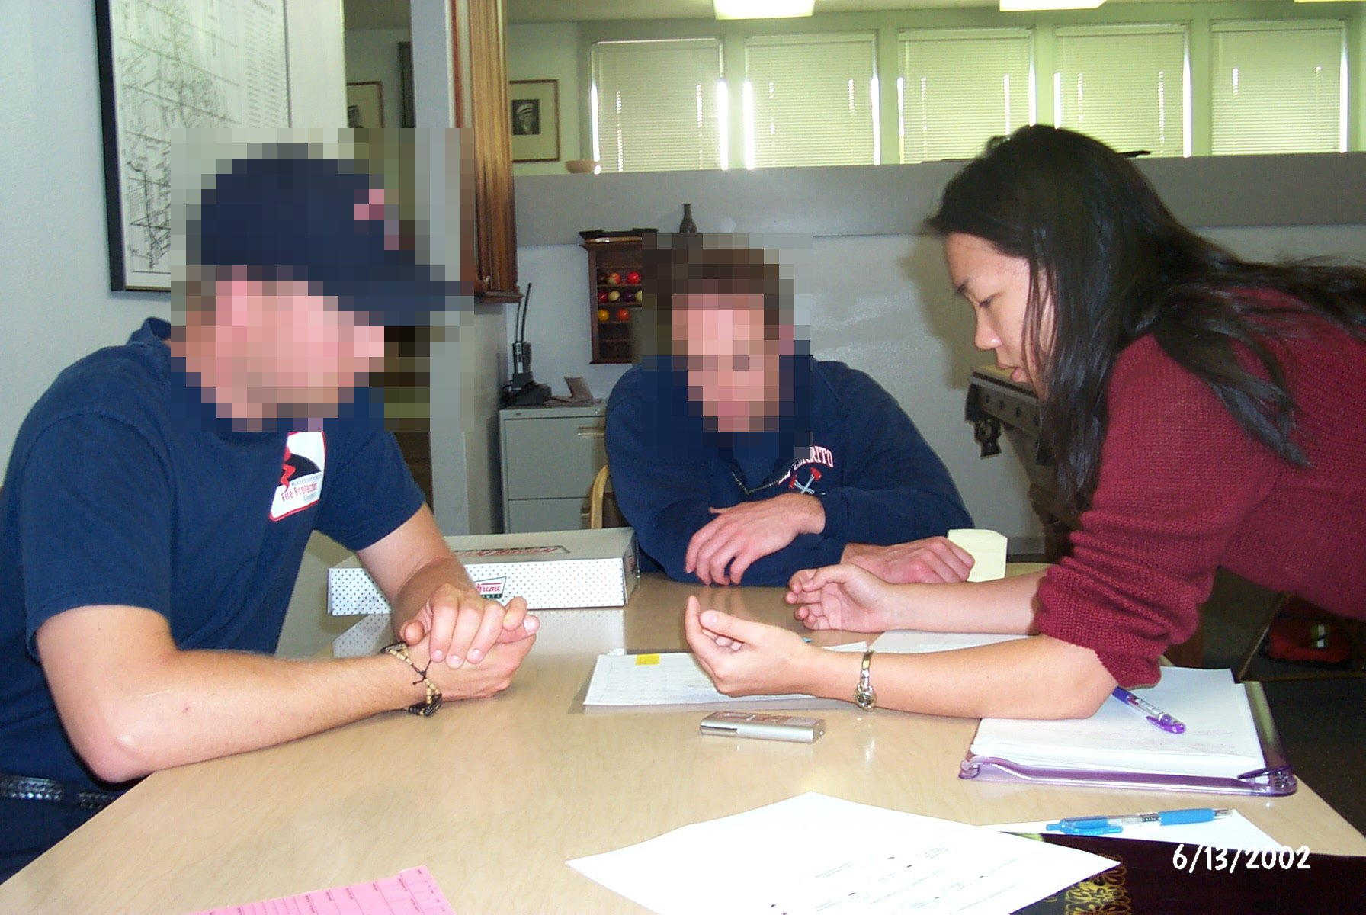
Contextual Inquiry
Go to the workplace & see the work as it unfolds
People summarize, but we want details
Keep it concrete when people start to abstract
  “We usually get reports by email”, ask “Can I see one?”
Notes:
not there to get a list of questions answered
not there to answer their questions either (easy traps to fall into)
Contextual inquiry is not an interview, more of an process for understanding

Slide 22
Contextual Inquiry
Facts are only the starting point, you want a
design based on correct interpretations
Validate & rephrase
  share interpretations to check your reasoning
    Ex. “So accountability means a paper trail?”
  people will be uncomfortable until the phrasing is right
Notes:
Turned out that accountability actually means safety for personnel and equipment

Slide 23
Conducting a Contextual Inquiry
Use recording technologies
  notebooks, tape recorders, still & video cameras
Structure
  conventional interview (15 minutes)
    introduce focus & deal with ethical issues
    get used to each other by getting summary data
  transition (30 seconds)
    state new rules – they work while you watch & interrupt
  contextual interview (1-2 hours)
    take notes, draw, be nosy! (“who was on the phone?”)
  wrap-up (15 minutes)
    summarize your notes & confirm what is important

Slide 24
Observation homework
http://cups.cs.cmu.edu/courses/ups-fa09/observations.html
Do this assignment with a partner, if possible.
Observe people in a public place using a computerized system. For example, you might observe people using a public transit ticket machine, a parking garage pay station, a hardware store self-checkout machine, a library self-checkout machine, or an airport self-check-in kiosk. Stay long enough to observe both experienced and inexperienced users using the system.
Alternatively, recruit a few people you know and observe them using a computer or computerized device (cell phone, microwave oven, etc.) to complete a task. Try to recruit someone who has used the device before and someone who has not.
What kinds of problems did people have using the system? What aspects of the system appeared to be easy to learn? What aspects of the system appeared to be difficult to learn? What aspects of the system seemed to frustrate experienced users? Most importantly, how might the design of the system be improved?
Write up a short report on your observations and recommendations to turn in. Include an appendix with photographs or sketches of key elements of the user interface you observed. The report should be 2-4 pages plus the appendix.

Slide 25
Diary studies
Participants asked to record a diary entry any time a certain type of event occurs, usually over a period of several days or weeks
Allows you to get their immediate response without recall
But they have to remember to do it

Slide 26
Experience sampling
Participants fill out questionaires in response to alerts so that they don’t have to recall, their responses are based on what is happening now
Often used to understand mood, time use, and social interactions
Need to find way to alert participants and have them respond to short survey (< 2 minutes)
  Beepers, email, SMS, diaries, etc.
S. Consolvo and M. Walker. Using the Experience Sampling Method to Evaluate Ubicomp Applications.Pervasinve Computing, April-June 2003http://www.seattle.intel-research.net/pubs/final-ESM-pub-with-Walker.pdf

Slide 27
Paratyping
Measuring real-life experiences instead of testing the technology
Paratypes
  a simulation, or model, of interaction (“-type”) with a technology which is evaluated alongside (“para-”) real-world experience
  “proxies” act as substitutes for researcher
  As they go about their daily life they survey the people they interact with
Iachello, G., Truong, K. N., Abowd, G. D., Hayes, G. R., and Stevens, M. 2006. Prototyping and sampling experience to evaluate ubiquitous computing privacy in the real world. CHI2006. DOI= http://doi.acm.org/10.1145/1124772.1124923

Slide 28
