Slide 1
Introduction to Usable Security
Reasoning About the Human in the Loop
Lorrie Faith Cranor
September 2011

Slide 2
Outline
Why should we make secure systems more usable?
How can we make secure systems more usable
The human in the loop

Slide 3
Why should we make secure systems more usable?

Slide 4
Unusable security & privacy
Unpatched Windows machines compromised in minutes
Phishing web sites costing $billions
Most PCs infected with spyware
Users have more passwords than they can remember and practice poor password security
Enterprises store confidential information on laptops and mobile devices that are frequently lost or stolen

Slide 5
Grand Challenge
“Give end-users security controls they can understand and privacy they can control for the dynamic, pervasive computing environments of the future.”
- Computing Research Association 2003

Slide 6
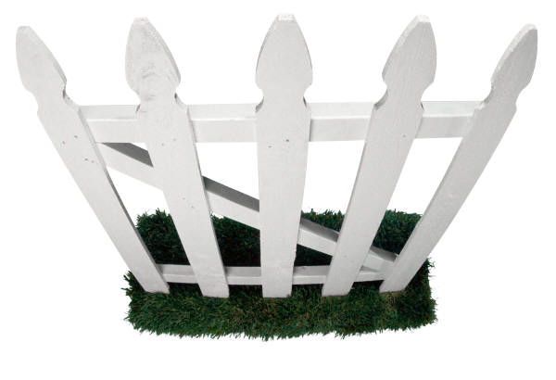
security/privacy researchers
and system developers
human computer interaction researchers
and usability professionals
Notes:
But until recently, security and privacy researchers weren’t paying a whole of attention to what users wanted.
Security folks worked in one department, while HCI folks worked in a different department, and they didn’t really talk much.
But that is starting to change.

Slide 7
The user experience
Notes:
Time we spend configuring security and privacy tools is time we are not spending doing what we really want to be doing with our computers

Slide 8
How do users stay safe online?

Slide 9

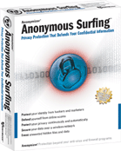
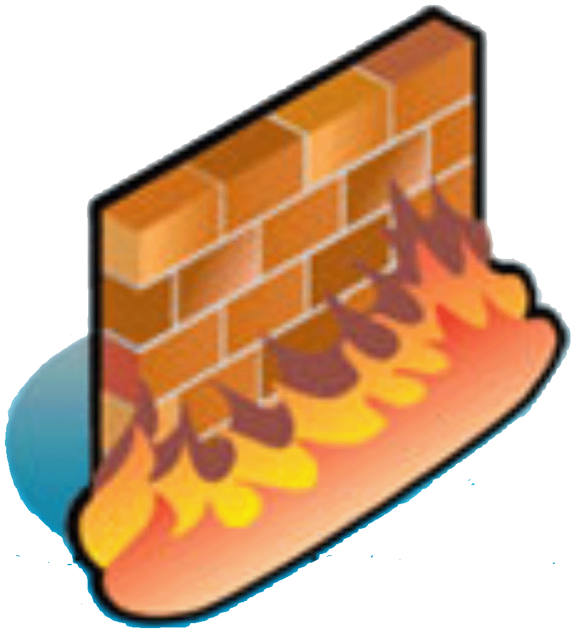

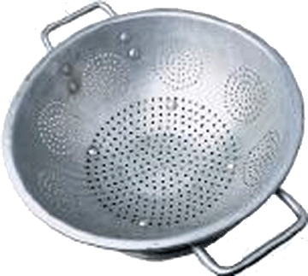
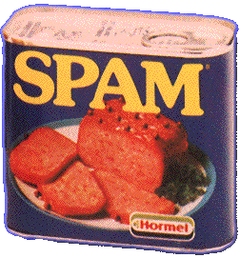

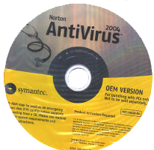



POP!
Notes:
Firewalls
Antivirus software
Spam filters
Pop-up blockers
Cookie managers
Spyware removers
encryption software
if you have kids, adult content filters,
and if you want to cover your tracks, anonymity tools

Slide 10
After installing all that security and privacy software do you have any time left to get any work done?

Slide 11
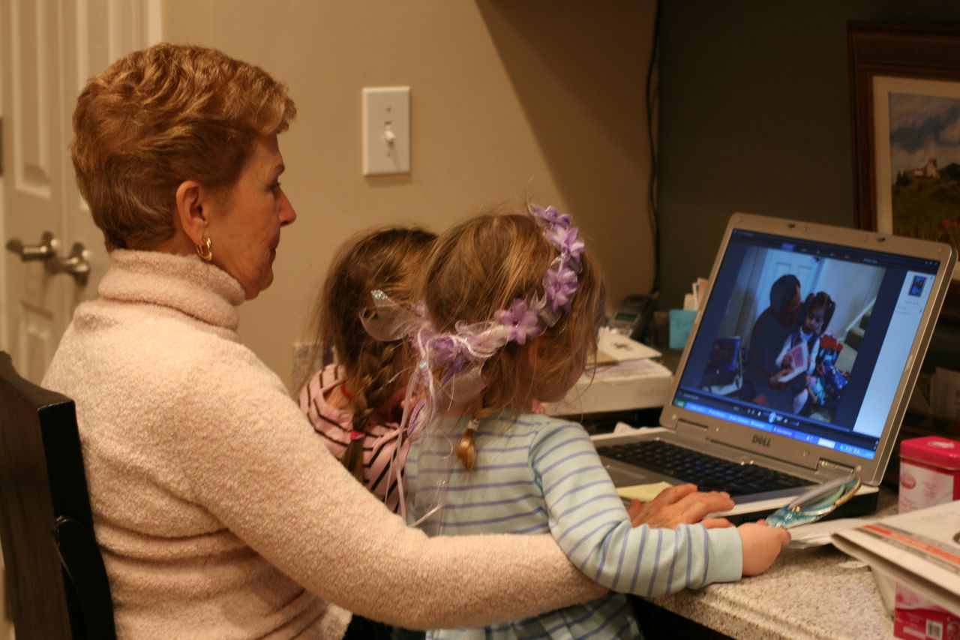
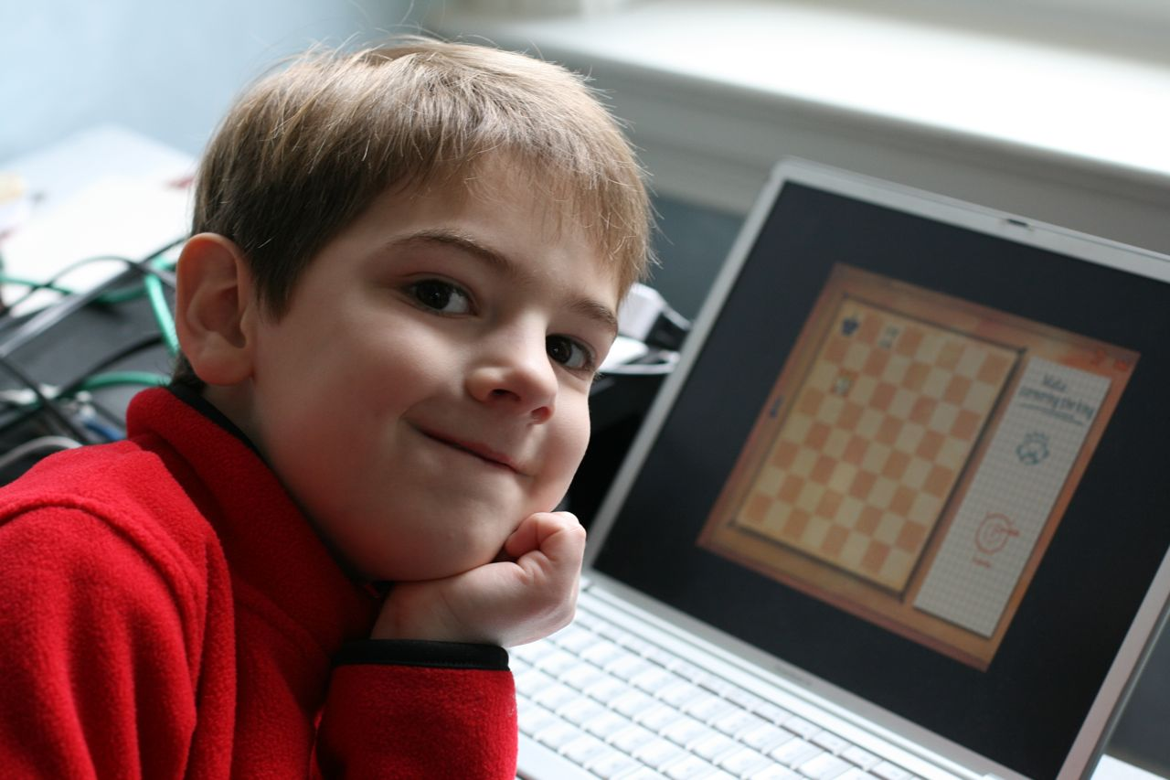
Security is a secondary task

Slide 12

“Users do not want to be responsible for, nor concern themselves with, their own security.”
- Blake Ross
Notes:
Firefox developer Blake Ross wrote about a set of security assumptions in the chapter he wrote for Cranor/Garfinkel Usable Security book.
These are a good set of assumptions that most software developers might follow. Here is one of them.

Slide 13
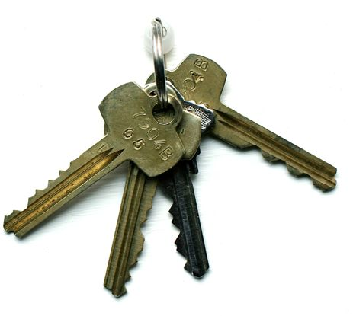
Concerns may not be aligned
Keep the bad guys out
Don’t lock me out!
Security Expert
User

Slide 14
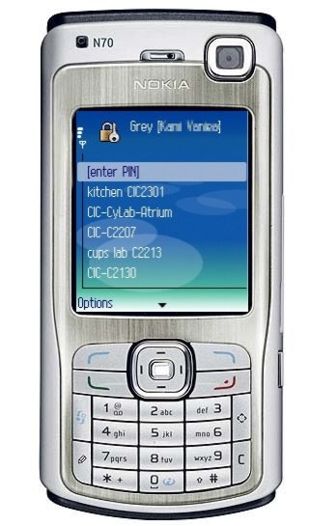
Grey
Smartphone based access-control system
Used to open doors in the Carnegie Mellon CIC building
Allows users to grant access to their doors remotely
L. Bauer, L.F. Cranor, R.W. Reeder, M.K. Reiter, and K. Vaniea. A User Study of Policy Creation in a Flexible Access-Control System. CHI 2008. http://www.robreeder.com/pubs/greyCHI2008.pdf
L. Bauer, L. F. Cranor, M. K. Reiter, and K. Vaniea. Lessons Learned from the Deployment of a Smartphone-Based Access-Control System. SOUPS 2007. http://cups.cs.cmu.edu/soups/2007/proceedings/p64_bauer.pdf
Notes:
Grey is used to control access to . . .

Slide 15
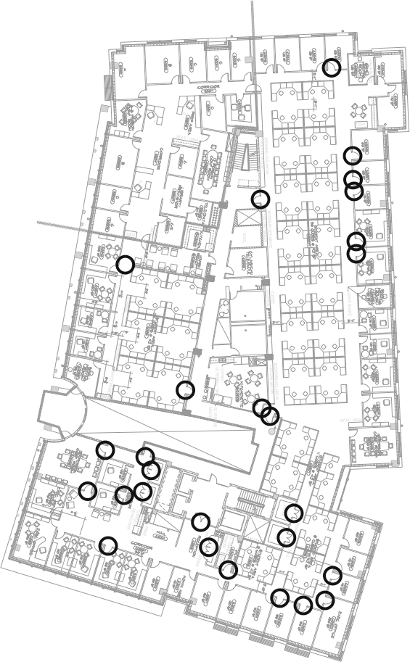
Data collection
Year long interview study
Recorded 30 hours of interviews with Grey users
System was actively used: 29 users x 12 access per week
Notes:
15

Slide 16
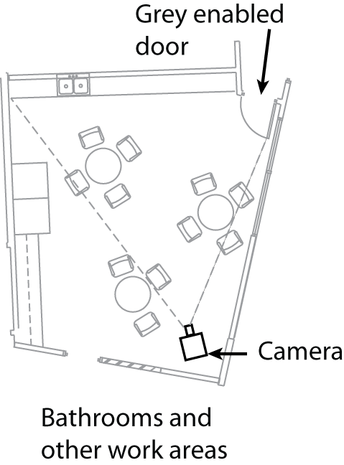
Users complained about speed
Users said Grey was slow
But Grey was as fast as keys
Videotaped a door to better understand how doors are opened differently with Grey and keys
Notes:
16

Slide 17
Average access times
3.6 sec
5.4 sec
5.7 sec
Total 14.7 sec
σ = 3.1
σ = 3.1
σ = 3.6
Getting keys
Stop in front of door
Door opened
Door Closed
σ = 5.6
Total 15.1 sec
8.4 sec
2.9 sec
3.8 sec
σ = 2.8
σ = 1.5
σ = 1.1
Getting phone
Stop in front of door
Door opened
Door Closed
σ = 3.9

Slide 18
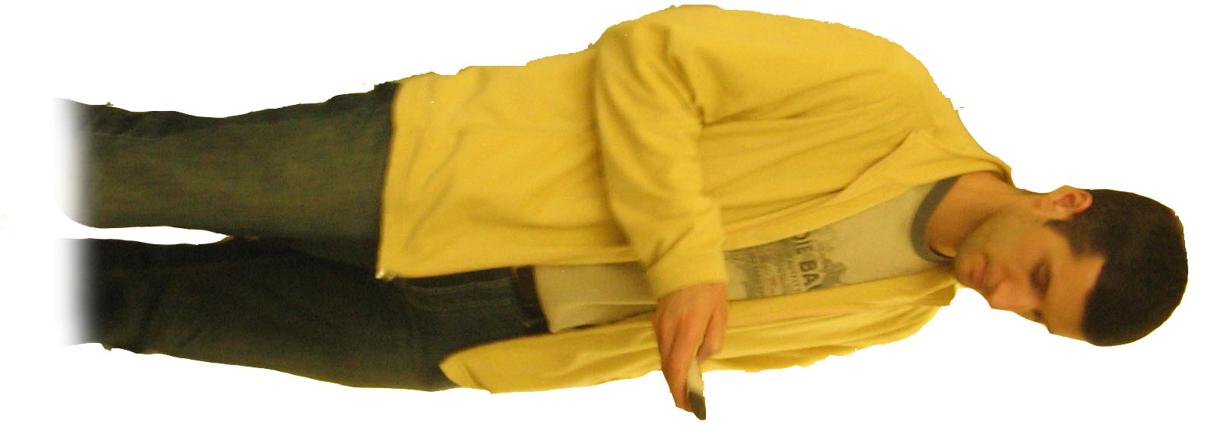
“I find myself standing outside and everybody inside is looking at me standing outside while I am trying to futz with my phone and open the stupid door.”

Slide 19
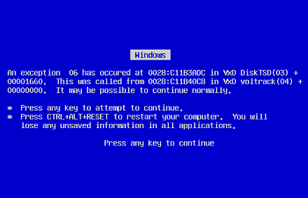
Nobody wants to have to reboot their door
DOOR

Slide 20
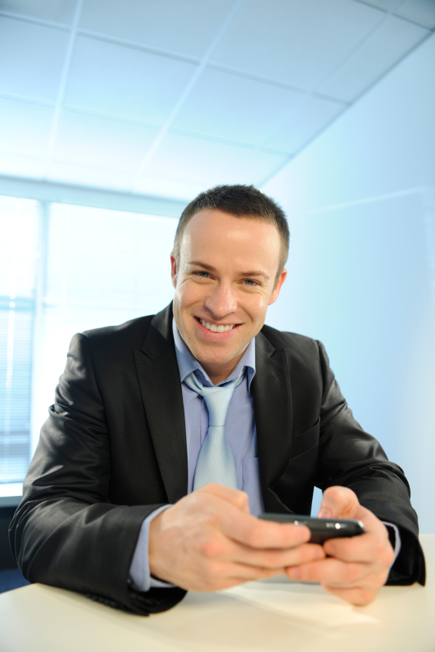
Unanticipated uses can bolster acceptance

Slide 21
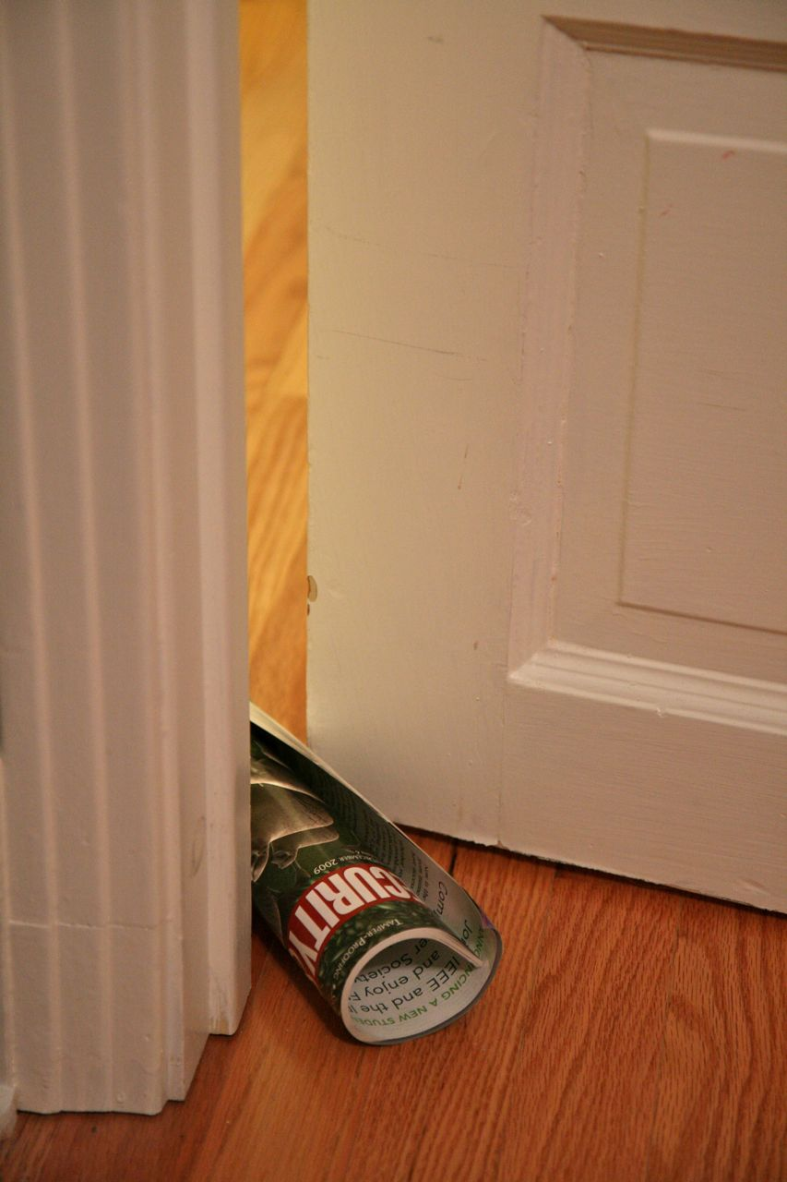
Convenience always wins

Slide 22
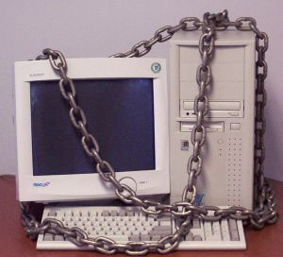
Secure, but usable?

Slide 23
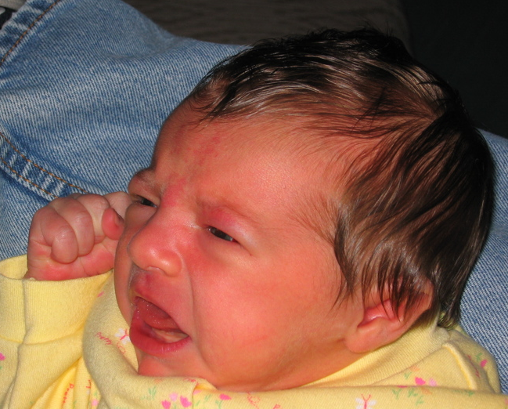
Unusable security frustrates users

Slide 24
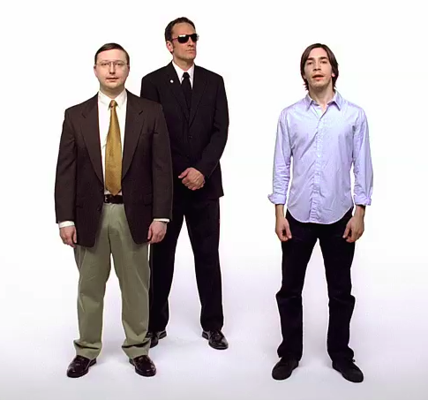
http://www.youtube.com/watch?v=FfetbidVUYw
Notes:
Apple add campaign making fun of unusable security in Microsoft Vista, from February 2007. Vista asks user to authorize everything “Cancel or allow?”

Slide 25
Typical password advice
Pick a hard to guess password
Don’t use it anywhere else
Change it often
Don’t write it down
Notes:
Common knowledge that this is advice doesn’t work

Slide 26
What do users do when every web site wants a password?

Slide 27

Bank = b3aYZ
Amazon = aa66x!
Phonebill = p$2$ta1

Slide 28
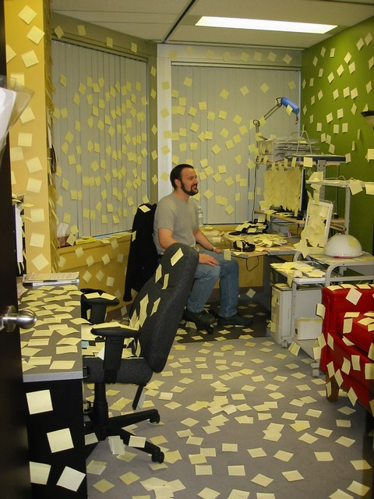
Notes:
From http://www.interactivetools.com/staff/dave/damons_office/

Slide 29
How can we make secure systems more usable?

Slide 30
How can we make secure systems more usable?
Make it “just work”
  Invisible security
Make security/privacy understandable
  Make it visible
  Make it intuitive
  Use metaphors that users can relate to
Train the user
Notes:
These are the three main approaches discussed in the literature. There is no silver bullet and often we rely on a combination.

Slide 31
Make it “just work”

Slide 32
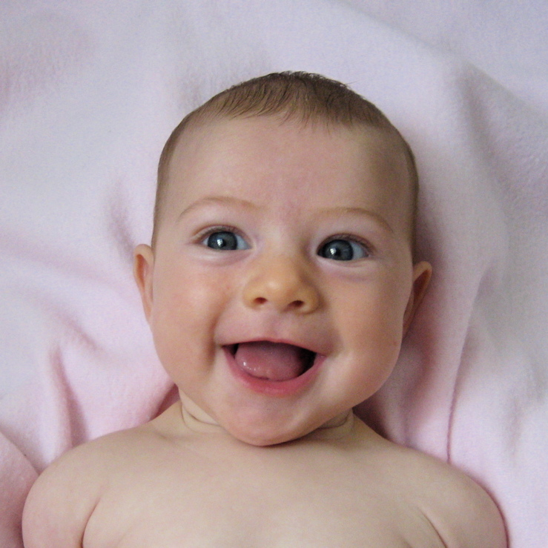
This makes users very happy
(but it’s not that easy)

Slide 33
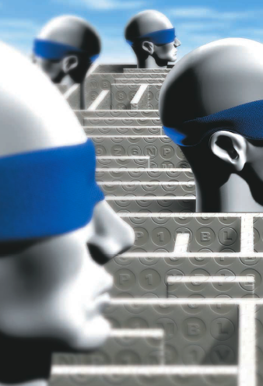
One way to make it work: make decisions
Developers should not expect users to make decisions they themselves can’t make
Notes:
Many pieces of software contain prompts in which the developers ask users to make a security-related decision.
Blake Ross suggests that -
Before coding up such questions, software developers should ask themselves a question:
if I can’t figure it out, how are users supposed to?
What additional qualifications do users possess that will help them arrive at a better conclusion?
(From Blake Ross’ book chapter)

Slide 34
Make security understandable

Slide 35
“Present choices, not dilemmas”
- Chris Nodder
(in charge of user experience for
Windows XP SP2)
Notes:
Chris Nodder, who was in charge of user experience for MS XP SP2, puts it this way:
“Present choices, not dilemmas.”
If the user doesn’t have any insights into how to answer a question, it is a dilemma, not a decision.
There are some situations where users possess some additional contextual knowledge or personal preferences that may allow them to make a better decision than the implementer could make in advance. In those cases, UIs are needed that will help users understand what bit of knowledge they bring to the decision and how they can best apply it. But if the users don’t have anything useful to contribute, they should not be making the decision.

Slide 36
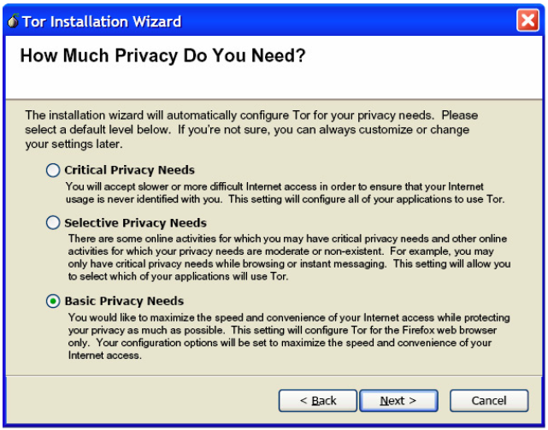
Notes:
My students developed this as part of their (winning) entry in the TOR GUI competition. Instead of asking users to configure the number of hops, key length, etc. we just ask them how much privacy they need and then we can setup the rest. This is the only question most users are actually qualified to answer.

Slide 37
Also not so easy
Privacy policy
matches user’s
privacy preferences
Privacy policy
does not match user’s privacy preferences
Notes:
Getting icons and metaphors right is really difficult.
I developed a privacy tool and did not want to use the usual lock or eyeball icons. Instead I used a bird.
The bird is supposed to represent a user’s agent who checks out a web site’s privacy policy and reports back to the user. The green bird indicates…. The red bird indicates….
In one user study I did, I asked subjects to tell me what they thought the icons meant before they used the software. Initially people thought the green bird with the music notes meant you could download music from the site. They thought the red bird meant that the site used fowl language and might not be appropriate for children.

Slide 38
Train the user

Slide 39

Why do humans fall for phish?
Not motivated to pay attention to training
  “Security is not my problem”
Mental models inconsistent with reality
  “If site looks professional it must be legitimate”
Need actionable advice they can understand
  Difficult to be alert if you don’t know what you’re looking for

Slide 40
How do we get people trained?
Learning science principles
+
Teachable moments
+
Fun
P. Kumaraguru, S. Sheng, A. Acquisti, L. Cranor, and J. Hong. Teaching Johnny Not to Fall for Phish. ACM Trans. Internet Technol. 10, 2 (May 2010), 1-31.

Slide 41

PhishGuru embedded training
Send email that look like phish
If recipient falls for it, train in succinct and engaging format
Study demonstrated effectiveness of PhishGuru and found that same training was not effective sent as regular email
Learning science principles
+
Teachable moments
+
Fun

Slide 42

School of phish
28-day study
515 CMU students, faculty, and staff
Conditions: No training, 1 training message, 2 training messages
7 simulated phishing emails and 3 legitimate emails sent to each participant
P. Kumaraguru, J. Cranshaw, A. Acquisti, L. Cranor, J. Hong, M.A. Blair, and T. Pham. School of Phish: A Real-Word Evaluation of Anti-Phishing Training. SOUPS 2009.
http://www.cylab.cmu.edu/research/techreports/tr_cylab09002.html

Slide 43
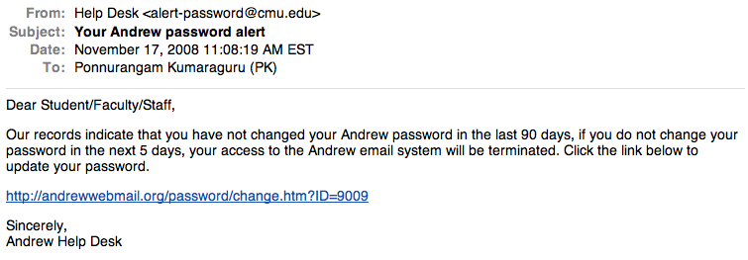
Simulated spear phishing message
Plain text email without graphics
URL is not hidden

Slide 44
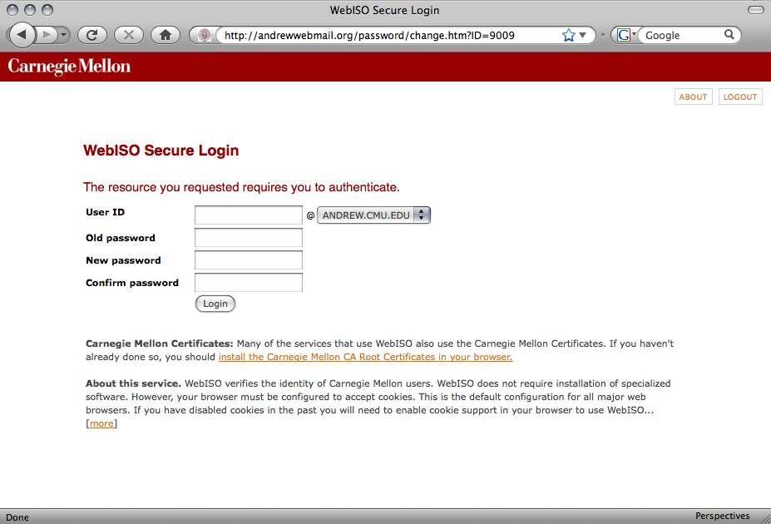
Simulated phishing website

Slide 45
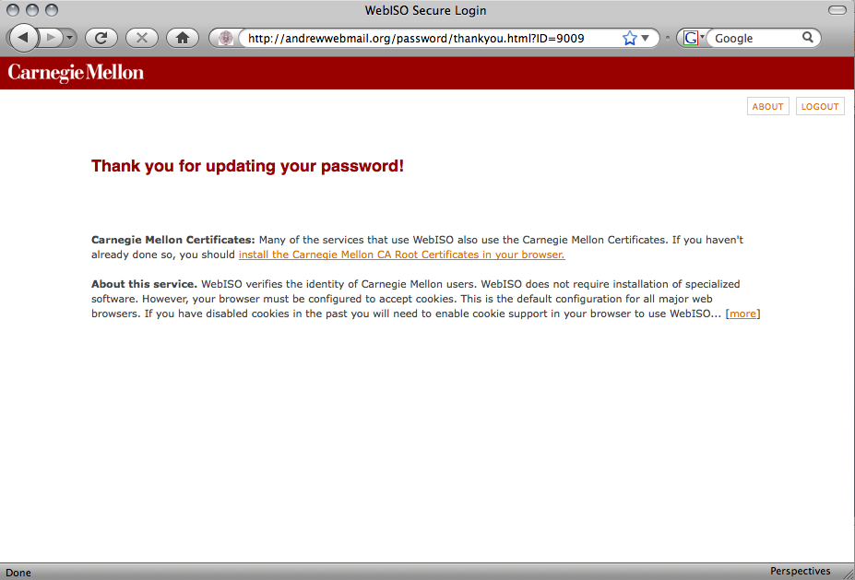
Simulated phishing website

Slide 46
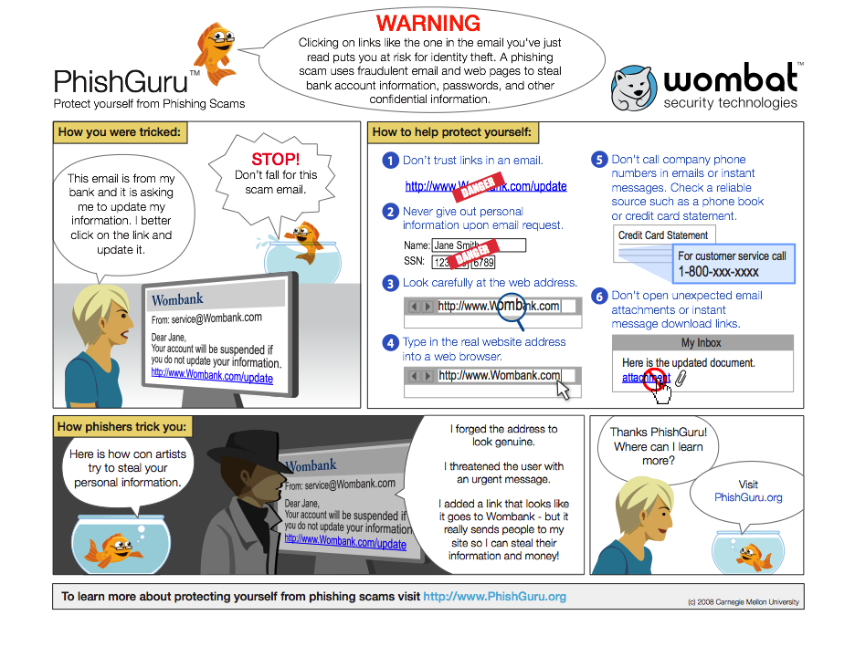

Slide 47
Results
PhishGuru training taught people to distinguish phishing and legitimate emails
  Those trained with PhishGuru still clicked on legitimate links
  But those trained with PhishGuru were less likely to click on phishing links, even 28 days after training

Slide 48
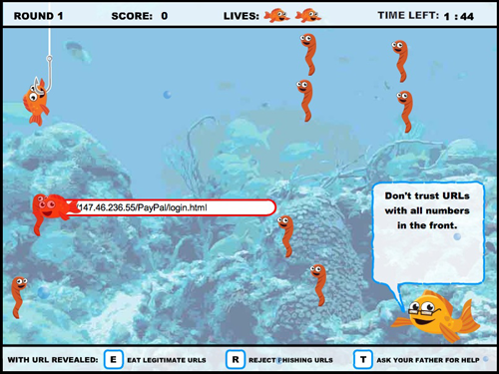
Training games: Anti-phishing Phil
Learning science principles
+
Teachable moments
+
Fun

Slide 49

From research to reality
Started as student thesis projects
Studied how experts, novices respond to phish
Iterated on PhishGuru and Phil implementations
  Lab studies, focus groups, field studies
PhishGuru training, Anti-Phishing Phil, and more now offered by Wombat Security Technologies
Notes:
-GIVEN THE PHISHGURU DESIGN AND THE CONTENT HERE ARE THE CONTRIBUTIONS THAT I HAVE MADE USING PHISHGURU… I EVUALUTATED VARIOUS DESINGS FOR THE CONTENT AND THE METHODOLOGY…
I EVALUATED PHISHGURU IN THE REAL WORLD… AND I AM CURRENTLY WORKING ON AN INTERESTING REAL-WORLD STUDY WITH CMU
MY WORK HAS CONTRIBUTTED TO A NUMBER OF PLACES, A FEW ARE LANDING PAGE OF APWG WHERE ATLEAST A FEW HUNDERDS OF PEOPLE ARE LOOKING AT MY PHISHGURU DESING EVERYDAY..
AND A LARGE ISP IN THE US HAS IMPLEMENTED THIS METHODOLOGY IN THEIR WEBMAIL SYSTEM…. ATLEAST 70K PEOPLE ARE LOOKING AT MY TRAINING DESIGN EVERYDAY…
MY WORK HAS INDIRECTLY BEEN USED BY A COUPLE OF ORGANIZATIONS (WHERE THEY CITE MY WORK) AND THERE IS A START-UP HERE AT CMU WHICH IS COMMERICALIZING MY PHISHGURU CONTRIBUTIONS
I WILL TALK ABOUT THE EVALUATIONS IN DETAIL AND OTHER IMPLEMENTATIONS BRIEFLY, I AM HAPPY TO TALK ABOUT EACH OR ALL OF THEM IF NEEDED

Slide 50
The human in the loop

Slide 51
Humans
“Humans are incapable of securely storing high-quality cryptographic keys, and they have unacceptable speed and accuracy when performing cryptographic operations. (They are also large, expensive to maintain, difficult to manage, and they pollute the environment. It is astonishing that these devices continue to be manufactured and deployed. But they are sufficiently pervasive that we must design our protocols around their limitations.)”
−− C. Kaufman, R. Perlman, and M. Speciner.
Network Security: PRIVATE Communication in a PUBLIC World.
2nd edition. Prentice Hall, page 237, 2002.

Slide 52
Humans are weakest link
Most security breaches attributed to “human error”
Social engineering attacks proliferate
Frequent security policy compliance failures
Automated systems are generally more predictable and accurate than humans

Slide 53
Why are humans in the loop at all?
Don’t know how or too expensive to automate
Human judgments or policy decisions needed
Need to authenticate humans

Slide 54
The human threat
Malicious humans who will attack system
Humans who are unmotivated to perform security-critical tasks properly or comply with policies
Humans who don’t know when or how to perform security-critical tasks
Humans who are incapable of performing security-critical tasks

Slide 55
Need to better understand humans in the loop
Do they know they are supposed to be doing something?
Do they understand what they are supposed to do?
Do they know how to do it?
Are they motivated to do it?
Are they capable of doing it?
Will they actually do it?

Slide 56
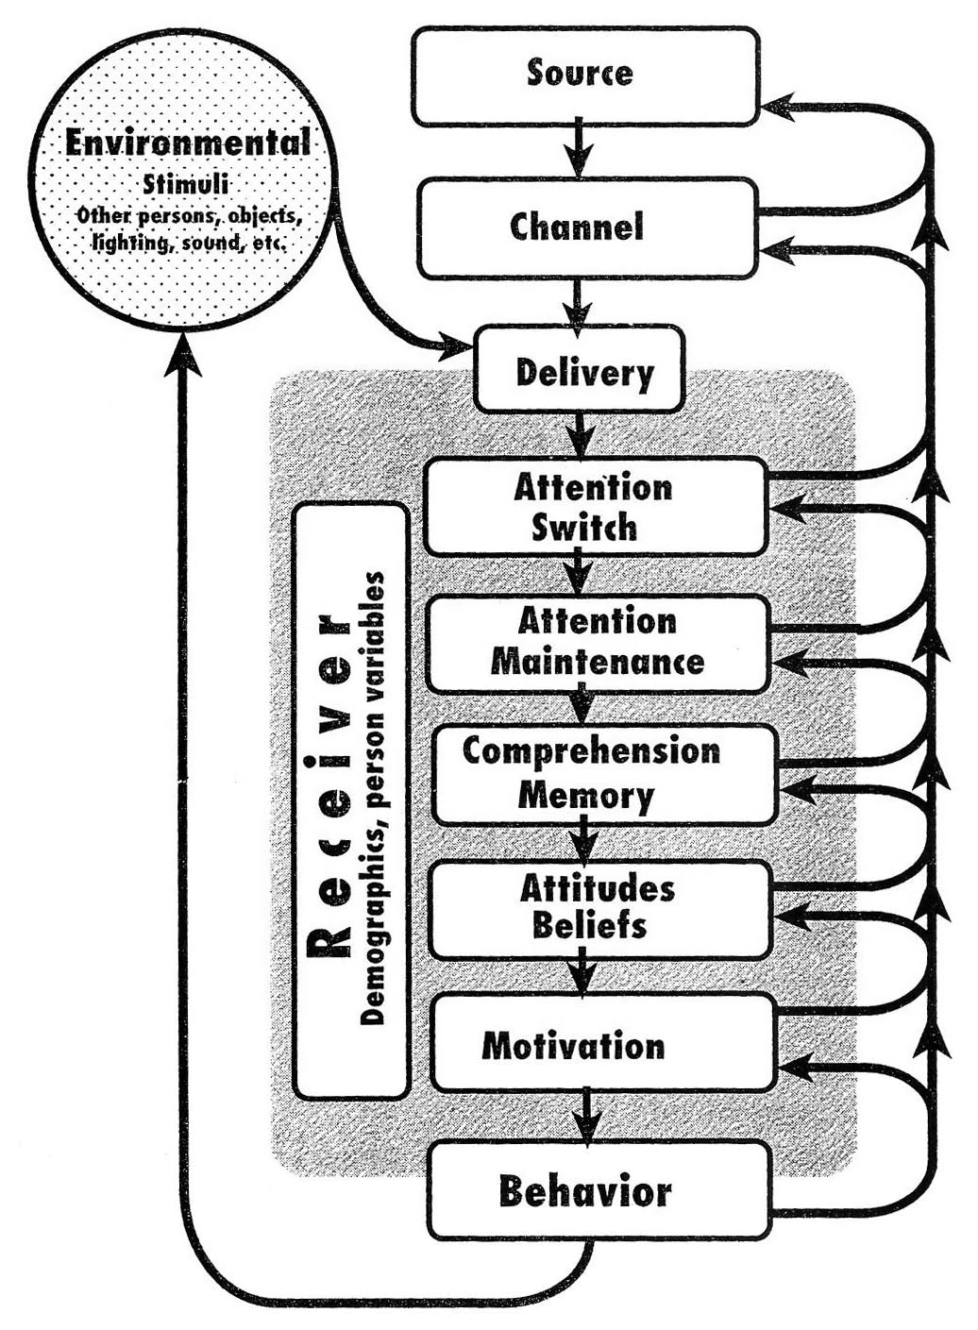

C-HIP Model
Communication-Human Information Processing Model
Wogalter, M. 2006. Communication-Human Information Processing (C-HIP) Model. In Wogalter, M., ed., Handbook of Warnings. Lawrence Erlbaum Associates, 51-61.

Slide 57
Human-in-the-loop security framework
Applied C-HIP to security indicators
Expanded to model other types of human interaction with secure systems
  Password policies
  Online trust decisions
Developed human threat identification and mitigation process
L. Cranor. A Framework for Reasoning About the Human In the Loop. Usability, Psychology and Security 2008. http://www.usenix.org/events/upsec08/tech/full_papers/cranor/cranor.pdf

Slide 58
Human-in-the-loop framework
Communication
Communication
Delivery
Attention
Switch
Human Receiver
Personal
Variables
Demographics
and Personal
Characteristics
Attention
Maintenance
Communication
Impediments
Knowledge &
Experience
Communication
Processing
Comprehension
Environmental
Stimuli
Behavior
Intentions
Knowledge
Acquisition
Interference
Attitudes
and Beliefs
Application
Motivation
Knowledge
Retention
Capabilities
Knowledge
Transfer

Slide 59
Communication processing model
Framework is based on communication processing model
  Many models in the literature
  Used to model all sorts of communications
Most end-user security actions are triggered by some form of communication
  Pop-up alert, email, manual, etc.
Expert self-discovery of a security process can be modeled as communication to oneself

Slide 60
Communication
Communication
Communication
Delivery
Attention
Switch
Human Receiver
Personal
Variables
Demographics
and Personal
Characteristics
Attention
Maintenance
Communication
Impediments
Knowledge &
Experience
Communication
Processing
Comprehension
Environmental
Stimuli
Behavior
Intentions
Knowledge
Acquisition
Interference
Attitudes
and Beliefs
Application
Motivation
Knowledge
Retention
Capabilities
Knowledge
Transfer

Slide 61
Types of security communications
Warnings
  Alert users to take immediate action to avoid hazard
Notices
  Inform users about characteristics of entity or object
Status indicators
  Inform users about system status information
Training
  Teach users about threat and how to respond
Policy
  Inform users about policies
Notes:
Examples of each?
Warnings - anti-phishing , expired SSL certs
Notices - privacy polices, SSL certs
Status indicators - taskbar and menu bar indicators about bluetooth, virus software up-to-date, file permissions
Training - tutorials, games, instruction manuals, web sites, emails, seminars, courses, videos
Policy - ISP terms of service, employee handbook, password policy, policy on encrypting documents

Slide 62
Active versus passive communications
Active
Passive
Firefox
Anti-
Phishing
Warning
Indicators
with audio
alerts
Bluetooth
indicator
in Mac
menu bar
Indicators
with
animation
Notes:
Other examples? Class discussion

Slide 63
Communication impediments
Communication
Communication
Delivery
Attention
Switch
Human Receiver
Personal
Variables
Demographics
and Personal
Characteristics
Attention
Maintenance
Communication
Impediments
Knowledge &
Experience
Communication
Processing
Comprehension
Environmental
Stimuli
Behavior
Intentions
Knowledge
Acquisition
Interference
Attitudes
and Beliefs
Application
Motivation
Knowledge
Retention
Capabilities
Knowledge
Transfer

Slide 64
Environmental stimuli
Divert user’s attention
Greatest impact on passive communication
Examples
  Other communications
  Ambient light and noise
  User’s primary task
Communication
Impediments
Environmental
Stimuli
Interference

Slide 65
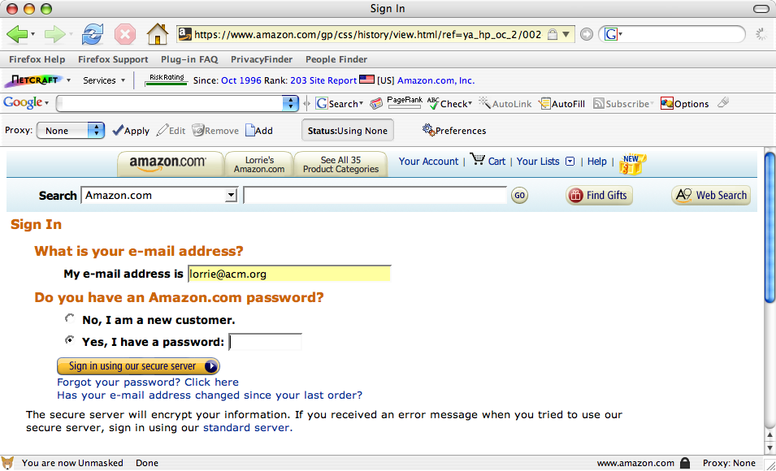

Slide 66
Interference
Anything that may prevent a communication from being received as the sender intended
Caused by
  Malicious attackers
  Technology failures
  Environmental stimuli that obscure
  the communication
Focus of traditional secure
systems analysis
Communication
Impediments
Environmental
Stimuli
Interference

Slide 67
Human receiver – The human in the loop
Communication
Communication
Delivery
Attention
Switch
Human Receiver
Personal
Variables
Demographics
and Personal
Characteristics
Attention
Maintenance
Communication
Impediments
Knowledge &
Experience
Communication
Processing
Comprehension
Environmental
Stimuli
Behavior
Intentions
Knowledge
Acquisition
Interference
Attitudes
and Beliefs
Application
Motivation
Knowledge
Retention
Capabilities
Knowledge
Transfer

Slide 68
Communication delivery
Attention switch
  Noticing communication
Attention maintenance
  Paying attention long enough to process
Breakdowns
  Environmental stimuli, interference
  Characteristics of communication
  Habituation
    Tendency for the impact of stimuli
    to decrease over time
Communication
Delivery
Attention
Switch
Attention
Maintenance
Notes:
Just because the communication appeared on the screen, doesn’t mean the user actually saw it

Slide 69
“What lock icon?”

Slide 70
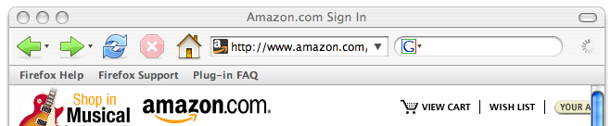
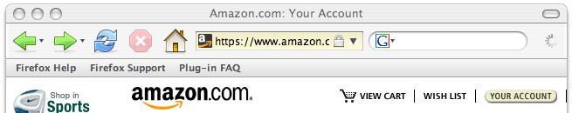
Notes:
Firefox turns address bar yellow and adds lock icon - still somewhat subtle
Relying on users to notice the subtlety to maintain their security is not going to work

Slide 71
Communication processing
Comprehension
  Understand communication
Knowledge acquisition
  Learn what to do in response
Breakdowns
  Unfamiliar symbols, vocabulary,
  complex sentences, conceptual
  complexity
Communication
Processing
Comprehension
Knowledge
Acquisition
Notes:
Just because a user comprehends a message, does not mean they know how to respond to it

Slide 72


Firefox SSL icon
Internet Explorer cookie flag
Notes:
IE cookie flag
Firefox closed lock, note that it puts name of site next to closed lock, no open lock

Slide 73
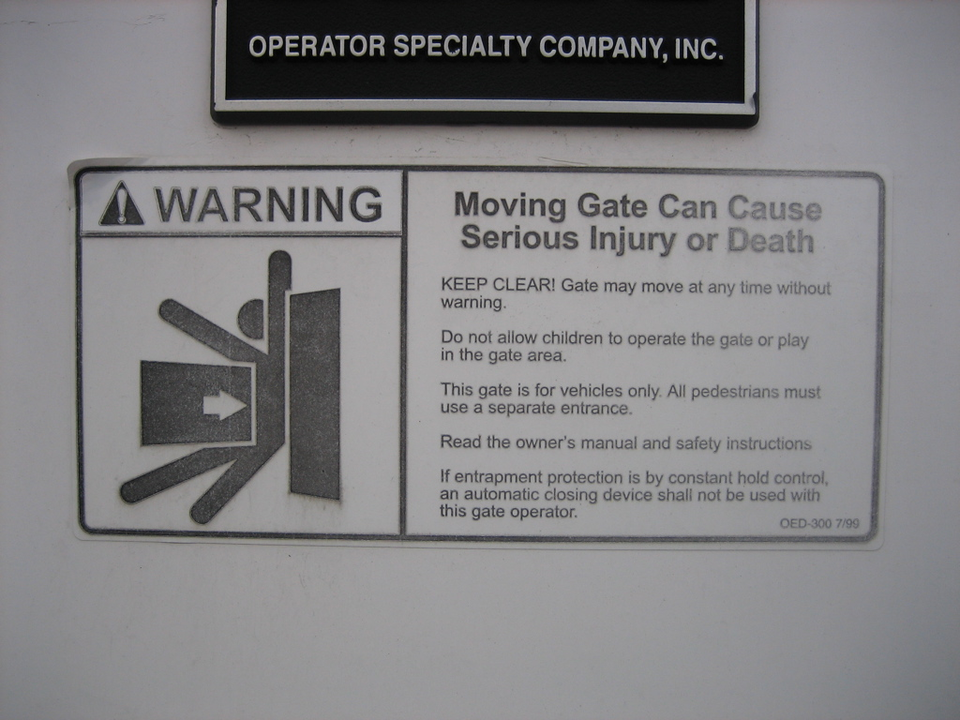
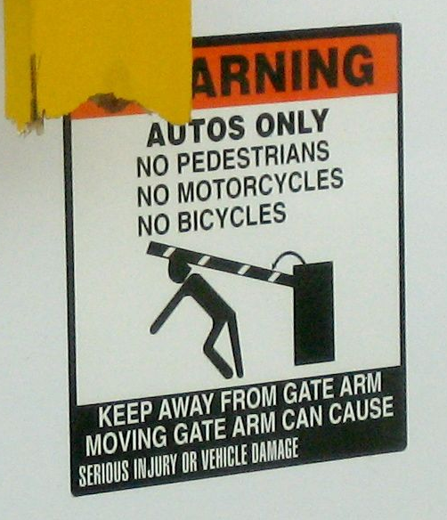
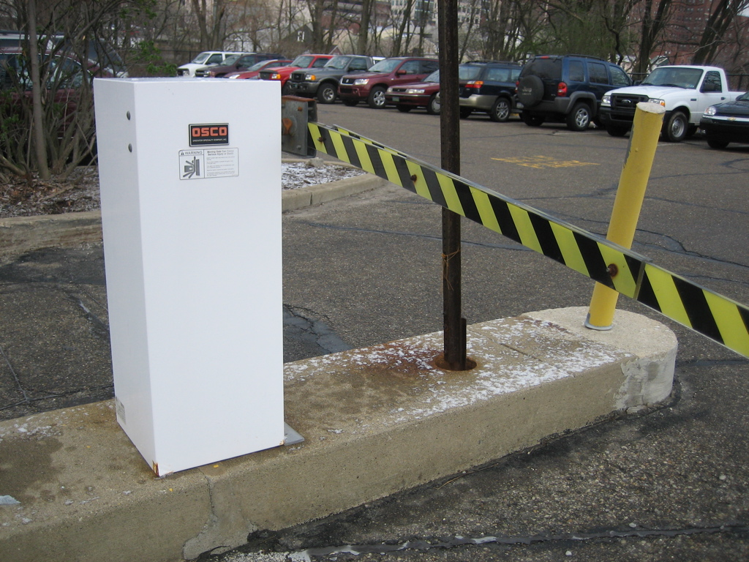
Notes:
It turns out the first warning was the wrong warning for that particular gate. They later replaced it with the correct one.

Slide 74
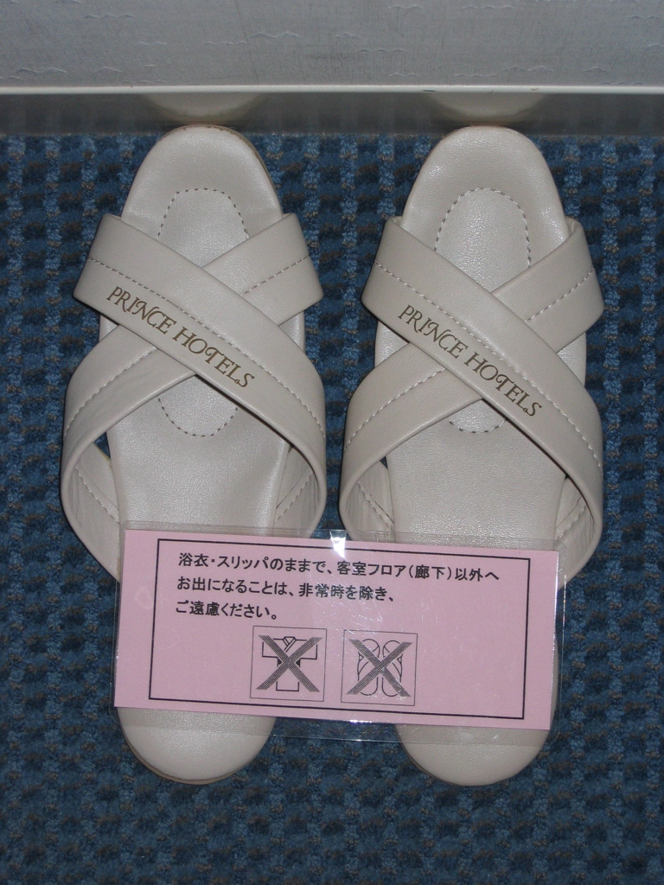

Notes:
What do you think these icons mean?
The rough translation from Japanese is “Do not wear slippers or kimono outside of hotel room unless there is an emergency.” How could we represent that in pictures?

Slide 75
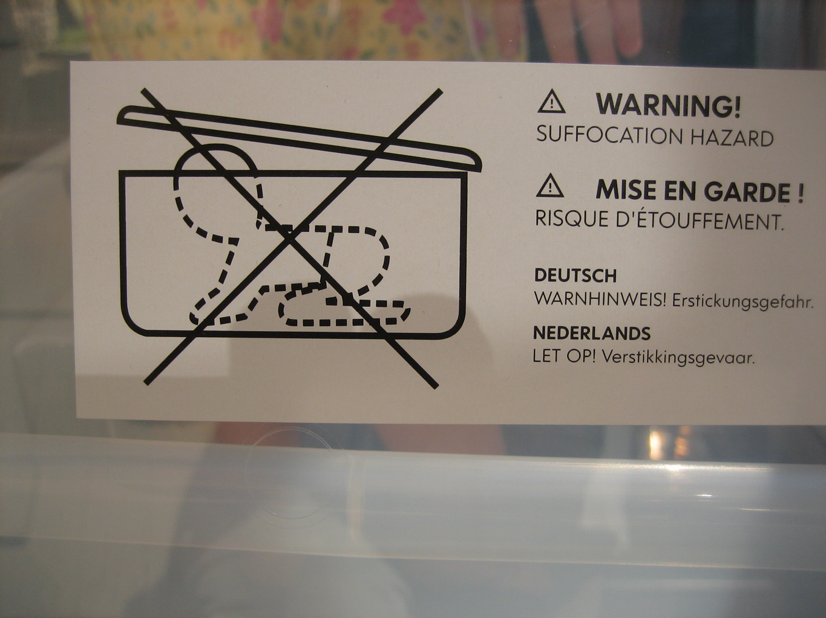
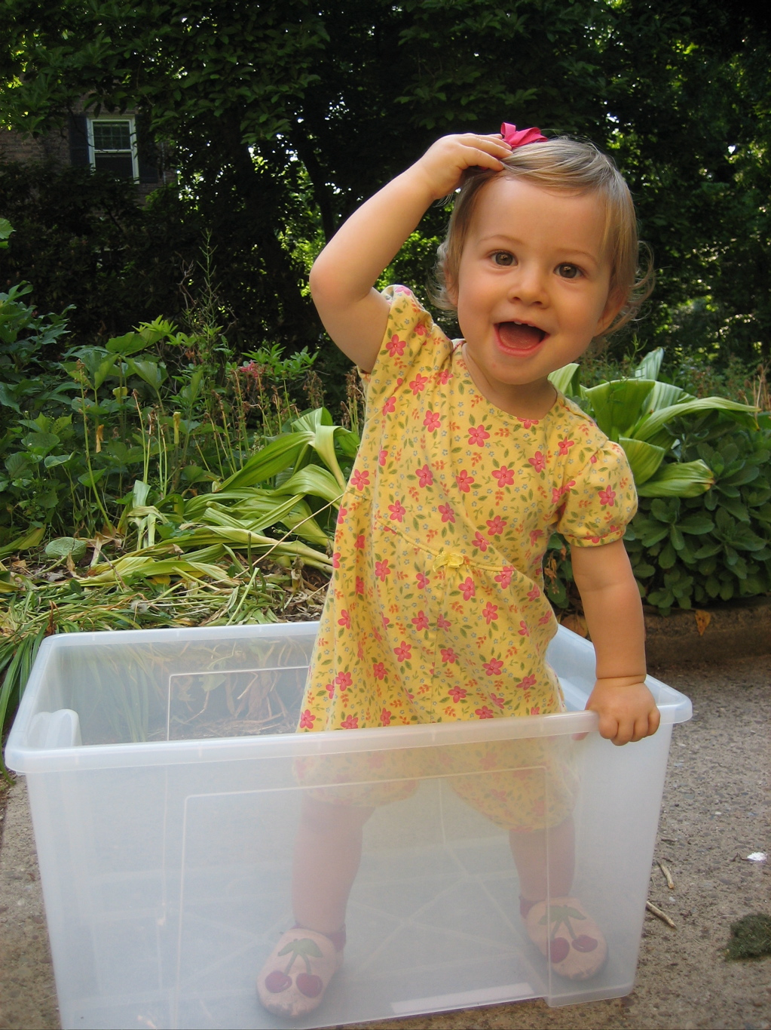
Notes:
Baby box warning – this one is actually pretty clear, but people still don’t pay attention to it

Slide 76
Application
Knowledge retention
  Ability to remember communication
Knowledge transfer
  Ability to recognize applicable situations and apply knowledge
May not be necessary if
application is immediate
(e.g. pop-up warning)
Application
Knowledge
Retention
Knowledge
Transfer

Slide 77
Personal variables
Demographics and personal characteristics
  Age, gender, culture, education, occupation, disabilities
Knowledge and experience
  Education, occupation, prior
  experience
Personal
Variables
Demographics
and Personal
Characteristics
Knowledge &
Experience

Slide 78
Intentions
Attitudes and beliefs
  Beliefs about communication accuracy
  Beliefs about whether they should pay attention
  Self-efficacy - whether they believe they can complete actions effectively
  Response-efficacy - whether they believe the actions they take will be effective
  How long it will take
  General attitudes - trust, annoyance
Motivation
  Incentives, disincentives
Intentions
Attitudes
and Beliefs
Motivation

Slide 79
Capabilities
User’s level of ability
  Cognitive or physical skills
  Availability of necessary software or devices
Capabilities
Notes:
Can you think of examples of security tasks users are commonly asked to do that are beyond their capabilities?

Slide 80
Are you capable of remembering a unique strong password for every account you have?

Slide 81
Behavior
Communication
Communication
Delivery
Attention
Switch
Human Receiver
Personal
Variables
Demographics
and Personal
Characteristics
Attention
Maintenance
Communication
Impediments
Knowledge &
Experience
Communication
Processing
Comprehension
Environmental
Stimuli
Behavior
Intentions
Knowledge
Acquisition
Interference
Attitudes
and Beliefs
Application
Motivation
Knowledge
Retention
Capabilities
Knowledge
Transfer

Slide 82
Behavior
Users may intend to comply, but may fail to complete necessary action
Users may complete recommended action, but do so in a way that follows a predictable pattern that can be exploited by attackers
  Example: password choice

Slide 83
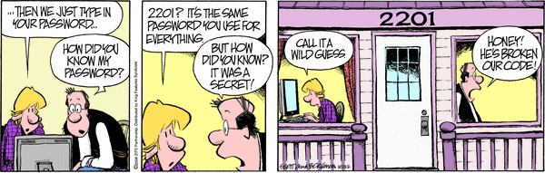
http://www.arcamax.com/zits/s-427369-156783
Zits by Jerry Scott and Jim Borgman, October 22, 2008

Slide 84
Gulfs
Gulf of Execution
  Gap between a person’s intentions to carry out an action and the mechanisms provided by a system to facilitate that action
    “I can’t figure out how to make it do what I want it to do”
Gulf of Evaluation
  When a user completes an action but is unable to interpret the results to determine whether it was successful
    “I can’t figure out whether it worked”
Don Norman. The Design of Every Day Things.1988.

Slide 85
Generic Error-Modeling System
Mistakes
  When people formulate action plans that will not achieve the desired goal
Lapses
  When people formulate suitable action plans, but forget to perform a planned action (for example, skipping a step)
Slips
  When people perform actions incorrectly (for example, press the wrong button)
James Reason. Human Error. 1990.
Notes:
Ask for examples of each

Slide 86
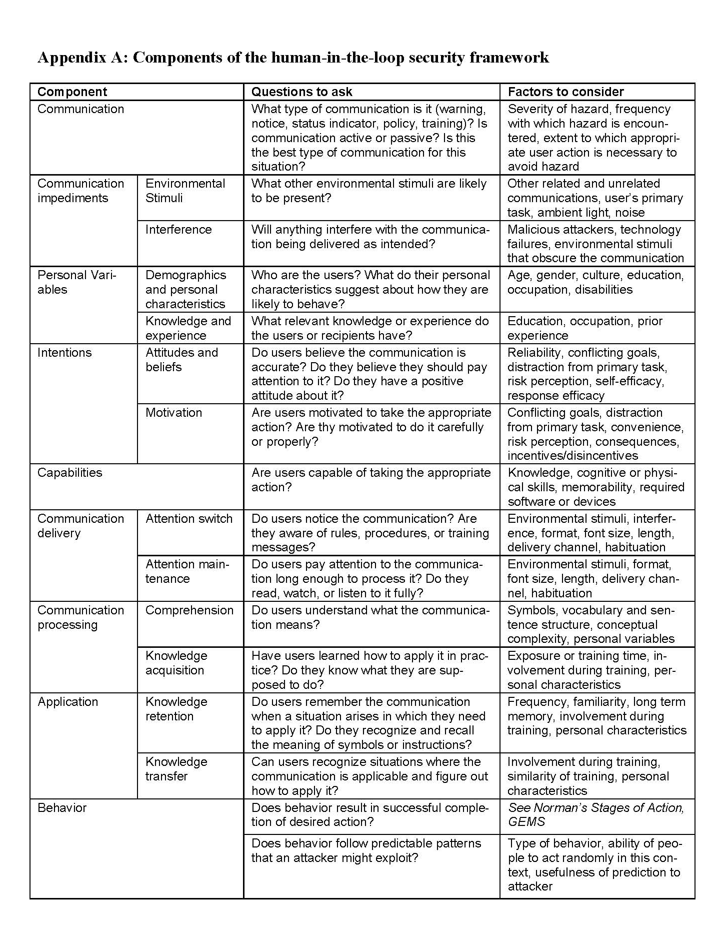
Handy table
Component
Questions
to ask
Factors to
consider

Slide 87
Human threat identification and mitigation process
Task
Identification
Task
Automation
Failure
Mitigation
Failure
Identification
Human-in-
the-loop
Framework
User
Studies
Identify points where system relies on humans to perform security-critical functions
Find ways to partially or fully automate some of these tasks
User
Studies
Find ways to prevent these failures
Identify potential failure modes for remaining tasks
Notes:
Note that there is a loop here. If we can automate with only 80% accuracy we might choose not to automate – until we discover humans can do this with only 50% accuracy.

Slide 88
Guidelines for automating appropriately
How accurate is the system?
How are stakeholder values embodied in the system? What roles do social and environmental contexts have in this particular application?
Does automation reduce end-user information overload or otherwise simplify the task of security decision making?
Are there alternatives to automation that are at least as appropriate for end-users?
If automating, are there mechanisms to “keep the human in the loop”?
If the automation mechanisms fail, are there user interfaces for gracefully dealing with these situations?
W.K. Edwards, E.S. Poole, and J. Stoll. Security Automation Considered Harmful? NSPW;07.

Slide 89
Applying the framework
Applied as part of a human threat identification and mitigation process
Can be applied to understand failures in existing systems and prioritize mitigations
Can be applied to proposed systems in design phase to inform design decisions

Slide 90
Applying threat identification and mitigation process to warnings
Task identification
  Determine whether the task I am trying to complete is sufficiently risky that I should stop
Often, software asks the user and provides little or no information to help user make this decision

Slide 91
Computer security warnings
All too often, when software detects a possible security hazard, it warns the user about it
Often, it turns out not to be a hazard
But sometimes it really is a hazard and users ignore the warning anyway

Slide 92
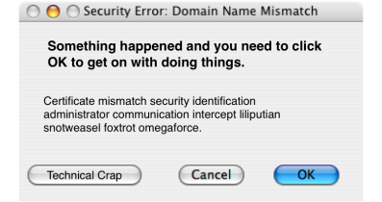
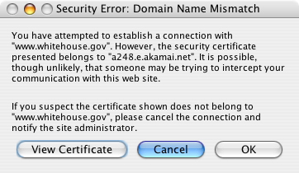
Image courtesy of Johnathan Nightingale

Slide 93
Automate and change tasks to reduce need for user involvement
High probability of danger
Block
Might be dangerous
User must decide
Might be dangerous
User must decide
Very low probability of danger
Don’t bother user
Use automated analysis to determine probability of danger

Slide 94
Support user decision
High probability of danger
Block
Might be dangerous
User must decide
Very low probability of danger
Don’t bother user
Improve warnings
Help user decide by asking question user is qualified to answer

Slide 95
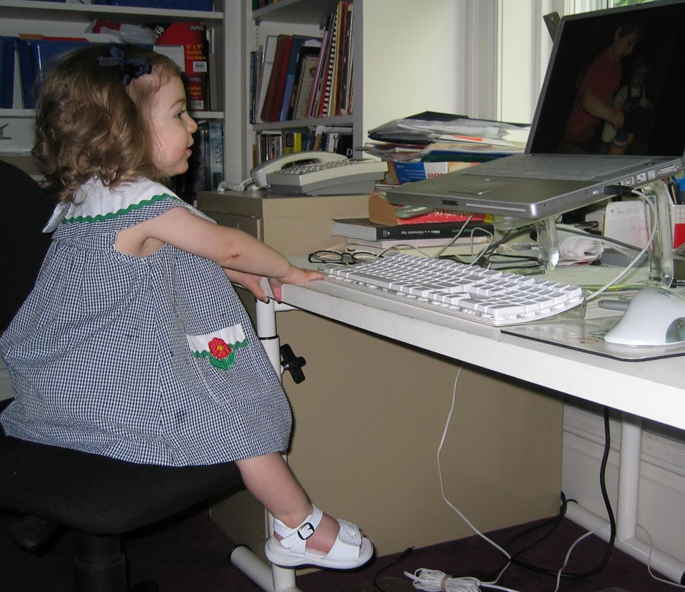
Bad question
Your web browser thinks this is a phishing web site. Do you want to go there anyway?
Don’t go there
Go there anyway
I don’t know what a phishing site is.
I really want to go to this site.
Of course I will go there anyway!

Slide 96
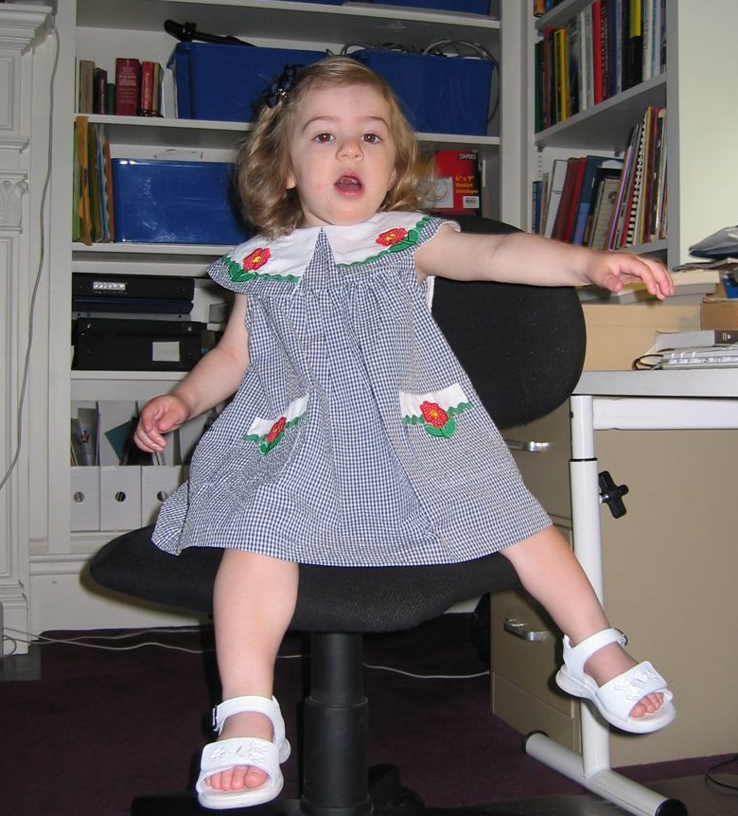
Better question
You are trying to go to evilsite.com. Do you really want to go there or would you rather go to yourbank.com?
Go to yourbank.com
Go to evilsite.com
Of course I want to go to yourbank.com!

Slide 97
Image courtesy of Johnathan Nightingale

Slide 98
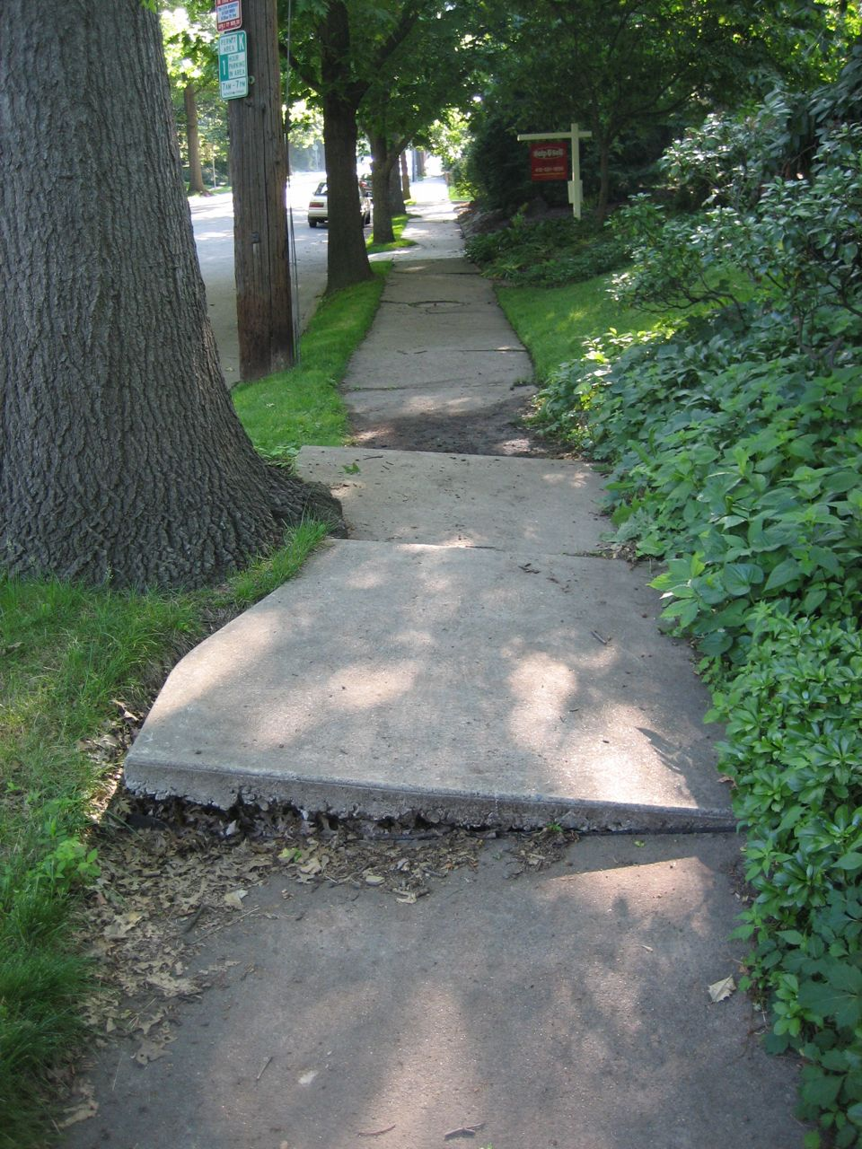
What to do about hazards?

Slide 99
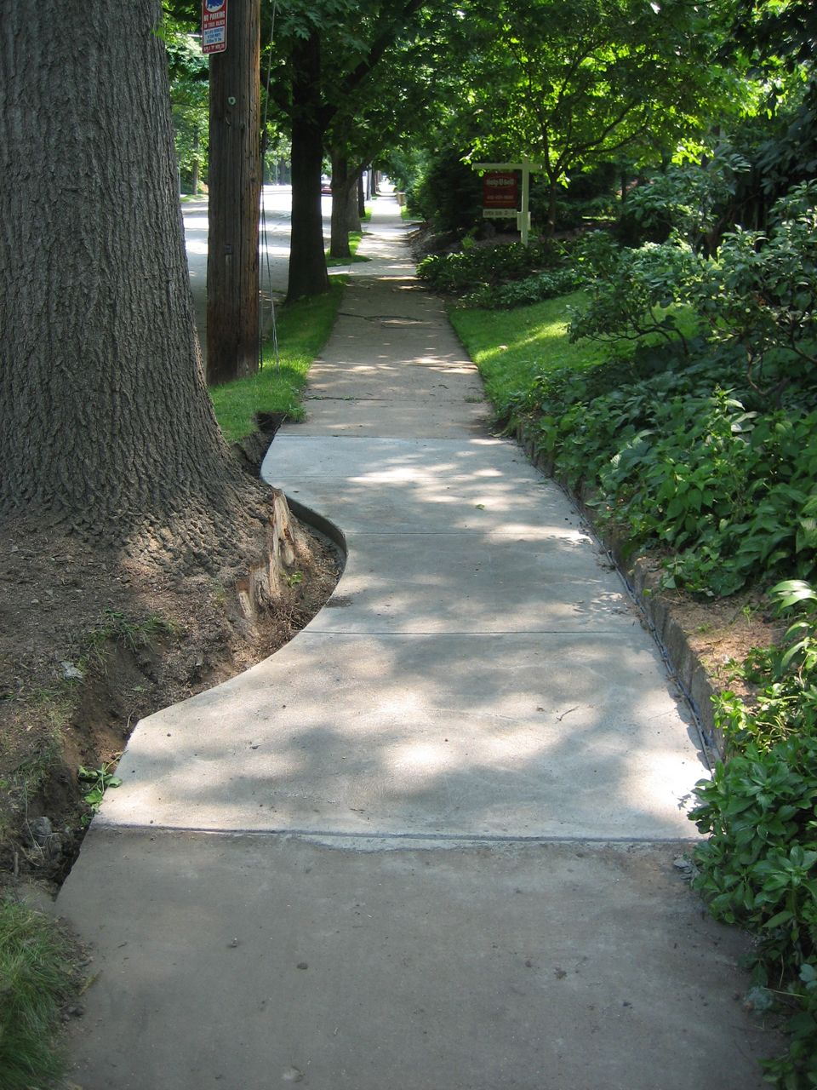
Best solution: remove hazard

Slide 100
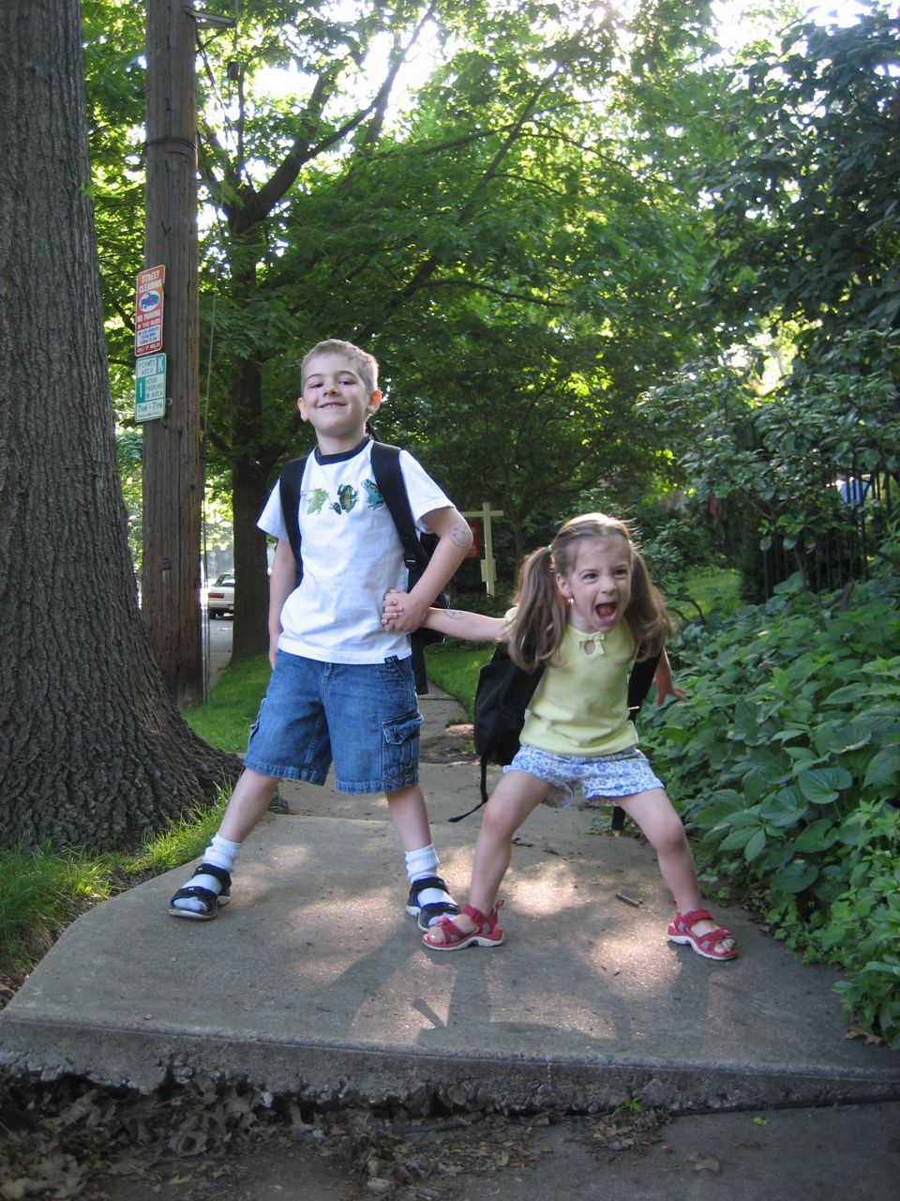

Next best: guard against hazard

Slide 101
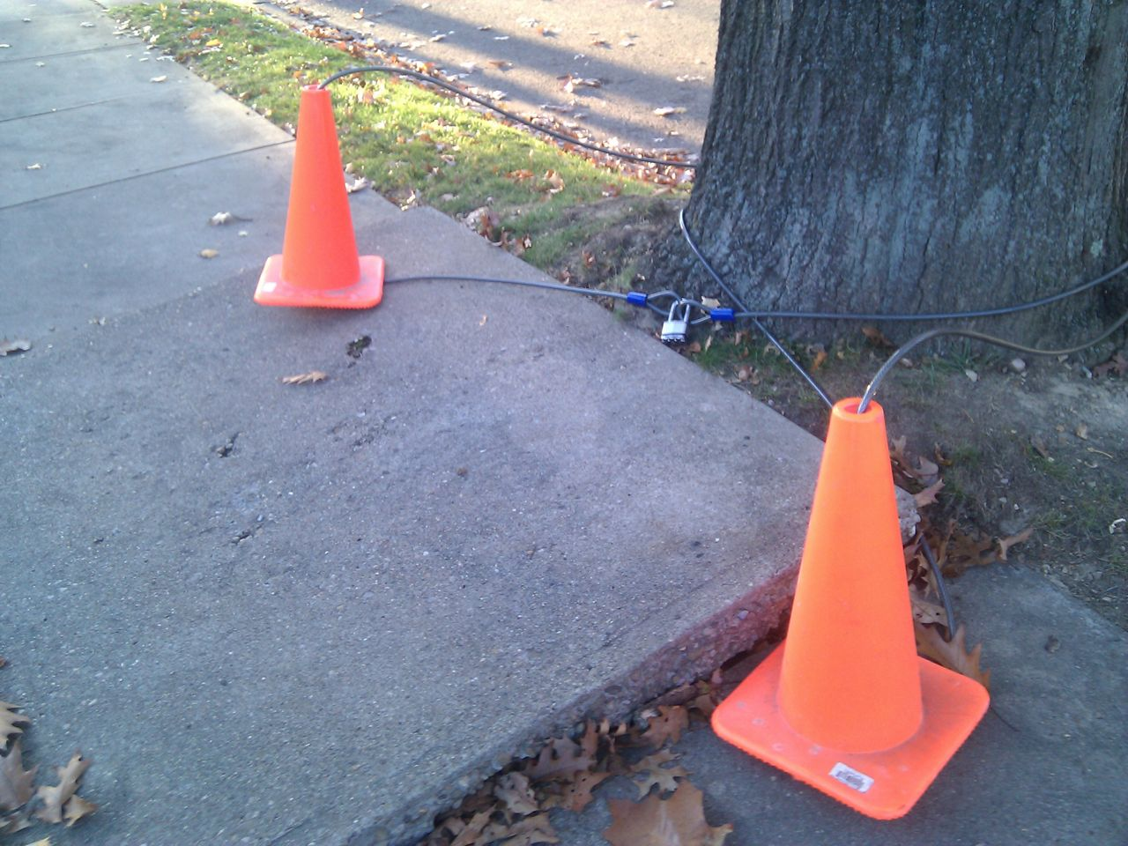

Slide 102
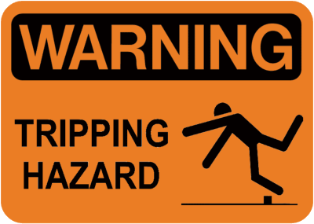
If all else fails: warn

Slide 103
