Slide 1
Towards Optimal Risk Mitigation Through Individualization
Serge Egelman, UC Berkeley
Eyal Peer, CMU

Slide 2
In the beginning…
Security mitigations were never designed with the user in mind
Very low compliance
Expensive training regimens
Security was seen as a separate chore
For instance, Why Johnny Can’t Encrypt (Whitten & Tygar, 1999) showed us how bad the PGP experience was

Slide 3
It Gets Better
Many pioneering works over the past ten years showed how improving the user experience improves overall security
User-Centered Security (Zurko & Simon, 1996)
Users Are Not The Enemy (Adams & Sasse, 1999)
Security and Usability (Cranor & Garfinkel, 2005)

Slide 4
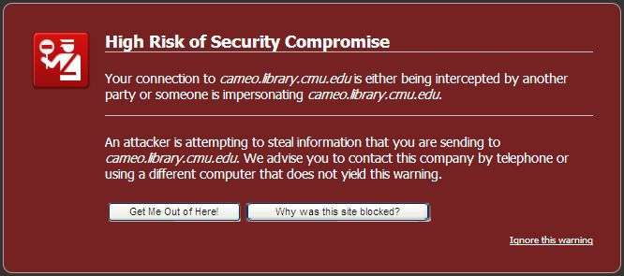
Problems Remain
Redesigned SSL warnings reduced click-through rates from 90% to 50% (Sunshine et al., 2009)
Redesigned file permission interfaces increased accuracy from 57% to 84% (Reeder et al., 2008)

Slide 5
Hypothesis
Current usable security solutions will only yield local maxima when they only consider human behavior in the aggregate; no individual perfectly matches the “average user.”

Slide 6
Corollary
We can optimize security mitigations (rather than satisfice) by tailoring them to the individual, rather than the average user.

Slide 7
Research Agenda
Do certain individual differences correlate with certain privacy/security behaviors?
Which differences are most predictive of privacy/security behaviors?
How can these differences be automatically inferred by systems?
Which privacy/security mitigations are most likely to benefit from individualization?

Slide 8
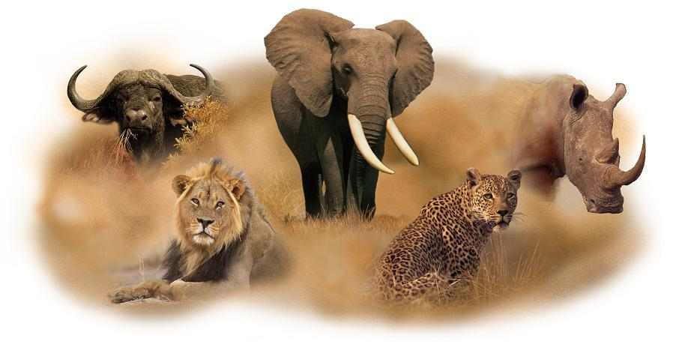
First steps
Do privacy behaviors/preferences correlate with personality traits?
The “Big 5”
Openness to new experiences
Conscientiousness
Extraversion
Agreeableness
Neuroticism

Slide 9
TIPI
Ten Item Personality Inventory
“I see myself as:”
Extraverted, enthusiastic
Critical, quarrelsome
Dependable, self-disciplined
Anxious, easily upset
Open to new experiences, complex
Reserved, quiet
Sympathetic, warm
Disorganized, careless
Calm, emotionally stable
Conventional, uncreative
Disagree strongly
Disagree moderately
Disagree a little
Neither agree nor disagree
Agree a little
Agree moderately
Agree strongly

Slide 10
Privacy Preference Metrics
Westin Index
Classifies people as…
Privacy fundamentalists
Privacy pragmatists
Privacy unconcerned
4-point Likert (agreement)
Consumers have lost all control over how personal information is collected and used by companies.
Most businesses handle the personal information they collect about consumers in a proper and confidential way.
Existing laws and organizational practices provide a reasonable of protection for consumer privacy today.

Slide 11
Privacy Preference Metrics
Privacy Concern Scale (Buchanan et al., 2007)
5-point Likert (concern)
16 statements
1. In general, how concerned are you about your privacy while you are using the internet?
2. How concerned are you about online organizations not being who they claim they are?
…
15. How concerned are you about emails you receive not being from whom they say they are?
16. How concerned are you that an email containing a seemingly legitimate internet address may be fraudulent?

Slide 12
Privacy Preference Metrics
Internet Users Information Privacy Concerns (Malhotra et al., 2004)
7-point Likert (agreement)
10 statements
A good consumer online privacy policy should have a clear and conspicuous disclosure.
It usually bothers me when online companies ask me for personal information.
I’m concerned that online companies are collecting too much personal information about me.
Companies seeking information online should disclose the way the data are collected, processed, and used.

Slide 13
Privacy Behavior Metrics
Social Desirability Scale (Crowne & Marlowe, 1960)
33* true/false statements
Measures willingness to disclose
1. Before voting I thoroughly investigate the qualifications of all the candidates.
2. I never hesitate to go out of my way to help someone in trouble.
3. It is sometimes hard for me to go on with my work, if I am not encouraged.
...
5. I sometimes think when people have a misfortune they only got what they deserved.
6. I have never deliberately said something that hurt someone's feelings.

Slide 14
Privacy Behavior Metrics
Moon et al., 2000
6 open-ended questions
Coders measure verbosity
1. What are some of the things you like to do in your free time?
2. What has been the biggest disappointment in your life?
3. What is your most common sexual fantasy?
4. What characteristics of yourself are you most proud of?
5. What have you done in your life that you feel most guilty about?
6. Describe the last time you were sexually aroused.

Slide 15
Privacy Behavior Metrics
John et al., 2011
14 yes/no questions to measure disclosure willingness
Do you own a life insurance policy?
Did you reach orgasm the last time you had sex?
Have you ever been diagnosed with a sexually transmitted disease?
Have you smoked marijuana in the past 12 months?
Have you ever had a creditor or collection agency come after you?
Have you ever, while watching TV, had a fatal heart attack?

Slide 16
Vision for the future
Automatically inferring privacy settings
Social networking websites
Photo sharing
Location sharing
Nudges for security mitigations
Warning designs
Software updates

Slide 17
Feedback
Are there other/better privacy metrics?
What about security behavior indexes?
Are there better [measurable] individual differences?
Next steps involve behavior observations

