Slide 1
User Education
Baik Sangyong
Cheng Zeng

Slide 2
Agenda
Why Need User Education
Examples of User Education
Security-Reinforcing Application for User Education
Class Activity
Anti-Phishing Phil
Demo
Fallacies of User Education

Slide 3
Why Need User Education
User Education
Teach users how to be safe online
Protect people from security and privacy threats
“Human In The Loop” Model
User As Weakest Link in Security Activities
"Given a choice between dancing pigs and security, users will pick dancing pigs every time.“
--Edward Felten and Gary McGraw

Slide 4
Examples of User Education
Network Advertising Initiative (NAI) (http://www.networkadvertising.org)
Digital Advertising Alliance (DAA) (http://www.aboutads.info/)
DAA’s Education Principle: The DAA must maintain a central educational website and provide educational ads.

Slide 5
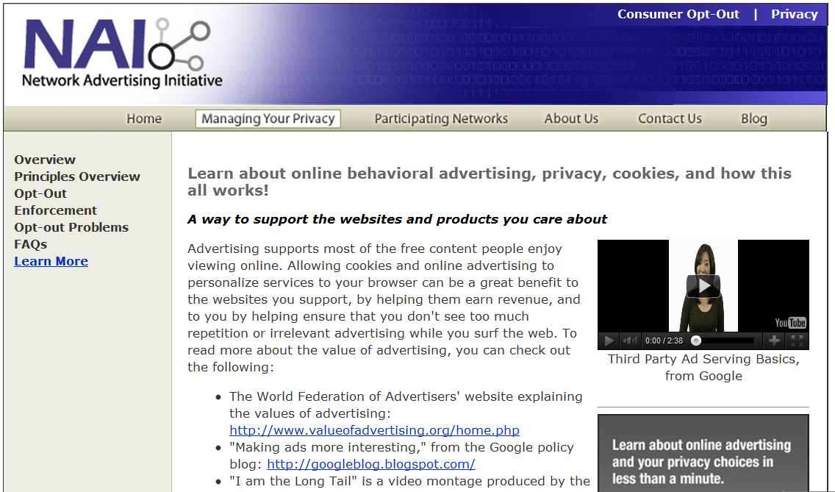
Network Advertising Initiative

Slide 6
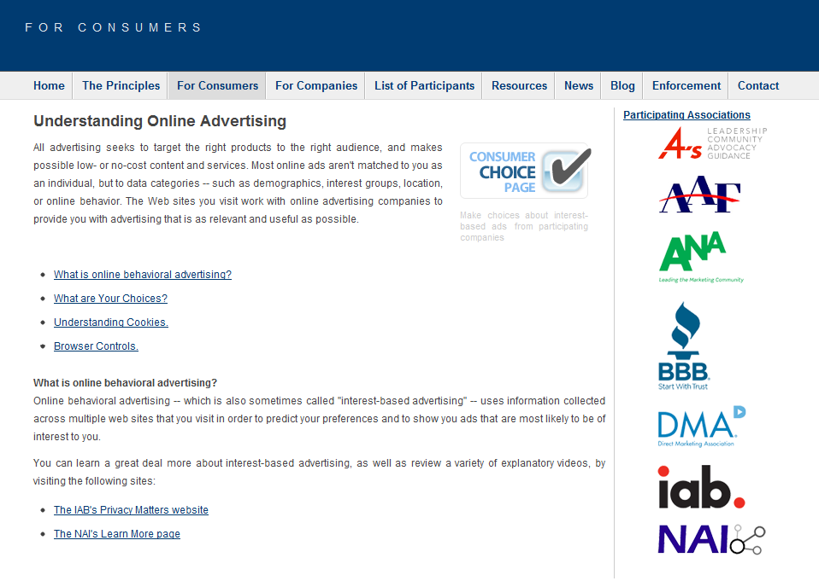
Digital Advertising Alliance

Slide 7
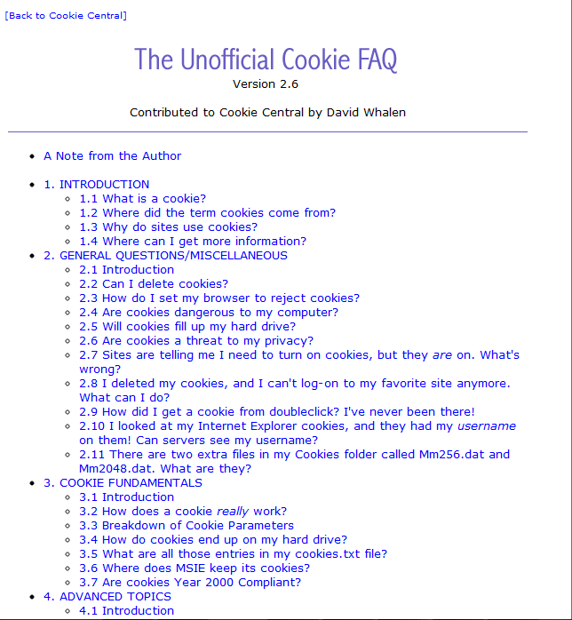
Cookie Education

Slide 8
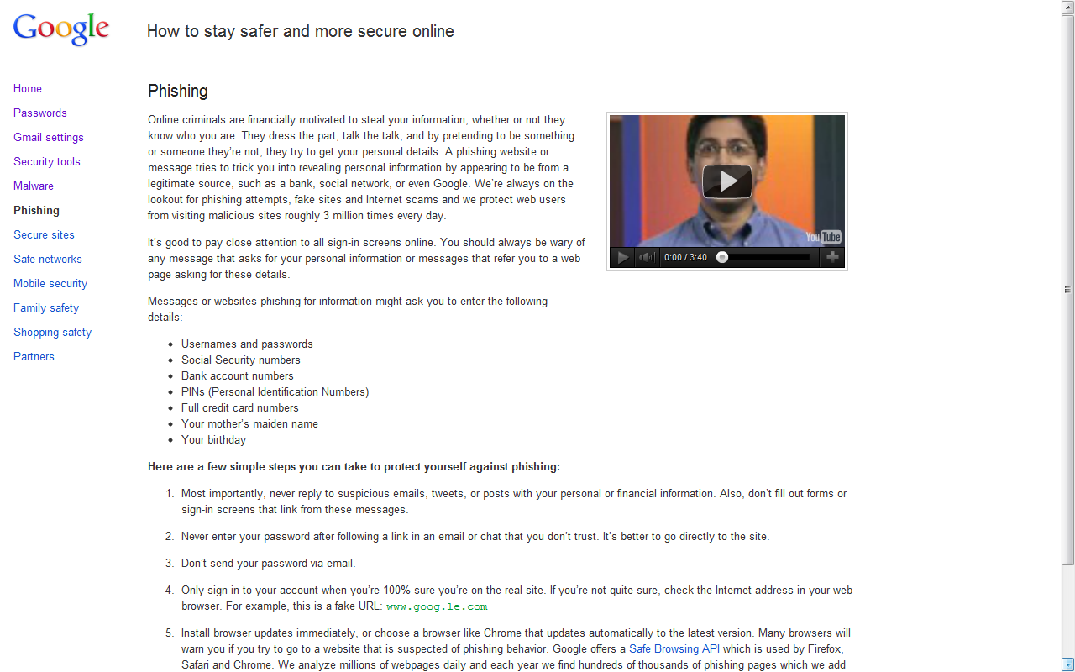

Slide 9
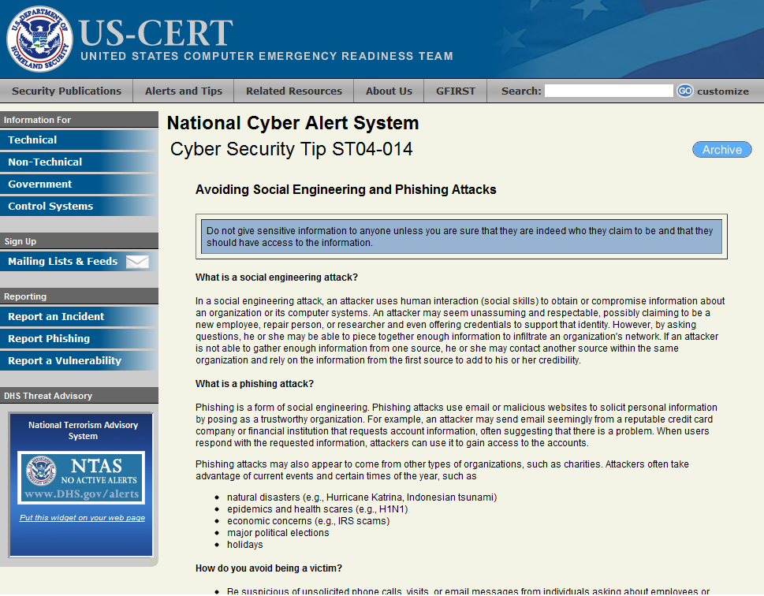

Slide 10
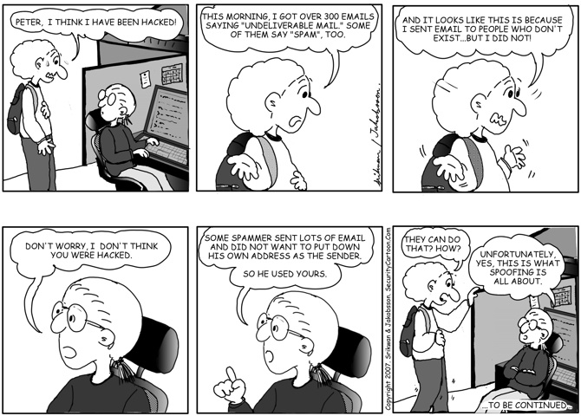
Cartoon about Spoofing
[http://www.securitycartoon.com/]

Slide 11
A Look At Cookies
http://www.youtube.com/watch?v=TBR-xtJVq7E

Slide 12
Cookies
http://www.youtube.com/watch?v=HC7CDqCrqnE

Slide 13
Got Cookies
http://www.youtube.com/watch?v=JYCpiZKY30E

Slide 14
What They Know Advertising Cookies And You
http://www.youtube.com/watch?v=O2wMVk10X0M

Slide 15
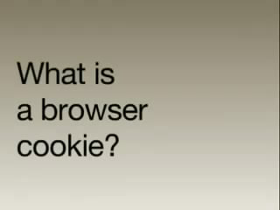
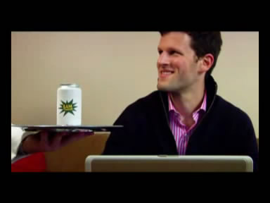
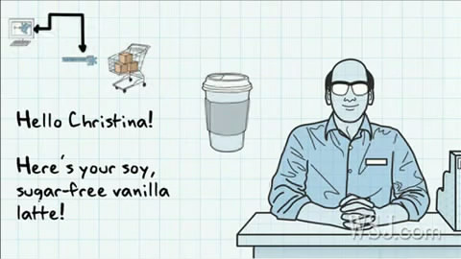
Which one do you like?
1
2
3
4

Slide 16
Staying Clear of Cyber Tricks
http://www.youtube.com/watch?v=MrG061_Rm7E

Slide 19
Security Reinforcement Applications Vicarious Security Reinforcement
[Villamarín-Salomón et al., 2010]
“Using Reinforcement to Strengthen Users' Secure Behaviors”
Security-Reinforcing Applications (SRA)
Inspired by Operant Conditioning Model
Reward users' secure behavior
Vicarious Security Reinforcement (VSR)
Inspired by Social Learning Theory
Help accelerate SRA benefits
Results
SRA improves users' secure behaviors
Not extinguish after several weeks
VSR accelerates learning of desired security behaviors in SRA users.

Slide 20
Operant Conditioning (OC) Model
Operant Conditioning
A form of psychological learning
An individual acquires or maintains a behavior as a result of the behavior's consequences to the individual
Reinforcer
Consequence that strengthen a behavior
Positive Reinforcement
Present something pleasing
Negative Reinforcement
Remove something displeasing
Punishment
Consequence that weaken a behavior
Antecedent
Stimuli present in the environment only immediately before behaviors that are reinforced

Slide 21
Security-Reinforcing Applications
Security-Reinforcing Applications
Reinforce users' secure behaviors
Deploy within organizations
Secure Behavior
Rejection of unjustified risks (UR)
Acceptance of justified risks (JR)
Insecure Behaviors
Acceptance of unjustified risks (UR)
Rejection of justified risks (JR)
Justified Risks
primary tasks
no other alternatives to accomplish such tasks
no means to mitigate the risks

Slide 22
Example of UR and JR
UR may be an email message containing an attachment that is unexpected, from an unknown sender, unnecessary to the user's job-related tasks, or of a type that may spread infections (e.g., .exe). In this case, the user may mitigate the risk by, e.g., asking the sender to retransmit the attachment in a less risky file format (e.g., .txt).
JR may be represented by an email that (a) the user was expecting and contains an attachment useful to complete a work-related task, or (b) was sent by a known member of the user's organization, with wording not appearing out of character for such sender, and explaining clearly why the recipient needs the attachment for her work.

Slide 23
Security-Reinforcing Applications

Slide 24
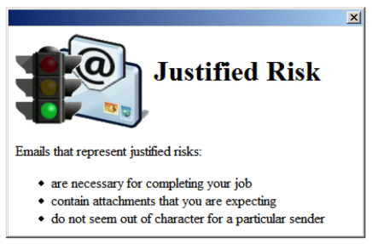
Security-Reinforcing Applications

Slide 25
Vicarious Security Reinforcement
Problems when using SRA:
Take time for users to understand association between secure behavior and reward
Users handle some of risks, but may miss others
“Vicarious security reinforcement (VSR) can model secure behaviors and present their desirable consequences without waiting for users to emit fortuitously such behaviors and stumble upon their consequences.”

Slide 26
Social Learning (SL) Theory
Learning in social context
Individuals can also acquire and maintain behaviors by observing their consequences in others (models)
Vicarious reinforcement sub process
Attention
Retention
Reproduction
Motivation
Difference to Imitation
refrain from unwanted behavior by observing subsequent consequences

Slide 27
Vicarious Security Reinforcement

Slide 28
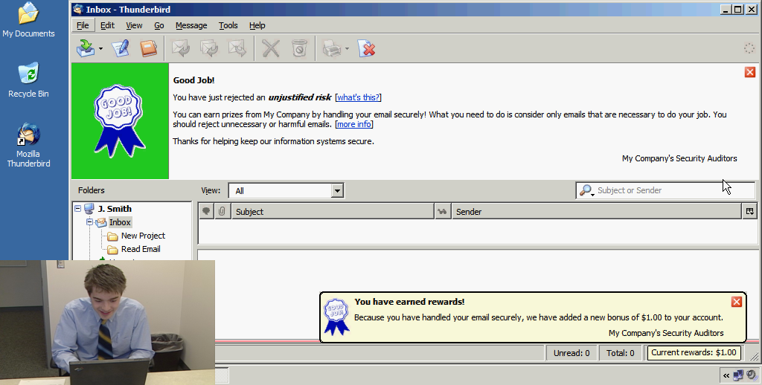
Vicarious Security Reinforcement

Slide 29
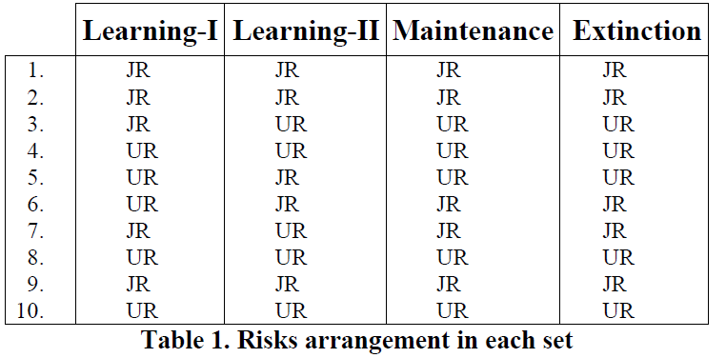
Experiment

Slide 30
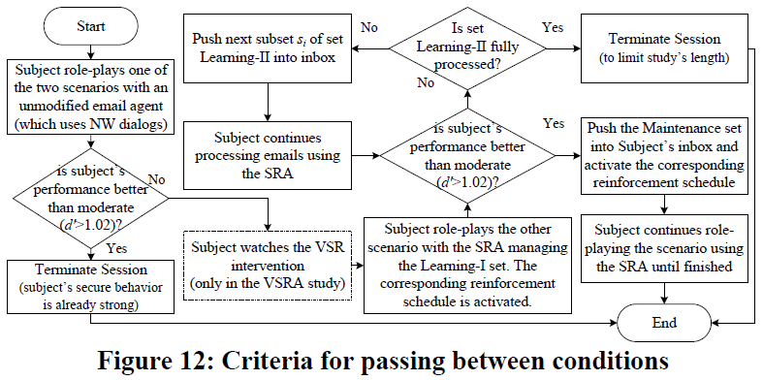
Experiment

Slide 31
Comparison with PhishGuru
SRAs
Embedded rewards
Organization-specific security policies and targeted attacks
With supervision
Educate about complex policies
PhishGuru
Links to websites with educational cartoons
Organization-specific security policies and targeted attacks
Without supervision
quicker apply simpler policies

Slide 33
Class Activity: User Education on SNS Phishing

Slide 34
Contextual Training
Users are sent simulated phishing emails by the experimenter to test user’s vulnerability regarding phishing attacks
At the end of the study, user is notified about phishing attacks
No immediate feed-back

Slide 35
Embedded Training
Teaches user about phishing during regular usage of the application, such as email

Slide 36
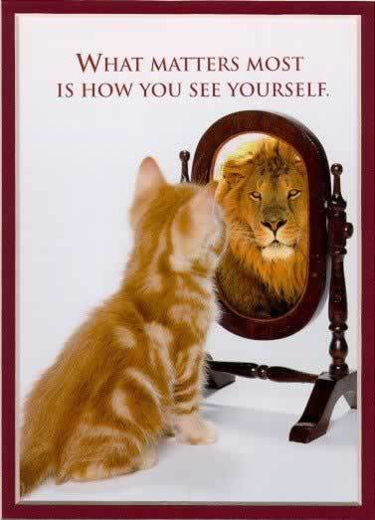
Reflection Principle
Reflection is the process by which learners are made to stop and think about what they’re learning

Slide 37
Story-based Agent Environment Principle
Agents are characters that help users regarding learning process

Slide 38
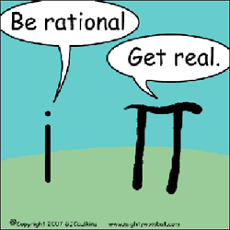
Conceptual-Procedural Principle
Conceptual & Procedural knowledge influence one and another

Slide 39
Demo of Anti-Phishing Phil
http://wombatsecurity.com/antiphishingphil

Slide 40
Another Form of Phishing Attack
Full Screen API Demo

Slide 41
Ad-Click Demo
http://www.yahoo.com/

Slide 42
User Should Reject Security Advice?
User rejecting security advice is rational from an economic perspective
100% of certificate error warnings appear to be false positive
Most security advices provide poor cost-benefit tradeoff to users and is rejected
How can we blame users for not adhering to certificate warnings when vast majority of them are false positives?

Slide 43
Users are the Weakest Link in Security
Why attack machines when users are so easy to target?
Most large web-sites offer security tips to users
Not so effective however
Users are lazy

Slide 44
Why Do Users Disregard Security Warnings?
Overwhelmed
Benefits are moot or perceived as moot
Strong password does nothing in presence of keylogger
How often does user perceive a real attack?

Slide 45
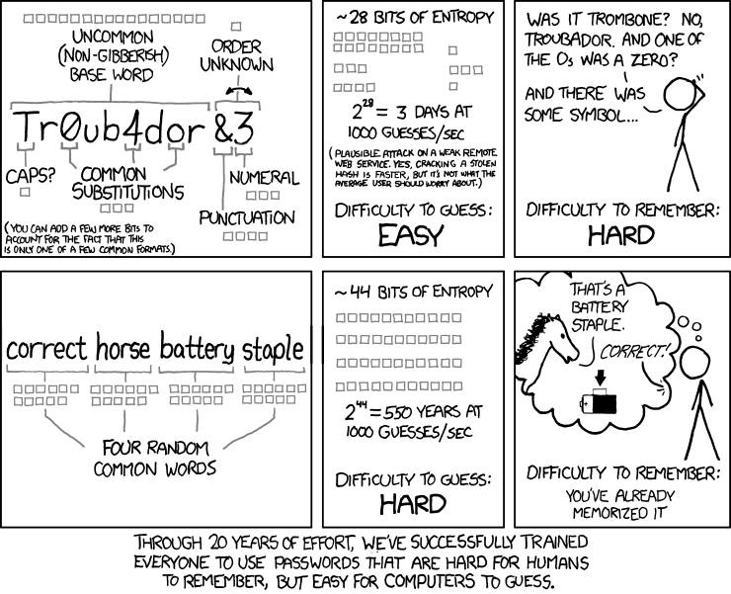
Password Policies

Slide 46
Teaching Users to Identify Phishing Sites By Reading URL
Phishers quickly evolve

Slide 47
Certificate Errors
Type https://www.paypal.com
Type http://www.paypal.com
Type paypal control + enter
Search Google for PayPal and click link
Click bookmarked https://www.paypal.com
Click bookmarked http://www.paypal.com
Problems?

Slide 48
Discussion

