Slide 1
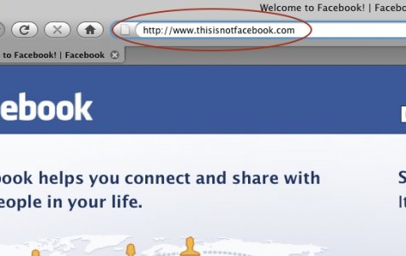
Class Activity: User Education on SNS Phishing

Slide 2
Contextual Training
Users are sent simulated phishing emails by the experimenter to test user’s vulnerability regarding phishing attacks
At the end of the study, user is notified about phishing attacks
No immediate feed-back

Slide 3
Embedded Training
Teaches user about phishing during regular usage of the application, such as email

Slide 4
Reflection Principle
Reflection is the process by which learners are made to stop and think about what they’re learning

Slide 5
Story-based Agent Environment Principle
Agents are characters that help users regarding learning process

Slide 6
Conceptual-Procedural Principle
Conceptual & Procedural knowledge influence one and another

Slide 7
Demo of Anti-Phishing Phil
http://wombatsecurity.com/antiphishingphil

Slide 8
Another Form of Phishing Attack
Full Screen API Demo

Slide 9
Ad-Click Demo
http://www.yahoo.com/

Slide 10
User Should Reject Security Advice?
User rejecting security advice is rational from an economic perspective
100% of certificate error warnings appear to be false positive
Most security advices provide poor cost-benefit tradeoff to users and is rejected
How can we blame users for not adhering to certificate warnings when vast majority of them are false positives?

Slide 11
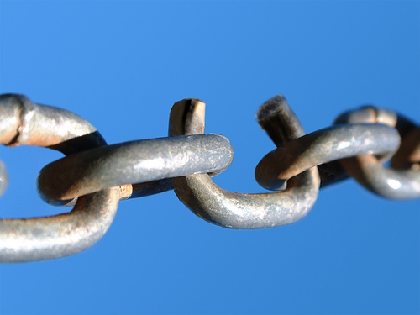
Users are the Weakest Link in Security
Why attack machines when users are so easy to target?
Most large web-sites offer security tips to users
Not so effective however
Users are lazy

Slide 12
Why Do Users Disregard Security Warnings?
Overwhelmed
Benefits are moot or perceived as moot
Strong password does nothing in presence of keylogger
How often does user perceive a real attack?

Slide 13
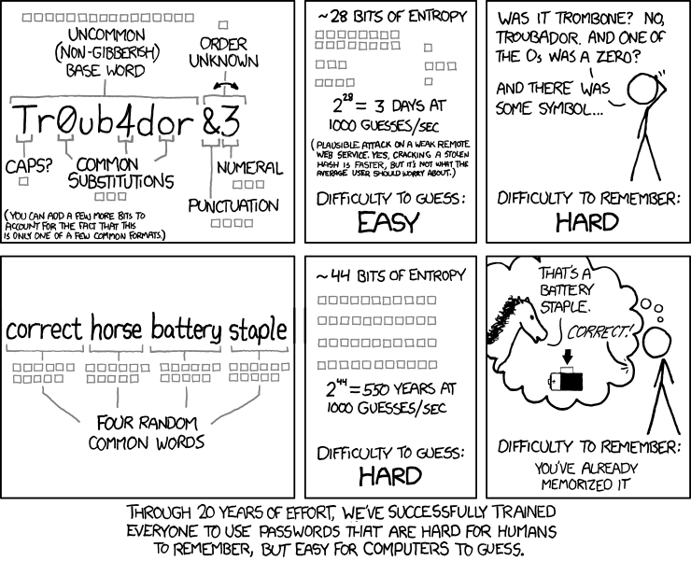
Password Policies

Slide 14
Teaching Users to Identify Phishing Sites By Reading URL
Phishers quickly evolve

Slide 15
Certificate Errors
Type https://www.paypal.com
Type http://www.paypal.com
Type paypal control + enter
Search Google for PayPal and click link
Click bookmarked https://www.paypal.com
Click bookmarked http://www.paypal.com
Problems?

Slide 16
Discussion

