Slide 1
Designing Experiments
Lorrie Faith Cranor
September 2009

Slide 2
How is HCISEC different from HCI?
Is it different? If so, how?
Are different user study methods needed?

Slide 3
Designing and conducting a user study
Identify purpose and metrics
Decide what type of data to collect
Design tasks
Develop experimental design
Develop detailed plan, artifacts, protocol and scripts
IRB approval
Pilot test and revise
Recruit participants and run study
Analyze data
Report results

Slide 4
Purpose & metrics
Identify purpose of study
What are you trying to learn?
Human-in-the-loop questions may be relevant
What are your hypotheses?
Identify metrics
How will you know if it is better, faster, more useful, more usable, etc. ?
What will you measure?
What will you compare it to?
What is your target improvement, time, score, etc. ?
What qualitative data are you looking for?

Slide 5
What data to collect
Process data
Bottom-line data
Observations of what users are doing or thinking
Think aloud
Audio recording, video recording, screen capture
Formative evaluation
Collect this data first to help identify problems
Useful results with few users
May be hard generalize from results
Complements bottom-line data to help explain results
But think-aloud can impact speed and accuracy
Summary of what happened
Time
Accuracy, errors
Summative evaluation
Validate an approach, compare multiple approaches
But doesn’t usually tell you what went wrong or how to fix (“too slow” “too many errors”)
May require many users for statistical significance

Slide 6
What data to collect
Subjective user preference
Demographics of your participants
Rate system on a Likert scale
Example: The user interface was easy to use
1 - Strongly disagree
2 - Disagree
3 - Neither agree nor disagree
4 - Agree
5 - Strongly agree
Can be hard to be sure what data means
novelty, not realistic setting …
Open ended questions
what they liked, disliked, where they had trouble, best part, worst part, etc.
Important to know something about your participants
Basic demographics
Age, gender, income level, education level, occupation/major, location, disabilities
Other factors relevant to your study
Technical experience, native language, willingness to take risks, attitudes about privacy, etc.

Slide 7
Tasks
What tasks will you ask users to perform to allow you to take needed measurements? What questions will you ask them?
What degree of user interface fidelity do you need to allow you to take needed measurements?
Is a paper prototype or low fidelity prototype be preferable, or is a high-fidelity prototype needed?
Where should the study be done?
Lab study, online study, or field study?

Slide 8
Experimental design
What kind of experimental design should you use?
Within subjects, between subjects, hybrid
How many participants should you have?
What will you need for statistical significance?
What are your constraints in terms of time, budget, etc?
What kind of subjects do you need and how will you recruit them?
Special characteristics, knowledge or skills?
Sometimes we recruit a particular type of subject because it is more convenient, even if it doesn’t produce as generalizable results
What incentives will they have to participate?

Slide 9
Comparing alternatives
Between groups experiment (AB experiment)
Two (or more) groups of test users
Each group uses only 1 of the systems
Requires more participants
Make sure each group is similar
Within groups experiment
One group of test users
Each person uses both systems
Need to control for learning effect

Slide 10
Controlling for task order and learning effects
Present tasks in random order
Use Latin squares design
n x n table filled with n different symbols such that each appears exactly once in each row and each column

Slide 11
Detailed plan
Develop artifacts
Prototypes, questionnaires, screening tools, measuring tools, etc.
Protocol and scripts
Exactly what will participants do?
Will you ask participants to think aloud?
What will experimenter(s) do and say?
Do you need to train participants?
Are warm-up or distracter tasks needed?
Will you make audio or video recordings or do screen captures?
Will the experimenter record specific information? Is there a form or template to facilitate this?
Figure out how you will analyze your data

Slide 12
IRB approval
All published research studies involving human subjects must have CMU IRB approval
Surveys are exempt, but you must still fill out form and ask IRB to give you exemption
Exempt and low-risk IRB approval usually happens within 2 weeks
High risk usually takes about a month, but may be longer if you have to iterate with IRB
Whenever possible, design study so participants sign informed consent form up front
You will have to convince IRB that there is a good reason not to
Submit your IRB form as early as possible, even if not all your study details are worked out
You can submit an amendment later
Label all recruitment forms and questionnaires as “Example” for more flexibility
http://www.cmu.edu/osp/regulatory-compliance/human-subjects.html

Slide 13
Ethical considerations
Sometimes tests can be distressing
users have left in tears
You have a responsibility to alleviate
make voluntary with informed consent
avoid pressure to participate
let them know they can stop at any time
stress that you are testing the system, not them
make collected data as anonymous as possible

Slide 14
Pilot test and revise
Run through the whole protocol with members of your team to work out all the details
Run through it with your friends or people you recruit to debug the protocol and find out how long it will take
Do some preliminary data analysis
Revise
Make sure tasks and questions aren’t confusing
Make sure the study can be done in a reasonable amount of time
Make sure the study measures what you are trying to measure
Repeat

Slide 15
Recruit participants and run study
Posters, email, ads, etc. to recruit study participants
Screen participants, sign them up
Make sure they know where to meet you and how to contact you
Send them a reminder the day of the study
Run the study
Make sure you have reserved lab or appropriate space, if needed
Post signs to help participants find you
Make sure you have enough people there to run the study
Make sure your computers are setup, you have your recording devices, human subject payments, and anything else you need

Slide 16
Analyze data
Sort & prioritize observations
what was important?
lots of problems in the same area?
Summarize the data
make a list of all critical incidents, positive & negative
try to judge why each difficulty occurred
Determine scores, times, etc.
Code audio or text for quantitative analysis
Run appropriate statistical tests to test your hypotheses
What does data tell you?
Iterate
Should you change your interface and test again?
Should you change your experimental protocol to fix problems, test other data?

Slide 17
Report results
Detail your methodology
Document your assumptions and threat model
How were participants recruited?
What incentive was provided to participate?
Where did the participants go to participate?
What were participants asked to do before, as part of, and following the experiment?
What information did participants learn along the way and how might this have influenced behaviors later on in the experiment?
If the study was a between-subjects study, how did the experience (treatment) vary between the groups?
Did the order of any tasks change for different participants?
Use proper statistical analysis
If your distribution is not normal, don’t use statistical tests that assume a normal distribution
Account for multiple comparisons
If you can’t demonstrate a statistically significant difference it does not necessarily it mean it doesn’t exist
Statistical correlation does not prove causation
Report the limitations of your study
Cite related work

Slide 18
Group exercise: study design
The AT&T web mail client identifies suspected phishing emails and warns a user if they try to open them. If a user opens the messages anyway, they will see the warning symbol next to all suspicious links. If they click on the link, they will go to a page warning them that the link is suspicious, and asking them if they are sure they want to proceed. Design a user study that will allow you to evaluate the effectiveness of this approach to protecting users from phishing and to come up with recommendations for improving the warning interface. Optionally, you can come up with some design improvements and test them in your user study as well. (Groups will be assigned to design a lab study or a field study.)

Slide 19
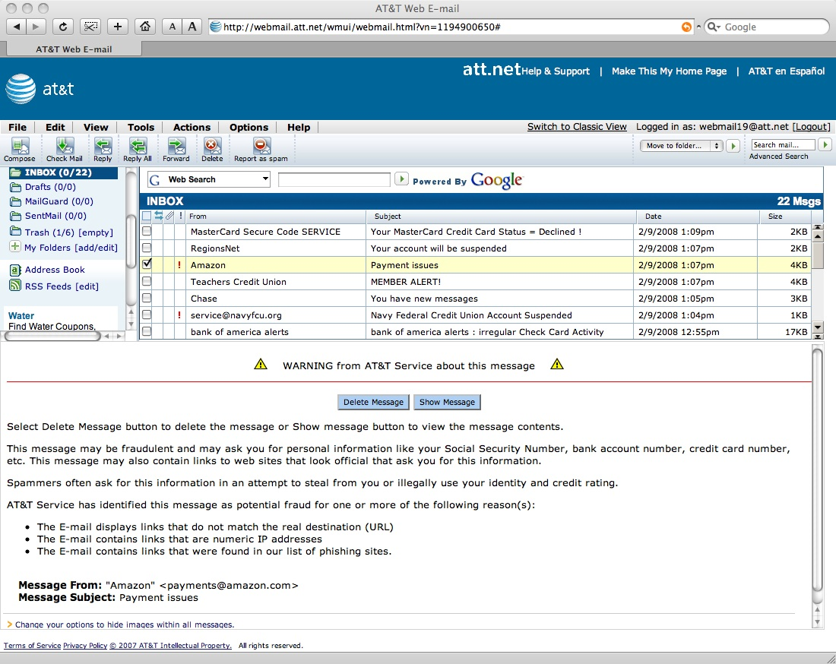

Slide 20
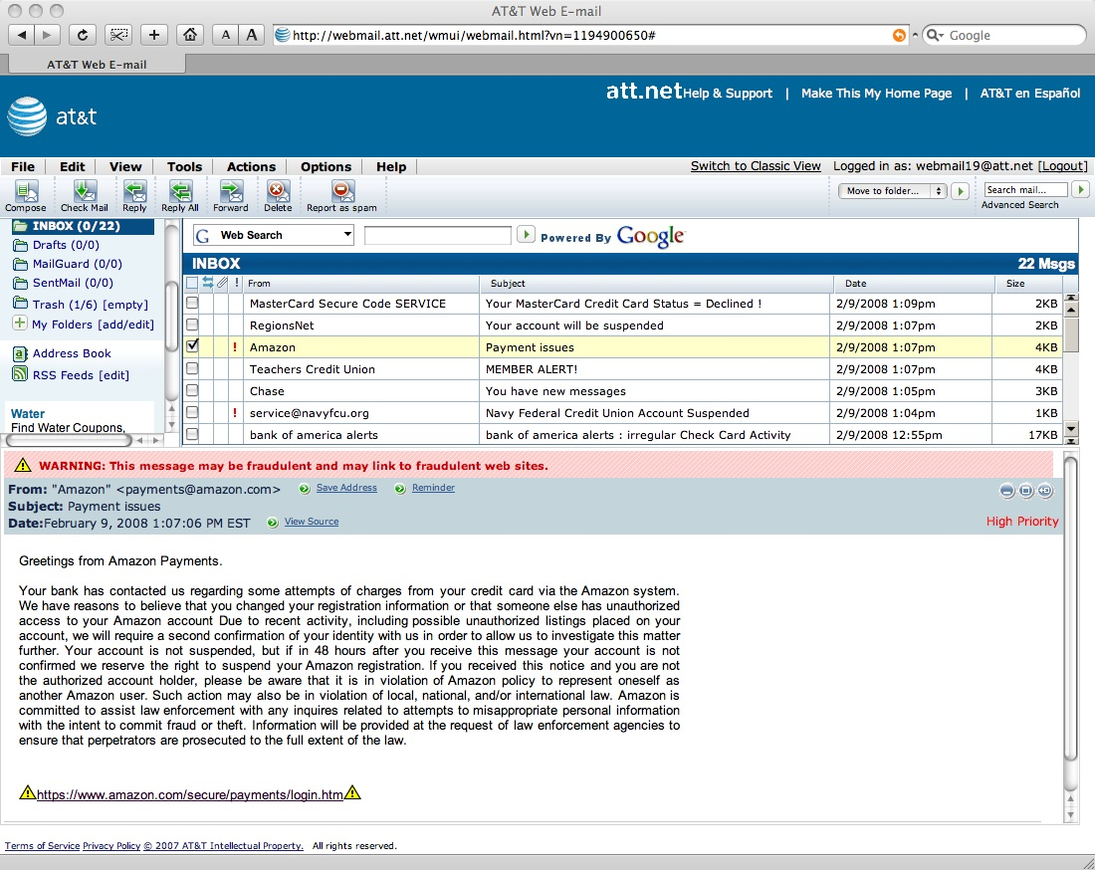

Slide 21
