Slide 1
HCI Methods and UI Design
Lorrie Faith Cranor
August 2009

Slide 2
Human-Computer Interaction (HCI)
Human
  the end-user of a program
  the others in the organization
Computer
  the machine the program runs on
  clients & servers, PDAs, cars, microwaves
Interaction
  the user tells the computer what they want (input)
  the computer communicates results (output)
Notes:
So far you have probably studied lots about Computers, but
little about Humans and Interaction.
This course will concentrate on how these three areas come together.

Slide 3
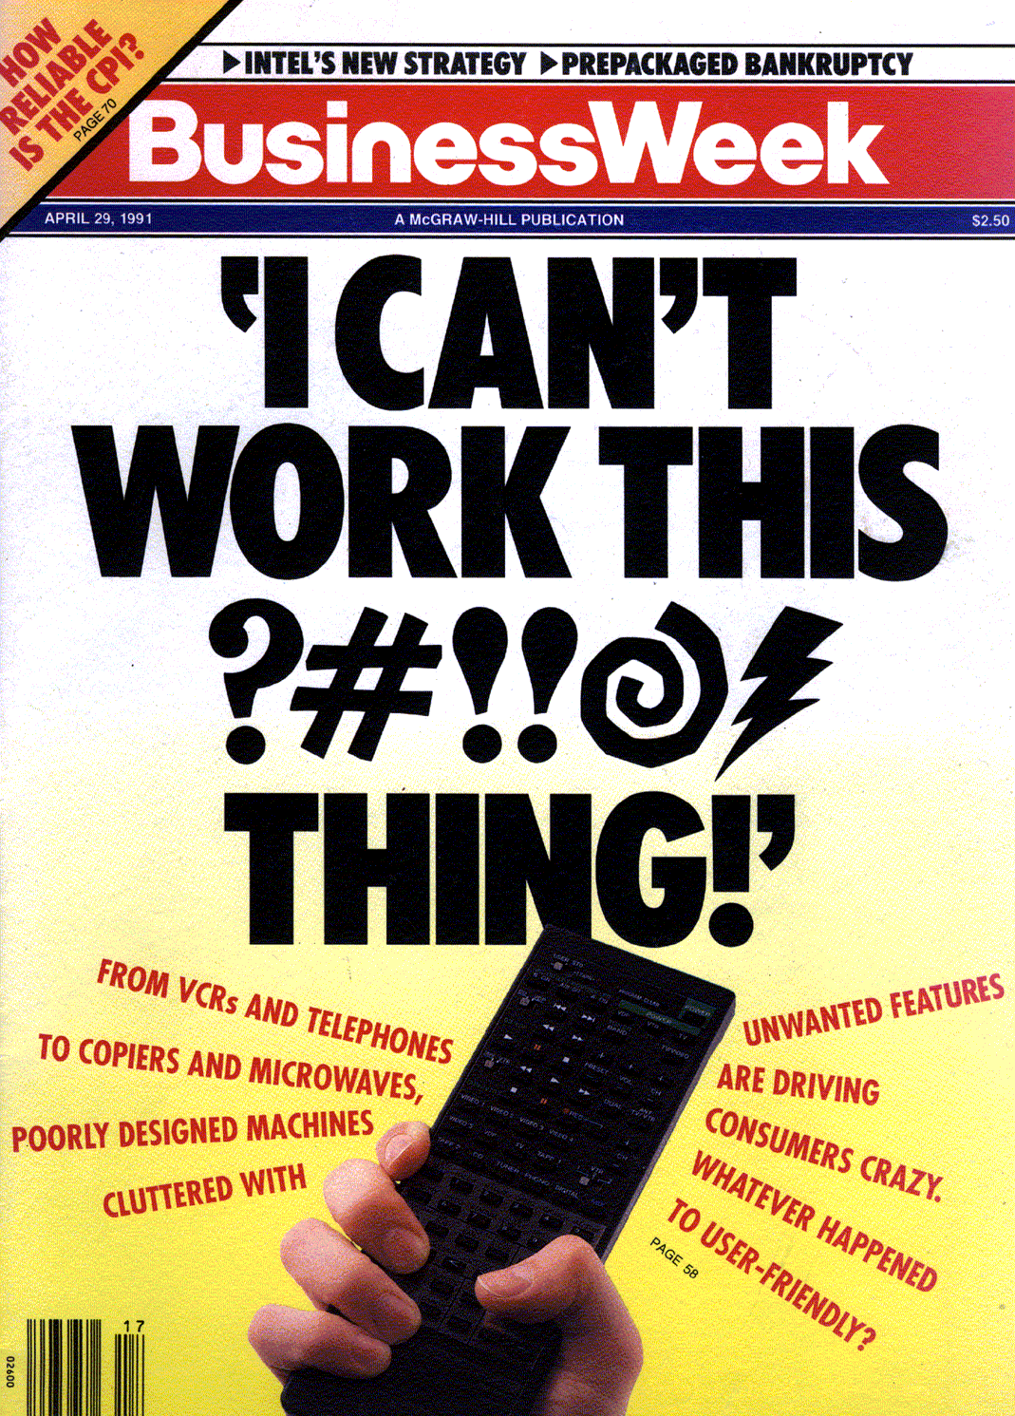
Why is HCI Important?
Major part of work for “real” programs (~50%)
Bad user interfaces cost:
  money (reduced profits, call centers)
    WiFi Alliance: 30% of WiFi boxes returned
  reputation of organization (e.g., brand loyalty)
  time (wasted effort and energy by users, rework)
  lives (Therac-25)
Notes:
Studies have shown that the design, programming, and evaluation of the UI can take up to 50% of the project time and cost for a wide range of commercial and in-house software
Nearly 25% of all applications projects fail. Why?
overrun budgets & management pulls plug
others complete, but are too hard to learn/use
Solution is user-centered design. Why?
easier to learn & use products sell better
can help keep a product on schedule
finding problems early makes them easier to fix!
training costs reduced

Slide 4
HCI Approach to UI Design
Organizational &
Social Issues
Tasks
Design
Technology
Humans
Other considerations we won’t look at
  Business models, level of fun
Notes:
Give Examples of Tasks:
high level:
- writing a paper
- drawing a picture
low level:
- copying a word from one paragraph to another
- coloring a line

Slide 5
Who are “Users”?
People who will use a computer system or web site.
As opposed to the “Designers”
  People who create the system or web site
Designers ≠ Users
Have to make an effort to Know The User
“The user is not like me!”

Slide 6
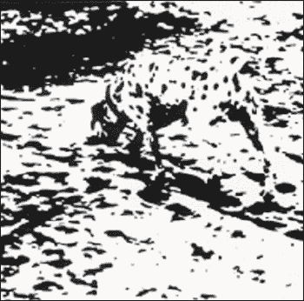
You Are Not the User
You already know too much
Notes:
Richard Gregory Dalmatian

Slide 7
You Are Not the User
You already know too much
  easy to think of self as typical user
  easy to make mistaken assumptions
Keep users involved throughout the design
  understanding work process
  getting constant feedback
User-centered design mind-set
  thinking of the world in users’ terms (empathy)
  not technology-centered / feature driven, think of benefit to users
Notes:
`

Slide 8
What is the “User Interface”?
Everything the user encounters
  Functionality
  Content
  Labels
  Presentation
  Layout
  Navigation
  Speed of response
  Documentation & Help

Slide 9
What is “Usability”?
Learnability
Efficiency
  Productivity
Memorability
  Little “re-learning” required
Lack of Errors
Satisfaction
  Pleasurable
All of these can be measured and improved through HCI methods

Slide 10
Why is Good Usability Important?
“Usability is the end-user's view of system quality”
Expect sit-down-and-use computers and software
  People don't read the manuals
Usability is critical to software sales:
  In magazine ratings
  “User friendly”
Novices will be more effective quicker
Make experts more efficient
Reduce errors
Can help identify what is really needed
  What will be useful and what is not needed

Slide 11
Why Hard to Design UIs?
“It is easy to make things hard. It is hard to make things easy.”
No silver bullet
User Interface design is a creative process
Designers have difficulty thinking like users
  Often need to understand task domain
  Can’t “unlearn” something

Slide 12
Why Difficult, 2
Specifications are always wrong:
  “Only slightly more than 30% of the code developed in application software development ever gets used as intended by end-users. The reason for this statistic may be a result of developers not understanding what their users need.”
    -- Hugh Beyer and Karen Holtzblatt, "Contextual Design: A Customer-Centric Approach to Systems Design,“
    ACM Interactions, Sep+Oct, 1997, iv.5, p. 62.
  Need for prototyping and iteration

Slide 13
Why Difficult, 3
Tasks and domains are complex
  MacDraw 1 vs. Illustrator
  Word 1 vs. Office 2007 (>2000)
  BMW iDrive adjusts over 700 functions
Existing theories and guidelines are not sufficient
  Too specific and/or too general
  Standard does not address all issues.
Adding graphics can make worse
  Pretty ≠ Easy to use

Slide 14
Why Difficult, 4
All UI design involves tradeoffs:
  Standards (style guides, related products)
  Graphic design (artistic)
  Technical writing (Documentation)
  Internationalization
  Performance
  Multiple platforms (hardware, browsers, etc.)
  High-level and low-level details
  External factors (social issues)
  Legal issues
  Time to develop and test (“time to market”)

Slide 15
Why Hard to Implement?
Need for robustness
  No crashing, on any input
  Helpful error messages and recover gracefully
  Aborts
  Undo
Lower testability
  Few tools for regression testing
Complexity of the tools
  Full bookshelf for documentation of user interface frameworks
  MFC, Java Swing, VB .Net, etc.

Slide 16
How to organize development process
“Usability is not a quality that can be spread out to cover a poor design like a thick layer of peanut butter.” [Nielsen]
Like Software Engineering, is a process for developing software to help insure high quality
Must plan for and support usability considerations throughout design

Slide 17
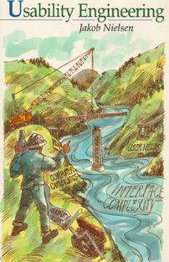
“Usability Engineering”
Parallel with “software engineering”
Make use of usability more like engineering
“Engineering”
  Measurable, process-oriented
  Not just “art”
Based on Jakob Nielsen,
“Usability Engineering” book
  Jakob Nielsen. “Usability Engineering,” Boston:
  Academic Press, Inc. 1993. ISBN 0-12-518406-9
  (paperback) or ISBN 0-12-518405-0 (hardcover).

Slide 18
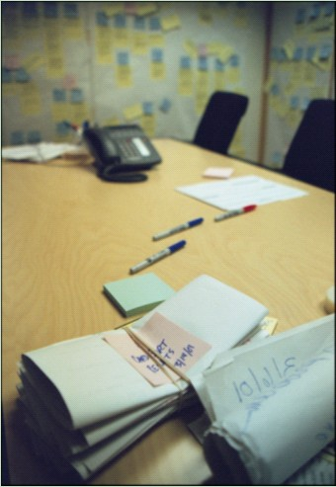
Who Builds User Interfaces?
A team of specialists (ideally)
  graphic designers
  interaction / interface designers
  information architects
  technical writers
  marketers
  test engineers
  usability engineers
  software engineers
  users
Notes:
In this course you will wear the hats of many of these specialists.

Slide 19
Design
Design is driven by requirements
  focus on the core needs, not how implemented
  e.g., Nokia N80 not as important as “mobile” app
    might be multiple ways of achieving your goals
A design is a simplified representation of the desired artifact
  text description of tasks
  screen sketches or storyboards
  flow diagrams / outline showing
  task structure
  executable prototypes
Write essay
start word processor
write outline
fill out outline
Start word processor
find word processor icon
double click on icon
Write outline
write down high-level ideas
.
.
.

Slide 20
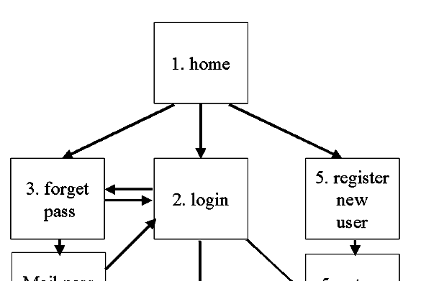
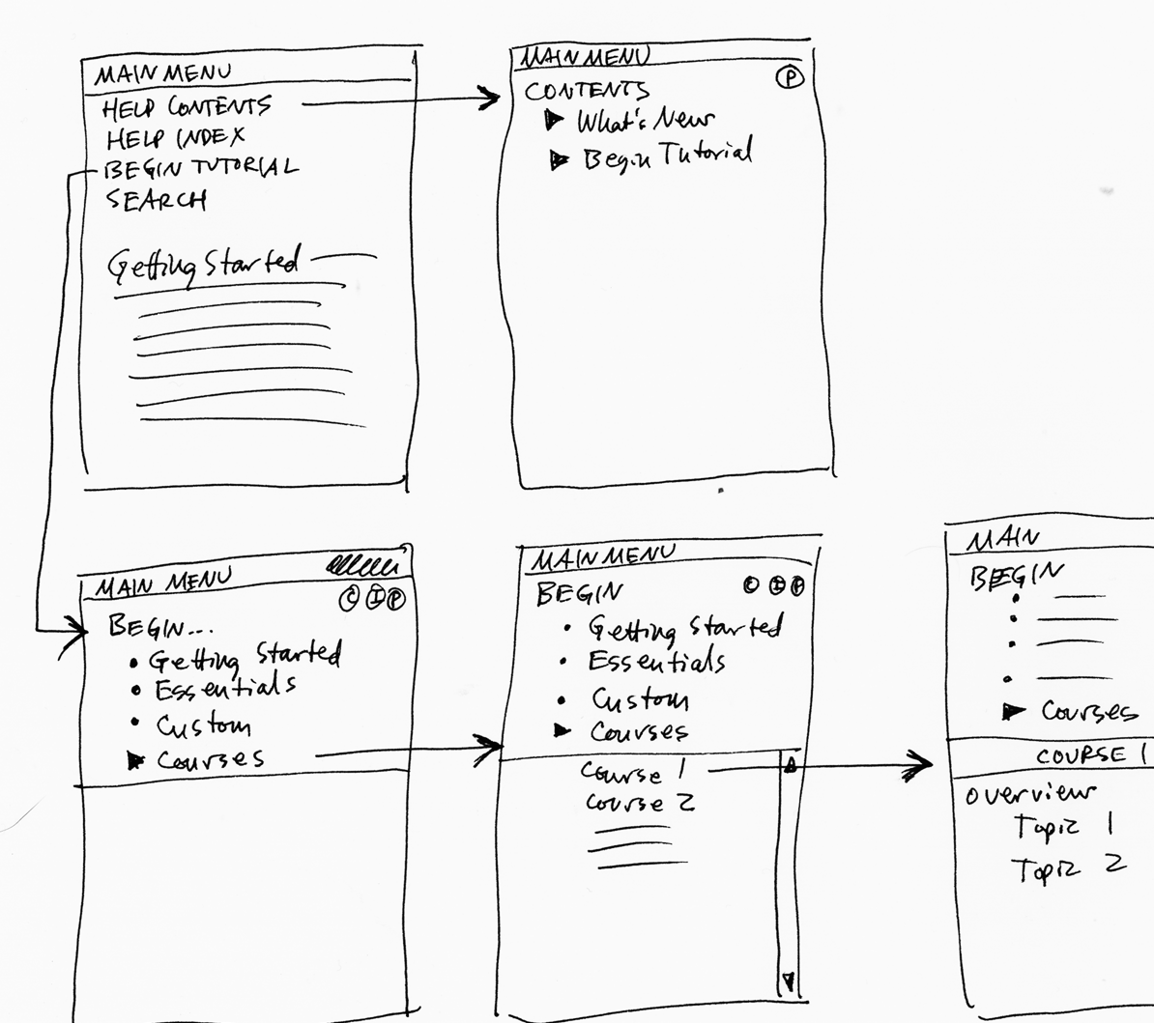
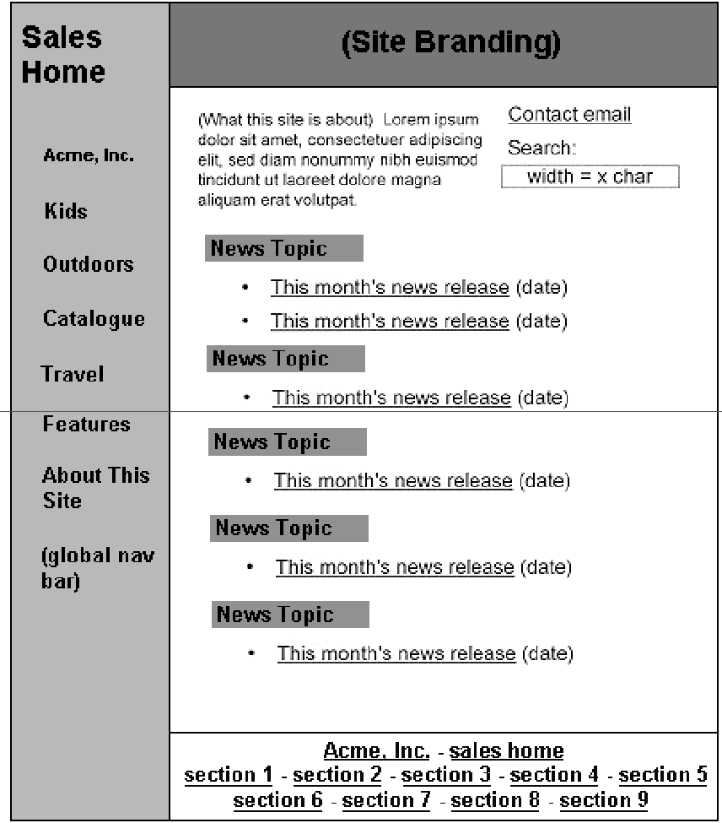

Web Design Representations
Site Maps
Storyboards
Schematics
Mock-ups
Notes:
Designers create representations of sites at multiple levels of detail
Web designs are iteratively refined at all levels of detail

Slide 21
How Achieve Good Usability?
How to know the users and their tasks
  Task Analysis using “Contextual Inquiry”
How to insure that the design is appropriate?
  Rapid and frequent prototypes
  Tested with users
  Iterative and Participatory Design
How to know if final product is usable and effective?
  Analyze Interfaces using various methods
  User Studies
  Heuristic Analysis
  Mathematical methods

Slide 22
Many HCI methods to choose from
Contextual Inquiry
Contextual Design
Paper prototypes
Think-aloud protocols
Heuristic Evaluation
Cognitive Walkthrough
KLM and GOMS
Task analysis
Questionnaires
Surveys
Interaction Relabeling
Personas
Log analysis
Focus groups
Video prototyping
Wizard of Oz
Body storming
Affinity diagrams
Expert interviews
Card sorting
Diary studies
Improvisation
Use cases
Scenarios
Cognitive Dimensions
…

Slide 23
1. Know the User
General information:
  Work experience, education level, age, previous computer experience
  Time available for learning, training
  Available hardware (monitor size, acceptance of plugins, cell-phones vs. desktop)
  Social context of use
Specific Task and Domain Information
  Difficult to get and understand

Slide 24
Contextual Inquiry & Design
Effective way to find out what users really do and need
Find out the important and relevant properties of the users
A kind of “ethnographic” or “participatory design” method
Combines aspects of other methods:
  Interviewing, think-aloud protocols, participant/observer in the context of the work
Part of “Contextual Design”
  Also includes diagrams to describe results
Described by Beyer and Holtzblatt:
  H. Beyer and K. Holtzblatt. 1998. Contextual Design: Defining Customer-Centered Systems. San Francisco, CA:Morgan Kaufmann Publishers, Inc.
  http://www.incent.com/
Used by many companies
  Microsoft, Intuit, Synaptec, Intel, Sun, HP, BestBuy, Medtronics, etc.

Slide 25
Contextual Inquiry
Interpretive field research method
Depends on conversations with users in the context of their work
  Direct observation when possible
Used to define requirements, plans and designs
Drives the creative process:
  In original design
  In considering new features or functionality

Slide 26
Why Context?
Design complete work process
  Fits into “fabric” of entire operations
    How people work together to perform tasks
  Not just “point solutions” to specific problems
Integration!
  Consistency, effectiveness, efficiency, coherent
Design from data
  Not just opinions, negotiation
  Not just a list of features
  Get specific breakdowns and opportunities that the product can address
  Get specific vocabulary
    What do users call it?

Slide 27
Key distinctions about context
Interviews, Surveys, Focus Groups
Summary data & abstractions
Subjective
Limited by reliability of human memory
What customers think &
say they want
Contextual Inquiry
Ongoing experience & concrete data
Objective
Spontaneous, as it happens
What customers actually need

Slide 28
Using the Data You Learn
Say who the users are (use personas or profiles)
  personas do not have to be a real person, but should be based on real facts and details
  design can really differ depending on who the target is
  provide names (easier to reference)
  characteristics of the users (job, expertise, etc.)
Might have one persona for each class of users
  helps the design team think in terms of the users
Keep in mind we already use personas
  “I wouldn’t like that”
  “My mom wouldn’t be able to use that”

Slide 29

Example Persona
Name: | Patricia
Age: | 31
Occupation: | Sales Manager, IKEA Store
Hobbies: | Painting Fitness/biking Taking son Devon to the park
Likes: | Emailing friends & family Surprises for her husband Talking on cell phone with friends Top 40 radio stations Eating Thai food Going to sleep late
Dislikes: | Slow service at checkout lines Smokers
Notes:
“Wixon and colleagues were developing an interface for a file management system. It passed lab tests with flying colors, but bombed as soon as customers got it. The problem was that it had a scrolling file list that was (say) twenty characters wide, but the file names customers used were very long, and in fact often identical for more than twenty characters (the names were made up by concatenating various qualifiers, and for many names the first several qualifiers would be the same.) Customers were not amused by needing to select from a scrolling list of umpty-ump identical entries that stood for different files. And this wasn't an oddball case, it was in fact typical. How had it been missed in the lab tests? Nobody thought it would matter what specific file names you used for the test, so of course they were all short.” – from Chapter 2 of TASK-CENTERED USER INTERFACE DESIGN A Practical Introduction by Clayton Lewis and John Rieman.

Slide 30
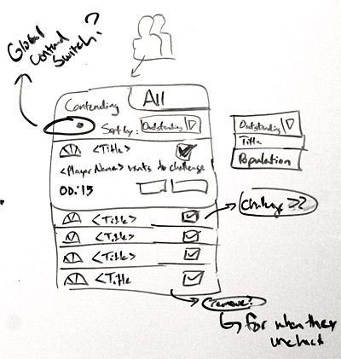
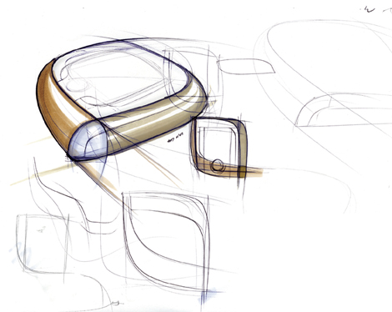
2. Prototyping and Iterative Design
Sketch many ideas first
  Designers invent while sketching = Ideation
  Linus Pauling: “The best way to a good idea
  is to have lots of ideas”
Build prototypes early and often
Many kinds
  Paper prototypes
  Visual Basic, Web, etc. simulations (no “works”)
Must test them with users
  Before system is architected or implemented
Useful for verifying that have identified:
  Appropriate tasks
  Appropriate roles of people and computers in the system

Slide 31
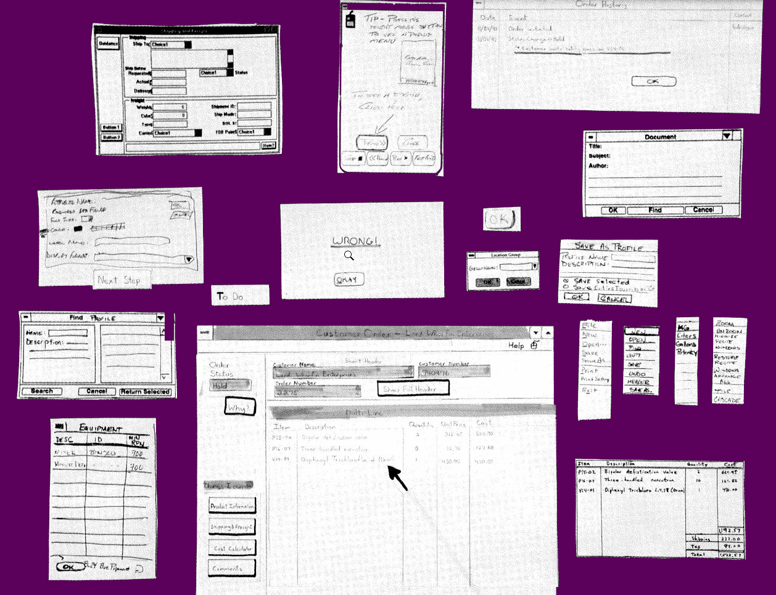
Examples of Paper Prototypes

Slide 32
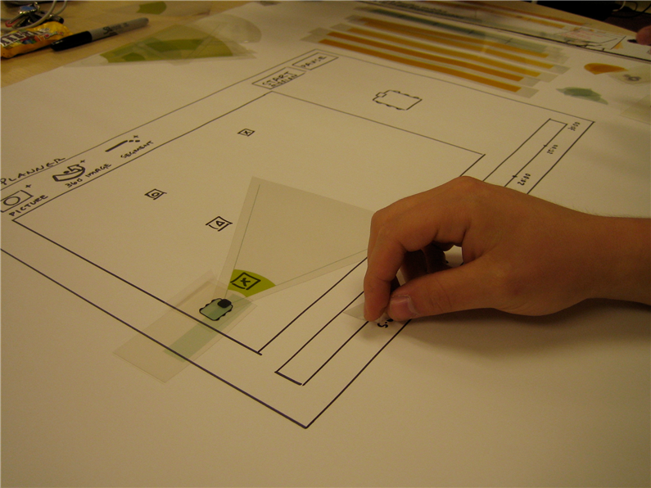
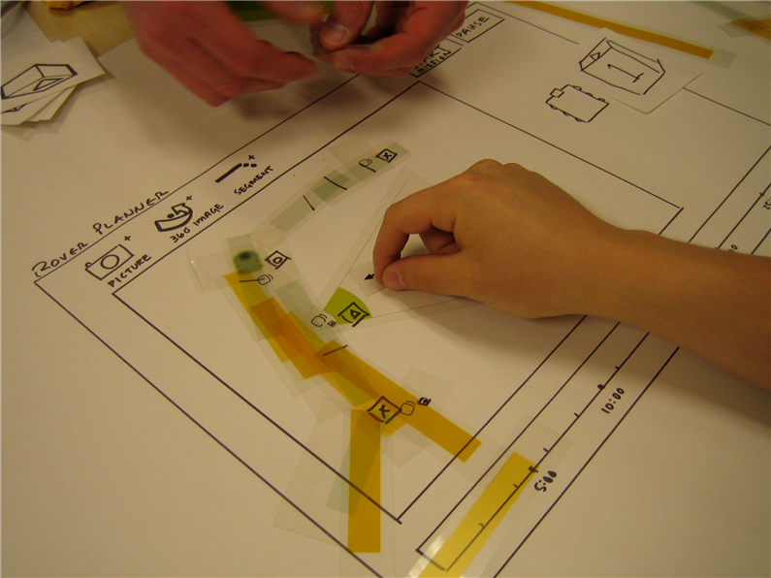
Another example
Prototype of interface for controlling the paths of a robot

Slide 33
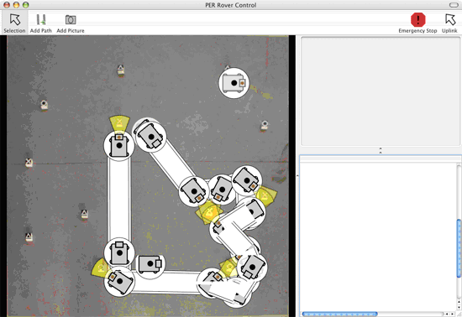
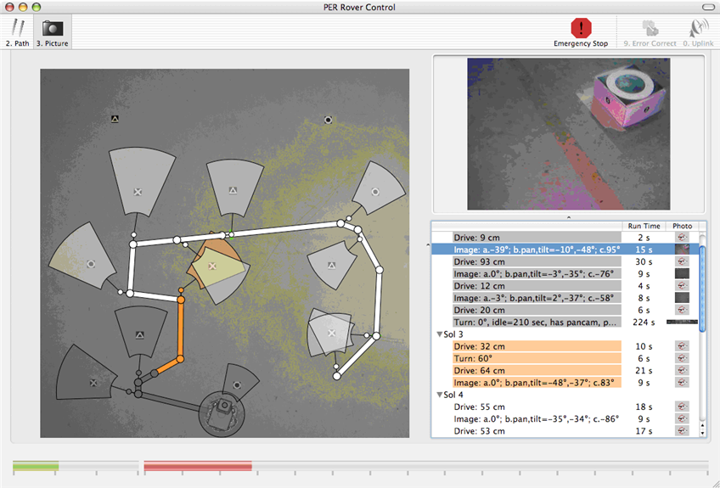
Resulting Prototype and Final Design

Slide 34
Why Do We Prototype?
Quickly experiment with alternative designs
Get feedback on your design faster
  fix problems before code is written
  saves time and money
Keeps the design centered on the user
  must test & observe ideas with users

Slide 35
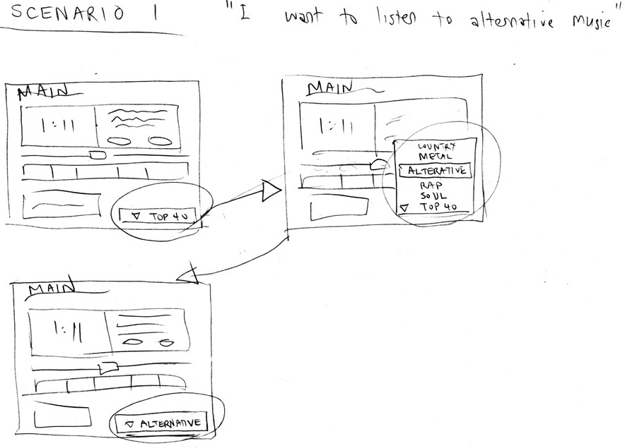
Fidelity in Prototyping
Fidelity refers to level of detail
High fidelity
  prototype looks like the final product
Low fidelity
  artist’s rendition with many details missing

Slide 36
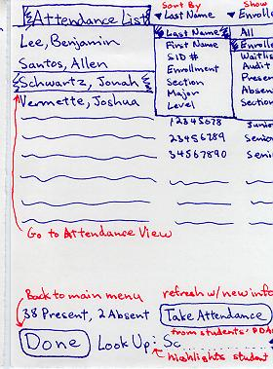
Low-fi Sketches & Storyboards

Slide 37
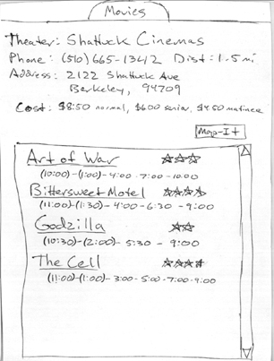
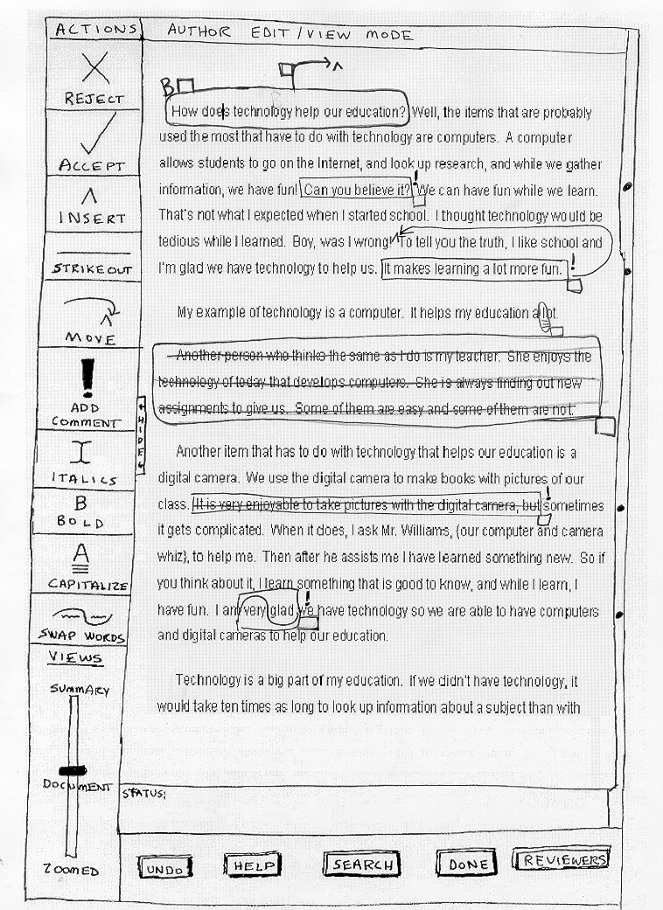
Low-fi Sketches & Storyboards

Slide 38
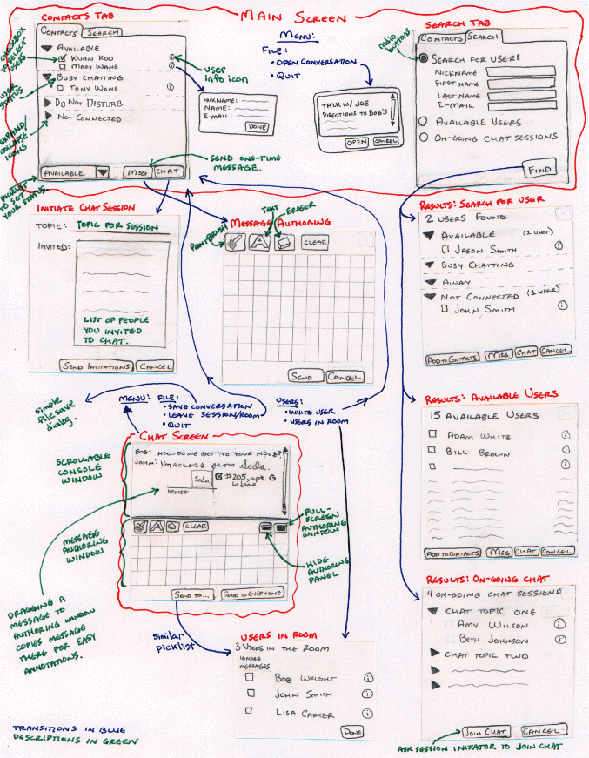
Ink Chat

Slide 39

Why Use Low-fi Prototypes?
Traditional methods take too long
  sketches → build prototype → evaluate → iterate
  don’t want to program for weeks or months before feedback
Simulate the prototype
  sketches → evaluate → iterate
  sketches act as prototypes
    designer “plays computer”
    other design team members observe & record
Kindergarten implementation skills
  allows non-programmers to participate
  helps make sure everyone on the team is together

Slide 40
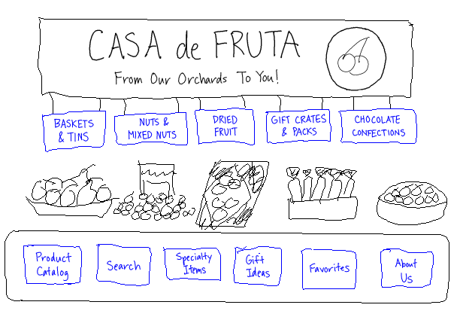
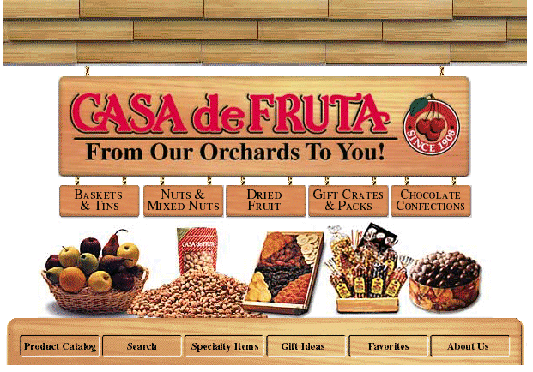
Qualities of Lo-Fi Prototypes
Advice: avoid high-fidelity tools until necessary
Informal visual representation
  communicates “unfinished”
  encourages creativity
  faster to create
  higher-level feedback
Formal visual representation
  communicates “finished”
  inhibits creativity (detailing)
  slower to create

Slide 41
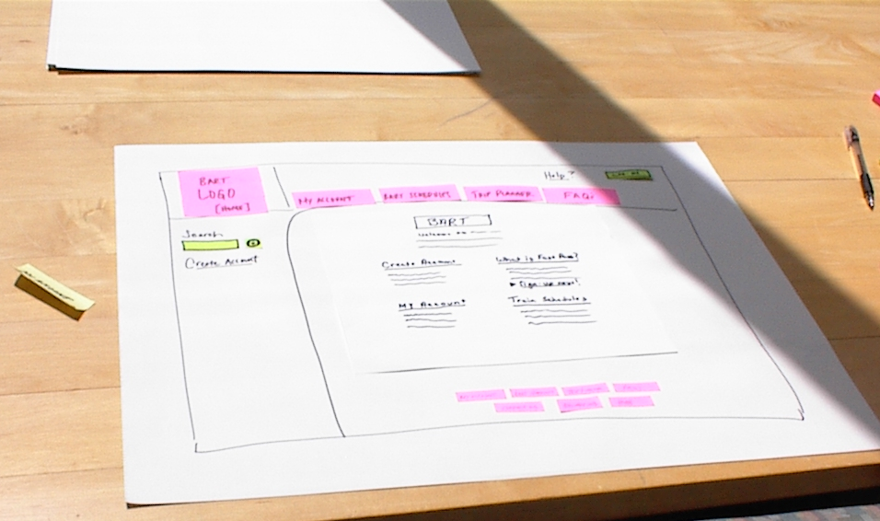
The Basic Materials
Large, heavy, white paper (11 x 17)
5x8 in. index cards
Post-its
Tape, stick glue, correction tape
Pens & markers (many colors & sizes)
Overhead transparencies
Scissors, X-acto knives, etc.

Slide 42
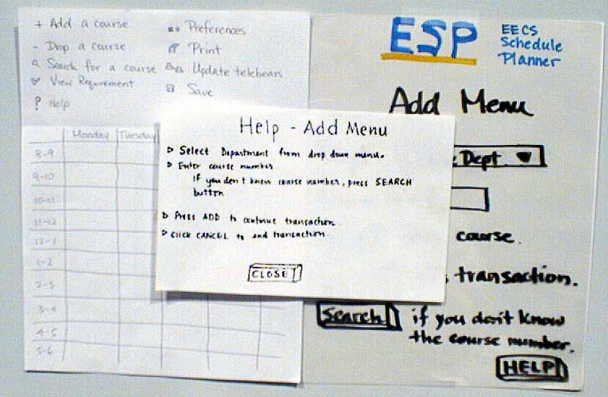
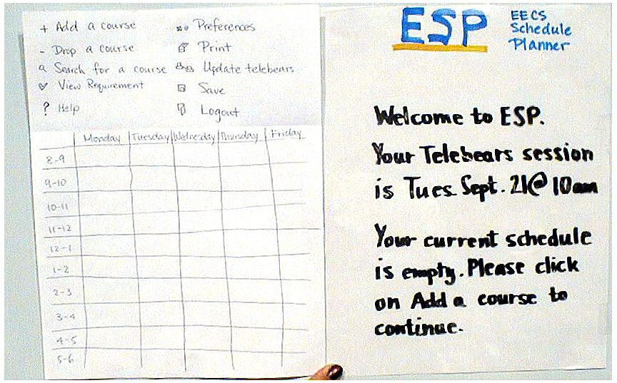
ESP

Slide 43
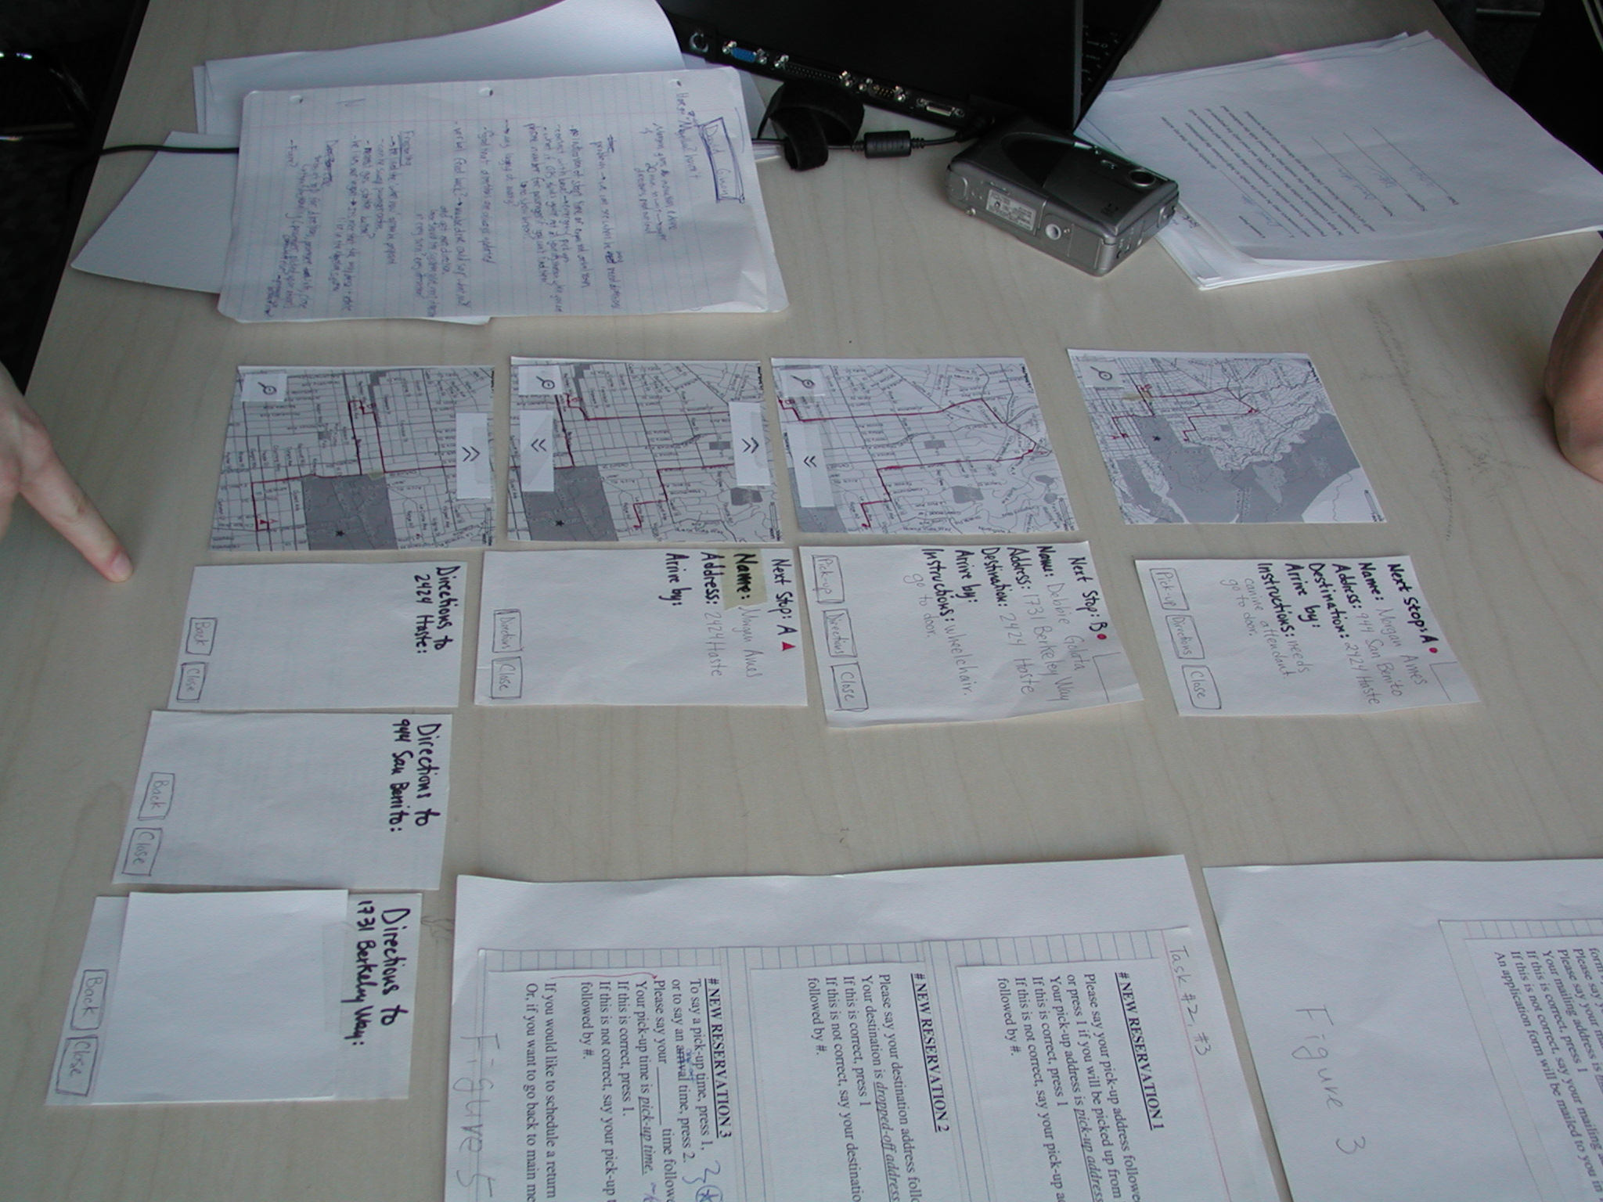
Constructing the Model

Slide 44
Constructing the Paper Prototype
Set a deadline
  a few hours or 1-2 days
  don’t think for too long - build it!
Draw a window frame on large paper
Put different screen regions on cards
  anything that moves, changes, appears/disappears
Ready response for any user action
  e.g., have those pull-down menus already made
Use photocopier to make many versions

Slide 45

Advantages of Low-fi Prototyping
Takes only a few hours
  no expensive equipment needed
Can test multiple alternatives
  fast iterations
    number of iterations is tied to final quality
Almost all interaction can be faked

Slide 46
Iterative Design
Redesign interface based on evaluation
New design may be worse or may break something
Keep track of reasons for design decisions
  Called "Design Rationale"
  So don't need to keep revisiting the same decisions
  When future conditions suggest changing a decision will remember why made that way and what implications for change are.
Instead of arguing about a design feature, figure out what information would tell you which way to go
  Experiment, marketing data, etc.
Nielsen says typically need about 3 iterations

Slide 47
Iterative design is crucial
Design
Prototype
Evaluate

Slide 48
3) Analyzing the System
Testing is crucial for whether software has bugs
  You wouldn’t ship a product without testing it
Also crucial for whether software is usable by the target users
If users can’t use it,
it doesn’t work!

Slide 49
Objective Measurements
Usability Can Be Objectively Defined and Measured
Example: Usability Goal for a corporate travel system…
  On their first try, within 12 minutes, 75% of travelers shall be able to correctly:
    Create a travel advance request form
    Select one departure flight and one return flight
    Designate one hotel
    Reserve one rental car
    Forward the form for approval . .
  By the second try, within 20 minutes, 90% of travelers shall be able to complete all 5 tasks correctly

Slide 50
Usability Goals
Set goals early and use them to measure progress
Goals often have tradeoffs, so prioritize
Example goals:
  Learnable
    faster the 2nd time & so on
  Memorable
    from session to session
  Flexible
    multiple ways to accomplish tasks
  Efficient
    perform tasks quickly
  Robust
    minimal error rates
    good feedback so user
    can recover
  Pleasing
    high user satisfaction
  Fun

Slide 51
Goal Levels
Pick Levels for your system:
  Minimum acceptable level
  Desired (planned) level
  Theoretical best level
  Current level or competitor's level
Minimum
Acceptable
Current
Best
Desired
0
1
2
5
Errors

Slide 52
User Studies
Use “think-aloud” protocols
  Get user to continuously verbalize their thoughts
“Single most valuable usability engineering method”
Find out why user does things
  What thought would happen, why stuck, frustrated, etc.
Encourage users to expand on whatever interesting
  Ask general questions:
    “What did you expect”
    “What are you thinking now”
Good
designers
Average
designers
Quality, before and
after user tests

Slide 53
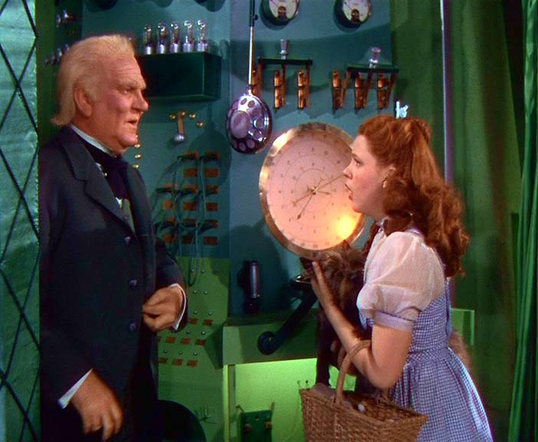
What to Evaluate
Paper prototypes
  “Low fidelity prototyping”
  Often surprisingly effective
  Experimenter plays the computer
“Wizard of Oz”
  “Pay no attention to the man
  behind the curtain”
  User’s computer is “slave” to experimenter’s computer
    Experimenter provides the computer’s output
Implemented Prototype
  Visual Basic, web browser, etc. (no database)
Real system

Slide 54
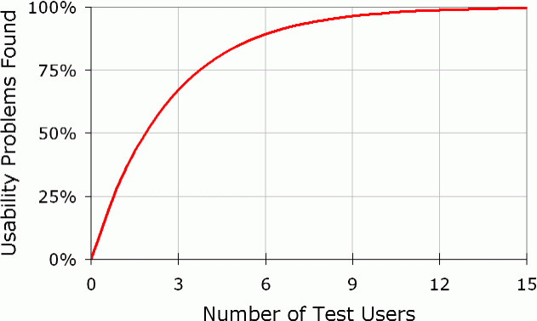
Number of test users
As few as 5
  Can update after each user to correct problems
    But can be misled by “spurious behavior” of a single person
      Accidents or just not representative
  Five users cannot
  test all of a system

Slide 55
Heuristic Evaluation Method
Expert evaluates the user interface using guidelines
“Discount” usability engineering method
  One case study found factor of 48 in cost/benefit:
    Cost of inspection: $10,500. Benefit: $500,000 (Nielsen, 1994)

Slide 56
Discount Usability Engineering
Reaction to excuses for not doing user testing
  “too expensive”, “takes too long”, …
Cheap
  no special labs or equipment needed
  the more careful you are, the better it gets
Fast
  on order of 1 day to apply
  standard usability testing may take a week or more
Easy to use
  some techniques can be taught in 2-4 hours

Slide 57
10 Basic Principles
From Nielsen’s web page: http://www.useit.com/papers/heuristic/heuristic_list.html
Visibility of system status
Match between system and the real world
User control and freedom
Consistency and standards
Error prevention
Recognition rather than recall
Flexibility and efficiency of use
Aesthetic and minimalist design
Help users recognize, diagnose, and recover from errors
Help and Documentation

Slide 58
How to do Heuristic Evaluation
Systematic inspection of system
Multiple evaluators are better
Trained evaluators are better
  22% vs. 41% vs. 60% of errors found
Go through whole interface
Result: list of problems, guidelines violated, and proposed fixes
Seems “obvious”, “common sense”
  But heuristics conflict
  People have different opinions

Slide 59
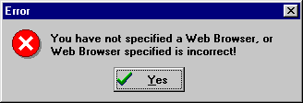
Example Heuristic
H2-9: Help users recognize, diagnose, and recover from errors
  error messages in plain language
  precisely indicate the problem
  constructively suggest a solution

Slide 60
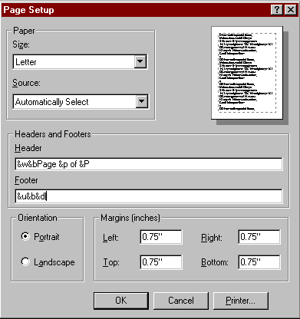
User Interface Hall of Fame or Shame?
IE5 page setup for printing
Problems
  codes for header & footer information
    requires recall!
    recognition over recall
    no equivalent GUI
  help is the way to find out, but not obvious

Slide 61
Resources for Further Study
Brad A. Myers. "Challenges of HCI Design and Implementation,“ ACM Interactions. vol. 1, no. 1. January, 1994. pp. 73-83.
H. Beyer and K. Holtzblatt. 1998. Contextual Design: Defining Customer-Centered Systems. San Francisco, CA:Morgan Kaufmann Publishers, Inc.
Jakob Nielsen. "Usability Engineering". Boston:
Academic Press, Inc. 1993. ISBN 0-12-518406-9
(paperback) or ISBN 0-12-518405-0 (hardcover).
Jakob Nielsen’s web site and free material:
  www.useit.com
  The Alertbox: Current Issues in Web Usability. A
  Bi-weekly column. Subscribe at: http://www.useit.com/alertbox/

Slide 62
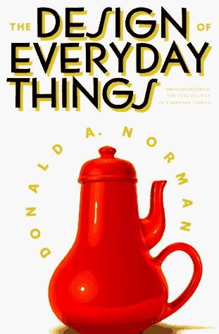
Design of Everyday Things
By Don Norman (UCSD, Apple, HP, NN Group)
Design of everyday objects illustrates problems faced by designers of systems
Explains conceptual models
  doors, washing machines, digital watches, telephones, ...
Resulting design guides
−> Highly recommend this book
Notes:
I re-read this book for the course. My lord, it’s *really* good. A bit reductive, certainly not at the forefront of research in cognitve science. (For a more academic overview of the field, I’d recommend Pinker’s book.) But it’s very readable, offers compelling, reusable anecdotes, and can be read in a few hours.

