Slide 1
Introduction to Usable Security Reasoning About the Human in the Loop
Lorrie Faith Cranor
August 2009

Slide 2
Outline
Why should we make secure systems more usable?
How can we make secure systems more usable
The human in the loop

Slide 3
Why should we make secure systems more usable?

Slide 4
Unusable security & privacy
Unpatched Windows machines compromised in minutes
Phishing web sites costing $billions
Most PCs infected with spyware (avg. = 25)
Users have more passwords than they can remember and practice poor password security
Enterprises store confidential information on laptops and mobile devices that are frequently lost or stolen

Slide 5
Grand Challenge
“Give end-users security controls they can understand and privacy they can control for the dynamic, pervasive computing environments of the future.”
- Computing Research Association 2003

Slide 6
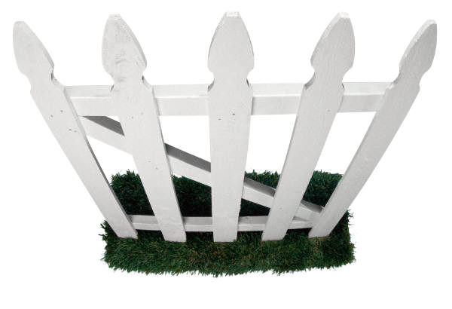
security/privacy researchers and system developers
human computer interaction researchers and usability professionals
Notes:
But until recently, security and privacy researchers weren’t paying a whole of attention to what users wanted.
Security folks worked in one department, while HCI folks worked in a different department, and they didn’t really talk much.
But that is starting to change.

Slide 7
The user experience
Notes:
Time we spend configuring security and privacy tools is time we are not spending doing what we really want to be doing with our computers

Slide 8
How do users stay safe online?

Slide 9
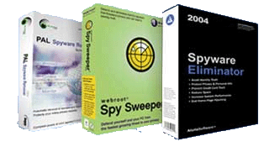
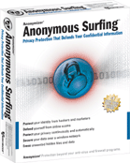
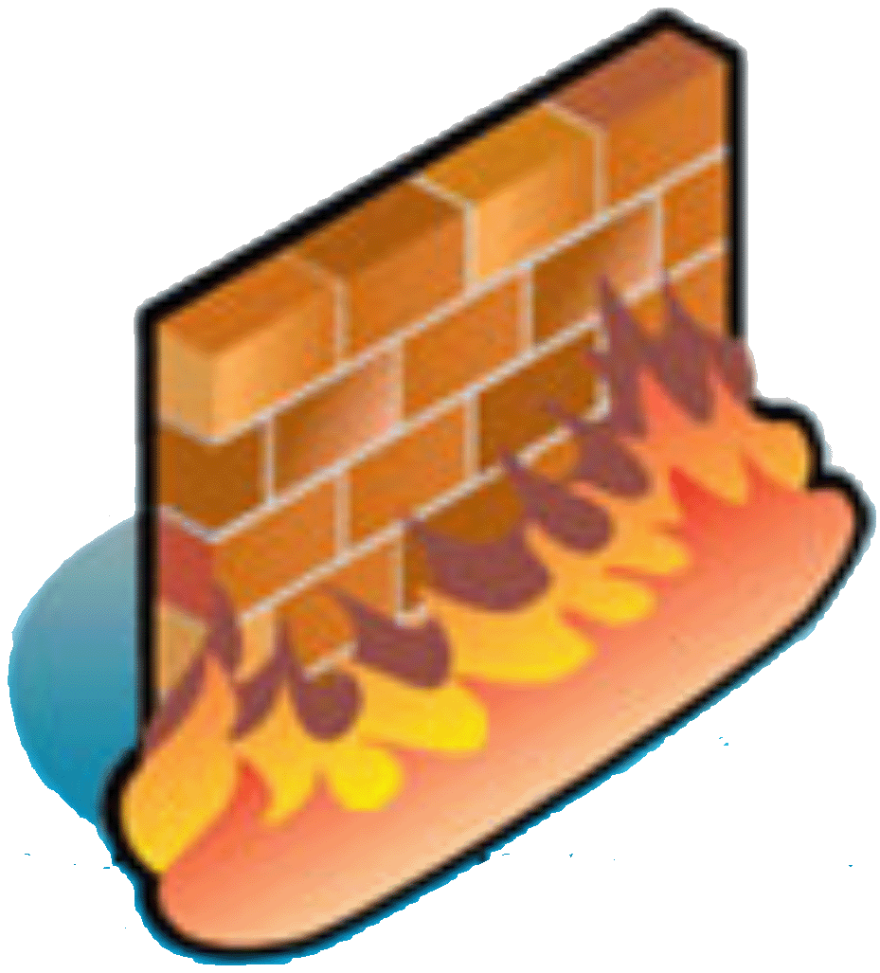
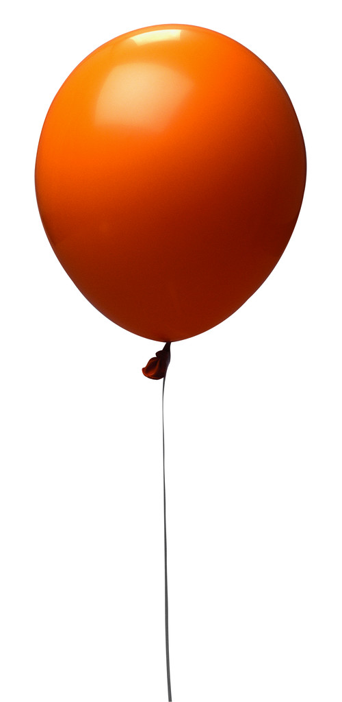
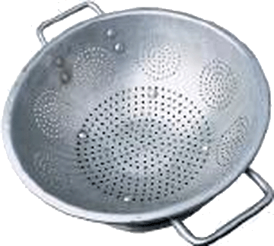
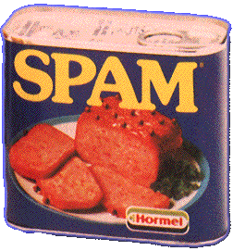
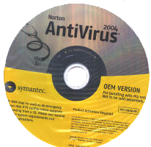
POP!
Notes:
Firewalls
Antivirus software
Spam filters
Pop-up blockers
Cookie managers
Spyware removers
encryption software
if you have kids, adult content filters,
and if you want to cover your tracks, anonymity tools

Slide 10
After installing all that security and privacy software do you have any time left to get any work done?

Slide 11
Secondary tasks
Notes:
Security and privacy are secondary tasks
Nobody buys a computer so they can spend time securing it.
Time we spend configuring security and privacy tools is time we are not spending doing what we really want to be doing with our computers

Slide 12
“Users do not want to be responsible for, nor concern themselves with, their own security.”
- Blake Ross
Notes:
Firefox developer Blake Ross wrote about a set of security assumptions in the chapter he wrote for Cranor/Garfinkel Usable Security book.
These are a good set of assumptions that most software developers might follow. Here is one of them.

Slide 13
Concerns may not be aligned
Security experts are concerned about the bad guys getting in
Users may be more concerned about locking themselves out

Slide 14
Grey: Smartphone based access-control system
Deployed in CMU building with computer security faculty and students
Nobody questions that the security works
But lots of concerns about getting locked out
L. Bauer, L. F. Cranor, M. K. Reiter, and K. Vaniea. Lessons Learned from the Deployment of a Smartphone-Based Access-Control System. Technical Report CMU-CyLab-06-016, CyLab, Carnegie Mellon University, October 2006. http://www.cylab.cmu.edu/default.aspx?id=2244

Slide 15
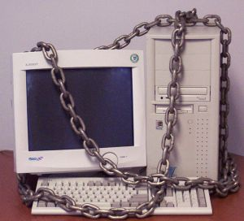
Secure, but usable?

Slide 16
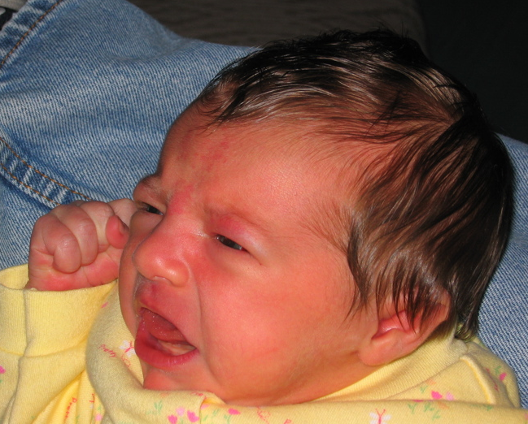
Unusable security frustrates users

Slide 17
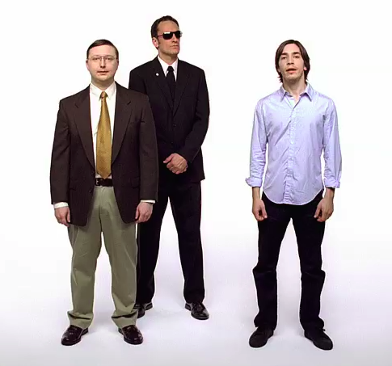
http://www.youtube.com/watch?v=FfetbidVUYw
Notes:
Apple add campaign making fun of unusable security in Microsoft Vista, from February 2007. Vista asks user to authorize everything “Cancel or allow?”

Slide 18
Typical password advice
Pick a hard to guess password
Don’t use it anywhere else
Change it often
Don’t write it down
Notes:
Common knowledge that this is advice doesn’t work

Slide 19
What do users do when every web site wants a password?

Slide 20
Bank = b3aYZ
Amazon = aa66x!
Phonebill = p$2$ta1

Slide 21
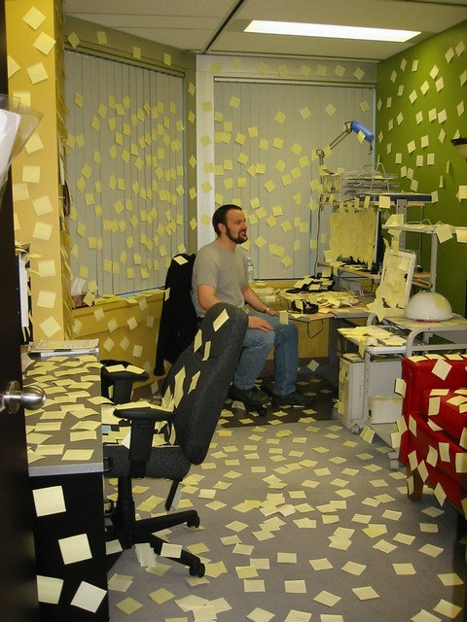
Notes:
From http://www.interactivetools.com/staff/dave/damons_office/

Slide 22
How can we make secure systems more usable?

Slide 23
How can we make secure systems more usable?
Make it “just work”
Invisible security
Make security/privacy understandable
Make it visible
Make it intuitive
Use metaphors that users can relate to
Train the user
Notes:
These are the three main approaches discussed in the literature. There is no silver bullet and often we rely on a combination.

Slide 24
Make it “just work”

Slide 25
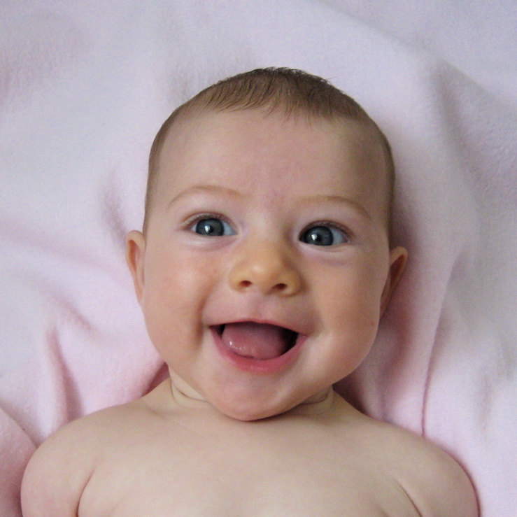
This makes users very happy
(but it’s not that easy)

Slide 26
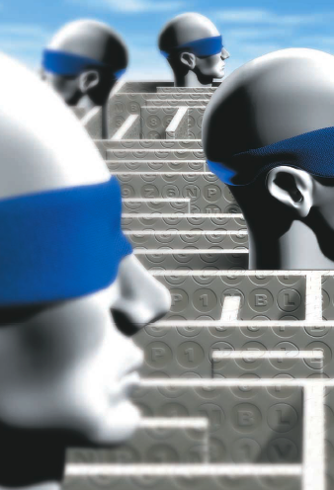
One way to make it work: make decisions
Developers should not expect users to make decisions they themselves can’t make
Notes:
Many pieces of software contain prompts in which the developers ask users to make a security-related decision.
Blake Ross suggests that -
Before coding up such questions, software developers should ask themselves a question:
if I can’t figure it out, how are users supposed to?
What additional qualifications do users possess that will help them arrive at a better conclusion?
(From Blake Ross’ book chapter)

Slide 27
Make security understandable

Slide 28
“Present choices, not dilemmas”
- Chris Nodder (in charge of user experience for Windows XP SP2)
Notes:
Chris Nodder, who was in charge of user experience for MS XP SP2, puts it this way:
“Present choices, not dilemmas.”
If the user doesn’t have any insights into how to answer a question, it is a dilemma, not a decision.
There are some situations where users possess some additional contextual knowledge or personal preferences that may allow them to make a better decision than the implementer could make in advance. In those cases, UIs are needed that will help users understand what bit of knowledge they bring to the decision and how they can best apply it. But if the users don’t have anything useful to contribute, they should not be making the decision.

Slide 29
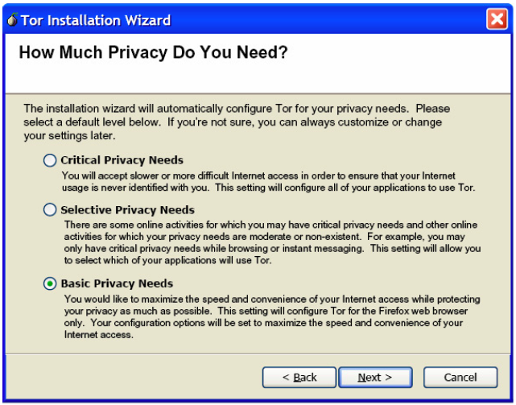
Notes:
My students developed this as part of their (winning) entry in the TOR GUI competition. Instead of asking users to configure the number of hops, key length, etc. we just ask them how much privacy they need and then we can setup the rest. This is the only question most users are actually qualified to answer.

Slide 30
Also not so easy
Privacy policy matches user’s privacy preferences
Privacy policy does not match user’s privacy preferences
Notes:
Getting icons and metaphors right is really difficult.
I developed a privacy tool and did not want to use the usual lock or eyeball icons. Instead I used a bird.
The bird is supposed to represent a user’s agent who checks out a web site’s privacy policy and reports back to the user. The green bird indicates…. The red bird indicates….
In one user study I did, I asked subjects to tell me what they thought the icons meant before they used the software. Initially people thought the green bird with the music notes meant you could download music from the site. They thought the red bird meant that the site used fowl language and might not be appropriate for children.

Slide 31
Train the user

Slide 32
Training people not to fall for phish
Laboratory study of 28 non-expert computer users
Asked to evaluate 10 web sites, take 15 minute break, evaluate 10 more web sites
Experimental group read web-based training materials during break, control group played solitaire
Experimental group performed significantly better identifying phish after training
People can learn from web-based training materials, if only we could get them to read them!
P. Kumaraguru, S. Sheng, A. Acquisti, L. Cranor, and J. Hong. Teaching Johnny Not to Fall for Phish. CyLab Technical Report. CMU-CyLab-07-003, 2007. http://www.cylab.cmu.edu/default.aspx?id=2275

Slide 33
How do we get people trained?
Most people don’t proactively look for training materials on the web
Many companies send “security notice” emails to their employees and/or customers
But these tend to be ignored
Too much to read
People don’t consider them relevant

Slide 34
Embedded training
Can we “train” people during their normal use of email to avoid phishing attacks?
Periodically, people get sent a training email
Training email looks like a phishing attack
If person falls for it, intervention warns and highlights what cues to look for in succinct and engaging format
User studies have demonstrated that this is effective
P. Kumaraguru, Y. Rhee, A. Acquisti, L. Cranor, J. Hong, and E. Nunge. Protecting people from phishing: the design and evaluation of an embedded training email system. In CHI 2007: Conference on Human Factors in Computing Systems, San Jose, California, 28 April - May 3, 2007, 905-914.

Slide 36
Notes:
Another approach is a game. Anti-Phishing Phil.
S. Sheng, B. Magnien, P. Kumaraguru, A. Acquisti, L. Cranor, J. Hong, and E. Nunge. Anti-Phishing Phil: The Design and Evaluation of a Game That Teaches People Not to Fall for Phish. In Proceedings of the 2007 Symposium On Usable Privacy and Security, Pittsburgh, PA, July 18-20, 2007.

Slide 37
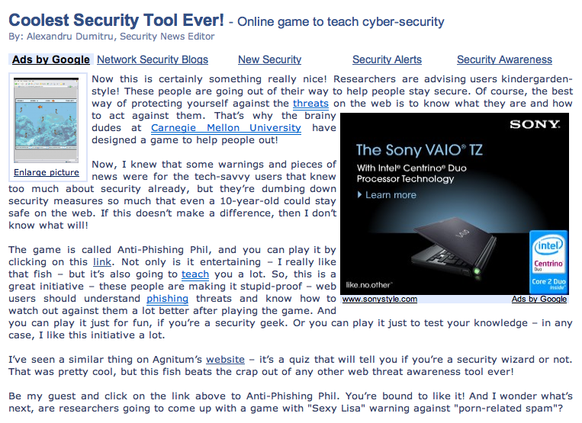

Slide 38
The human in the loop

Slide 39
Humans
“Humans are incapable of securely storing high-quality cryptographic keys, and they have unacceptable speed and accuracy when performing cryptographic operations. (They are also large, expensive to maintain, difficult to manage, and they pollute the environment. It is astonishing that these devices continue to be manufactured and deployed. But they are sufficiently pervasive that we must design our protocols around their limitations.)”
−− C. Kaufman, R. Perlman, and M. Speciner. Network Security: PRIVATE Communication in a PUBLIC World. 2nd edition. Prentice Hall, page 237, 2002.

Slide 40
Humans are weakest link
Most security breaches attributed to “human error”
Social engineering attacks proliferate
Frequent security policy compliance failures
Automated systems are generally more predictable and accurate than humans

Slide 41
Why are humans in the loop at all?
Don’t know how or too expensive to automate
Human judgments or policy decisions needed
Need to authenticate humans

Slide 42
The human threat
Malicious humans who will attack system
Humans who are unmotivated to perform security-critical tasks properly or comply with policies
Humans who don’t know when or how to perform security-critical tasks
Humans who are incapable of performing security-critical tasks

Slide 43
Need to better understand humans in the loop
Do they know they are supposed to be doing something?
Do they understand what they are supposed to do?
Do they know how to do it?
Are they motivated to do it?
Are they capable of doing it?
Will they actually do it?

Slide 44
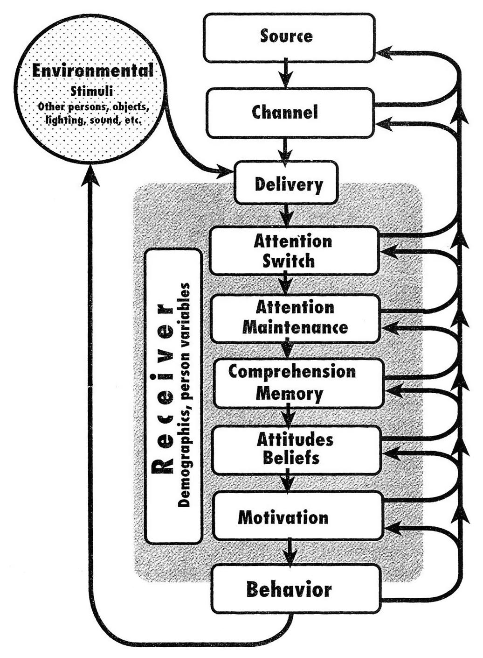
C-HIP Model
Communication-Human Information Processing Model
Wogalter, M. 2006. Communication-Human Information Processing (C-HIP) Model. In Wogalter, M., ed., Handbook of Warnings. Lawrence Erlbaum Associates, 51-61.

Slide 45
Human-in-the-loop security framework
Applied C-HIP to security indicators
Expanded to model other types of human interaction with secure systems
Password policies
Online trust decisions
Developed human threat identification and mitigation process
L. Cranor. A Framework for Reasoning About the Human In the Loop. Usability, Psychology and Security 2008. http://www.usenix.org/events/upsec08/tech/full_papers/cranor/cranor.pdf

Slide 46
Human-in-the-loop framework
Communication
Communication Delivery
Attention Switch
Human Receiver
Personal Variables
Demographics and Personal Characteristics
Attention Maintenance
Communication Impediments
Knowledge & Experience
Communication Processing
Comprehension
Environmental Stimuli
Behavior
Intentions
Knowledge Acquisition
Interference
Attitudes and Beliefs
Application
Motivation
Knowledge Retention
Capabilities
Knowledge Transfer

Slide 47
Communication processing model
Framework is based on communication processing model
Many models in the literature
Used to model all sorts of communications
Most end-user security actions are triggered by some form of communication
Pop-up alert, email, manual, etc.
Expert self-discovery of a security process can be modeled as communication to oneself

Slide 48
Communication
Communication
Communication Delivery
Attention Switch
Human Receiver
Personal Variables
Demographics and Personal Characteristics
Attention Maintenance
Communication Impediments
Knowledge & Experience
Communication Processing
Comprehension
Environmental Stimuli
Behavior
Intentions
Knowledge Acquisition
Interference
Attitudes and Beliefs
Application
Motivation
Knowledge Retention
Capabilities
Knowledge Transfer

Slide 49
Types of security communications
Warnings
Alert users to take immediate action to avoid hazard
Notices
Inform users about characteristics of entity or object
Status indicators
Inform users about system status information
Training
Teach users about threat and how to respond
Policy
Inform users about policies
Notes:
Examples of each?
Warnings - anti-phishing , expired SSL certs
Notices - privacy polices, SSL certs
Status indicators - taskbar and menu bar indicators about bluetooth, virus software up-to-date, file permissions
Training - tutorials, games, instruction manuals, web sites, emails, seminars, courses, videos
Policy - ISP terms of service, employee handbook, password policy, policy on encrypting documents

Slide 50
Active versus passive communications
Active
Passive
Firefox Anti- Phishing Warning
Indicators with audio alerts
Bluetooth indicator in Mac menu bar
Indicators with animation
Notes:
Other examples? Class discussion

Slide 51
Communication impediments
Communication
Communication Delivery
Attention Switch
Human Receiver
Personal Variables
Demographics and Personal Characteristics
Attention Maintenance
Communication Impediments
Knowledge & Experience
Communication Processing
Comprehension
Environmental Stimuli
Behavior
Intentions
Knowledge Acquisition
Interference
Attitudes and Beliefs
Application
Motivation
Knowledge Retention
Capabilities
Knowledge Transfer

Slide 52
Environmental stimuli
Divert user’s attention
Greatest impact on passive communication
Examples
Other communications
Ambient light and noise
User’s primary task
Communication Impediments
Environmental Stimuli
Interference

Slide 53
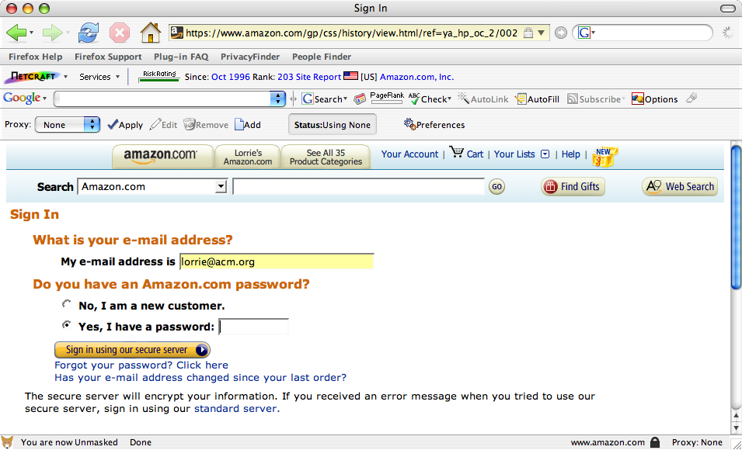

Slide 54
Interference
Anything that may prevent a communication from being received as the sender intended
Caused by
Malicious attackers
Technology failures
Environmental stimuli that obscure the communication
Focus of traditional secure systems analysis
Communication Impediments
Environmental Stimuli
Interference

Slide 55
Human receiver – The human in the loop
Communication
Communication Delivery
Attention Switch
Human Receiver
Personal Variables
Demographics and Personal Characteristics
Attention Maintenance
Communication Impediments
Knowledge & Experience
Communication Processing
Comprehension
Environmental Stimuli
Behavior
Intentions
Knowledge Acquisition
Interference
Attitudes and Beliefs
Application
Motivation
Knowledge Retention
Capabilities
Knowledge Transfer

Slide 56
Communication delivery
Attention switch
Noticing communication
Attention maintenance
Paying attention long enough to process
Breakdowns
Environmental stimuli, interference
Characteristics of communication
Habituation
Tendency for the impact of stimuli to decrease over time
Communication Delivery
Attention Switch
Attention Maintenance
Notes:
Just because the communication appeared on the screen, doesn’t mean the user actually saw it

Slide 57
“What lock icon?”

Slide 58
Notes:
Firefox turns address bar yellow and adds lock icon - still somewhat subtle
Relying on users to notice the subtlety to maintain their security is not going to work

Slide 59
Communication processing
Comprehension
Understand communication
Knowledge acquisition
Learn what to do in response
Breakdowns
Unfamiliar symbols, vocabulary, complex sentences, conceptual complexity
Communication Processing
Comprehension
Knowledge Acquisition
Notes:
Just because a user comprehends a message, does not mean they know how to respond to it

Slide 60
Firefox SSL icon
Internet Explorer cookie flag
Notes:
IE cookie flag
Firefox closed lock, note that it puts name of site next to closed lock, no open lock

Slide 61
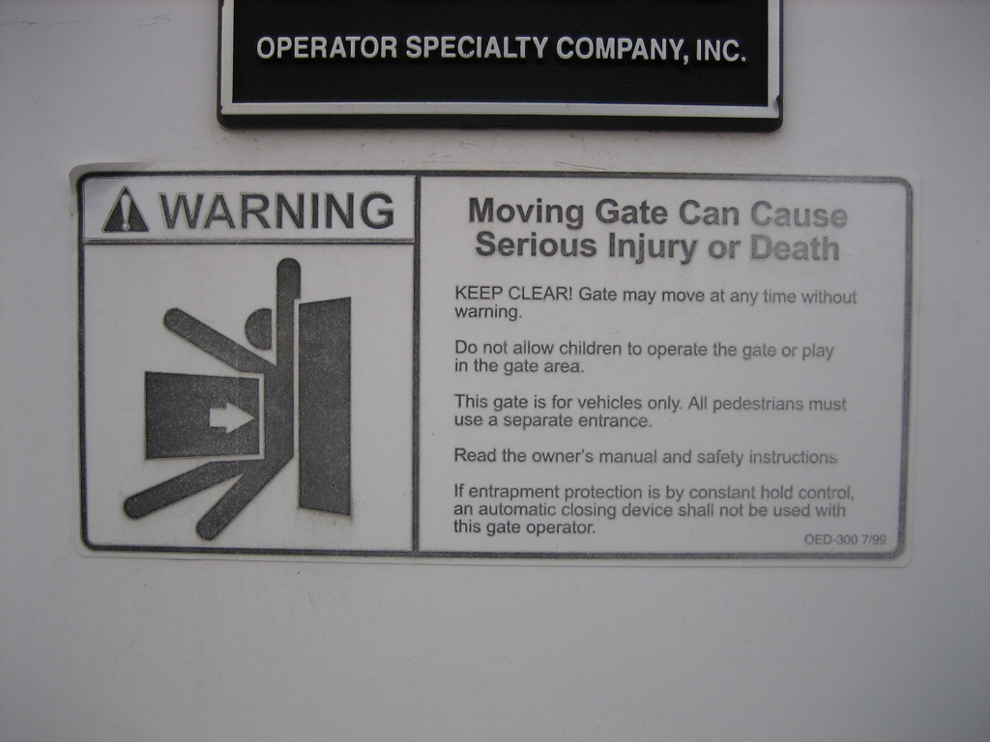
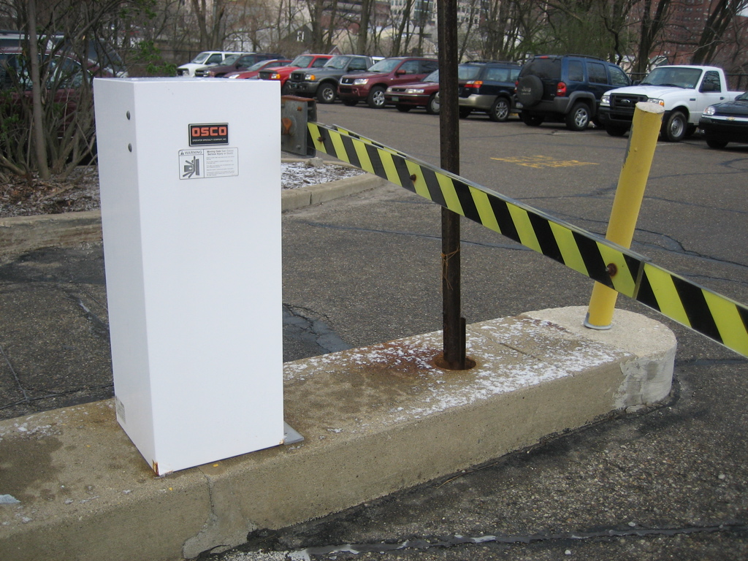
Notes:
It turns out the first warning was the wrong warning for that particular gate. They later replaced it with the correct one.

Slide 62
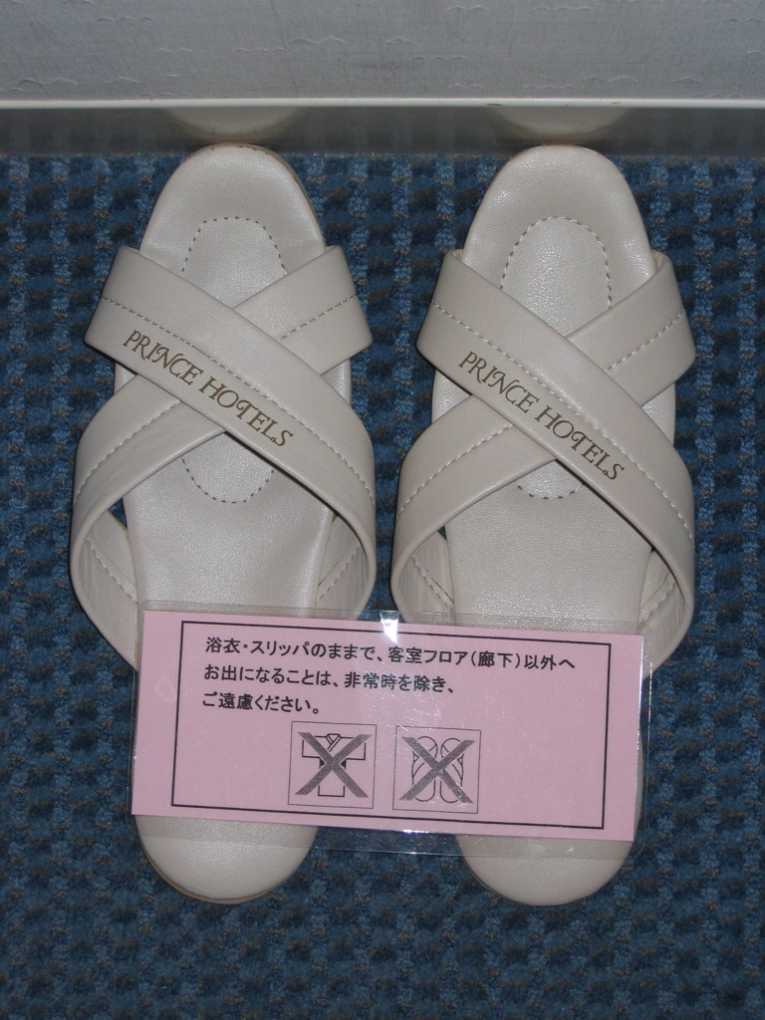
Notes:
What do you think these icons mean?
The rough translation from Japanese is “Do not wear slippers or kimono outside of hotel room unless there is an emergency.” How could we represent that in pictures?

Slide 63
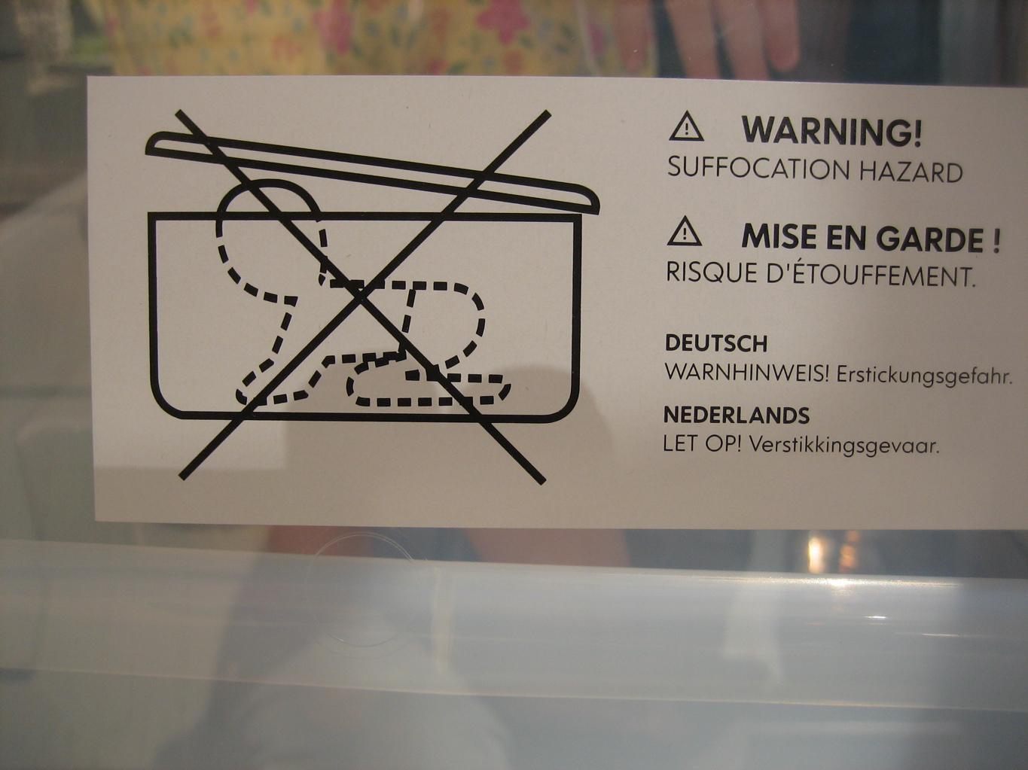
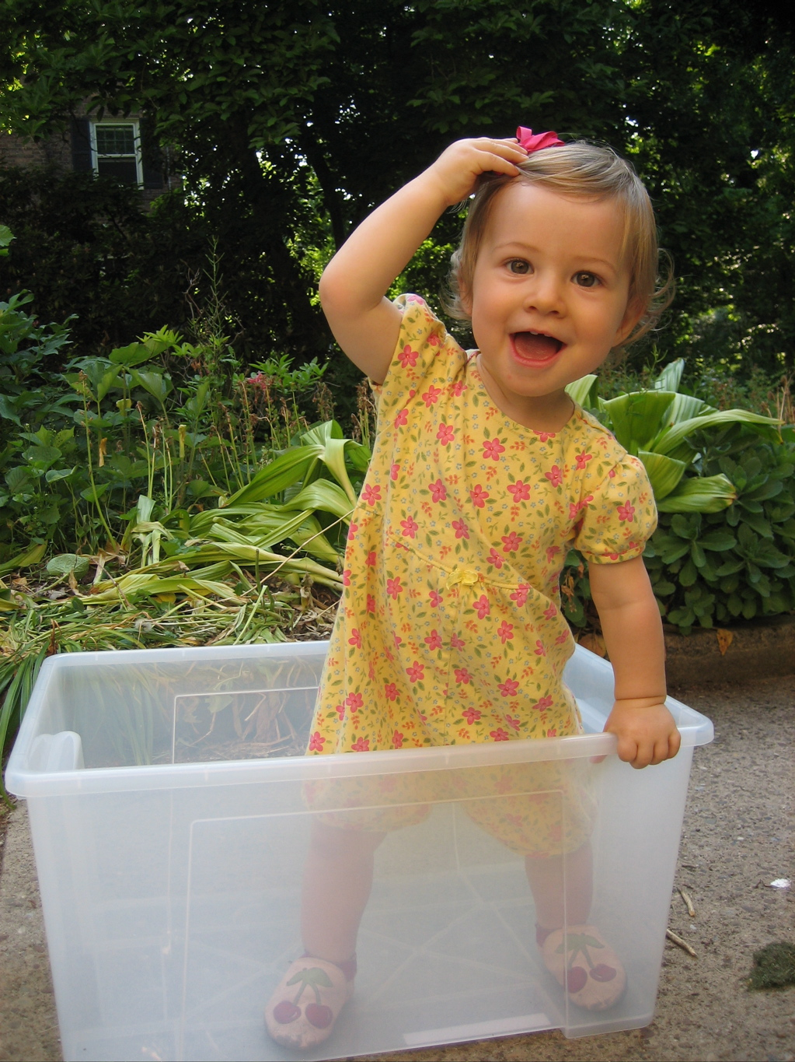
Notes:
Baby box warning – this one is actually pretty clear, but people still don’t pay attention to it

Slide 64
Application
Knowledge retention
Ability to remember communication
Knowledge transfer
Ability to recognize applicable situations and apply knowledge
May not be necessary if application is immediate (e.g. pop-up warning)
Application
Knowledge Retention
Knowledge Transfer

Slide 65
Personal variables
Demographics and personal characteristics
Age, gender, culture, education, occupation, disabilities
Knowledge and experience
Education, occupation, prior experience
Personal Variables
Demographics and Personal Characteristics
Knowledge & Experience

Slide 66
Intentions
Attitudes and beliefs
Beliefs about communication accuracy
Beliefs about whether they should pay attention
Self-efficacy - whether they believe they can complete actions effectively
Response-efficacy - whether they believe the actions they take will be effective
How long it will take
General attitudes - trust, annoyance
Motivation
Incentives, disincentives
Intentions
Attitudes and Beliefs
Motivation

Slide 67
Capabilities
User’s level of ability
Cognitive or physical skills
Availability of necessary software or devices
Capabilities
Notes:
Can you think of examples of security tasks users are commonly asked to do that are beyond their capabilities?

Slide 68
Are you capable of remembering a unique strong password for every account you have?

Slide 69
Behavior
Communication
Communication Delivery
Attention Switch
Human Receiver
Personal Variables
Demographics and Personal Characteristics
Attention Maintenance
Communication Impediments
Knowledge & Experience
Communication Processing
Comprehension
Environmental Stimuli
Behavior
Intentions
Knowledge Acquisition
Interference
Attitudes and Beliefs
Application
Motivation
Knowledge Retention
Capabilities
Knowledge Transfer

Slide 70
Behavior
Users may intend to comply, but may fail to complete necessary action
Users may complete recommended action, but do so in a way that follows a predictable pattern that can be exploited by attackers
Example: password choice

Slide 71
http://www.arcamax.com/zits/s-427369-156783
Zits by Jerry Scott and Jim Borgman, October 22, 2008

Slide 72
Gulfs
Gulf of Execution
Gap between a person’s intentions to carry out an action and the mechanisms provided by a system to facilitate that action
“I can’t figure out how to make it do what I want it to do”
Gulf of Evaluation
When a user completes an action but is unable to interpret the results to determine whether it was successful
“I can’t figure out whether it worked”
Don Norman. The Design of Every Day Things.1988.

Slide 73
Generic Error-Modeling System
Mistakes
When people formulate action plans that will not achieve the desired goal
Lapses
When people formulate suitable action plans, but forget to perform a planned action (for example, skipping a step)
Slips
When people perform actions incorrectly (for example, press the wrong button)
James Reason. Human Error. 1990.
Notes:
Ask for examples of each

Slide 74
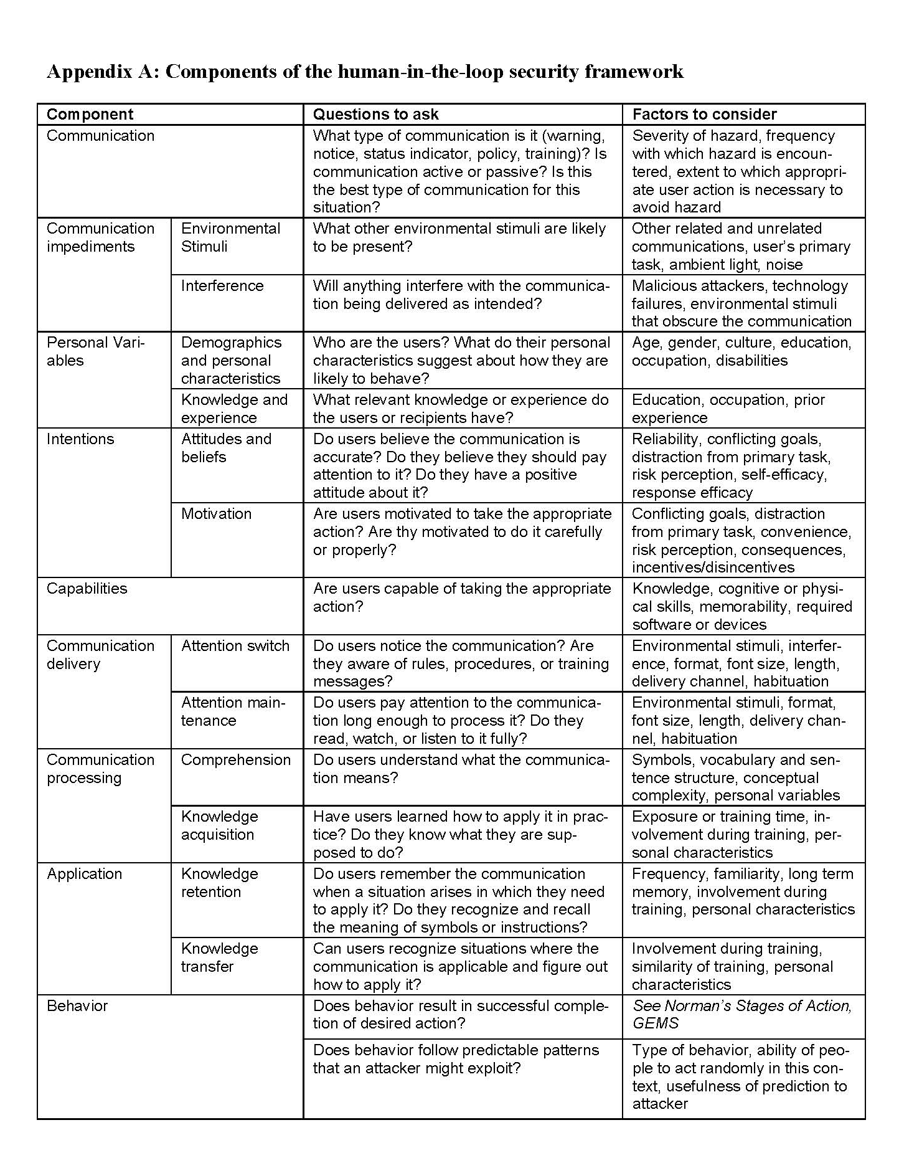
Handy table
Component
Questions to ask
Factors to consider

Slide 75
Human threat identification and mitigation process
Task Identification
Task Automation
Failure Mitigation
Failure Identification
Human-in- the-loop Framework
User Studies
Identify points where system relies on humans to perform security-critical functions
Find ways to partially or fully automate some of these tasks
User Studies
Find ways to prevent these failures
Identify potential failure modes for remaining tasks
Notes:
Note that there is a loop here. If we can automate with only 80% accuracy we might choose not to automate – until we discover humans can do this with only 50% accuracy.

Slide 76
Applying the framework
Applied as part of a human threat identification and mitigation process
Can be applied to understand failures in existing systems and prioritize mitigations
Can be applied to proposed systems in design phase to inform design decisions

Slide 77
Applying threat identification and mitigation process to warnings
Task identification
Determine whether the task I am trying to complete is sufficiently risky that I should stop
Often, software asks the user and provides little or no information to help user make this decision

Slide 78
Computer security warnings
All too often, when software detects a possible security hazard, it warns the user about it
Often, it turns out not to be a hazard
But sometimes it really is a hazard and users ignore the warning anyway

Slide 79
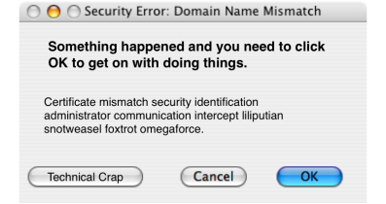
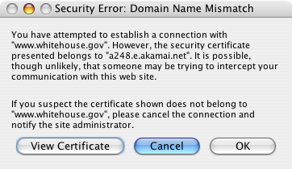
Image courtesy of Johnathan Nightingale

Slide 80
Automate and change tasks to reduce need for user involvement
High probability of danger
Block
Might be dangerous
User must decide
Might be dangerous
User must decide
Very low probability of danger
Don’t bother user
Use automated analysis to determine probability of danger

Slide 81
Support user decision
High probability of danger
Block
Might be dangerous
User must decide
Very low probability of danger
Don’t bother user
Improve warnings
Help user decide by asking question user is qualified to answer

Slide 82
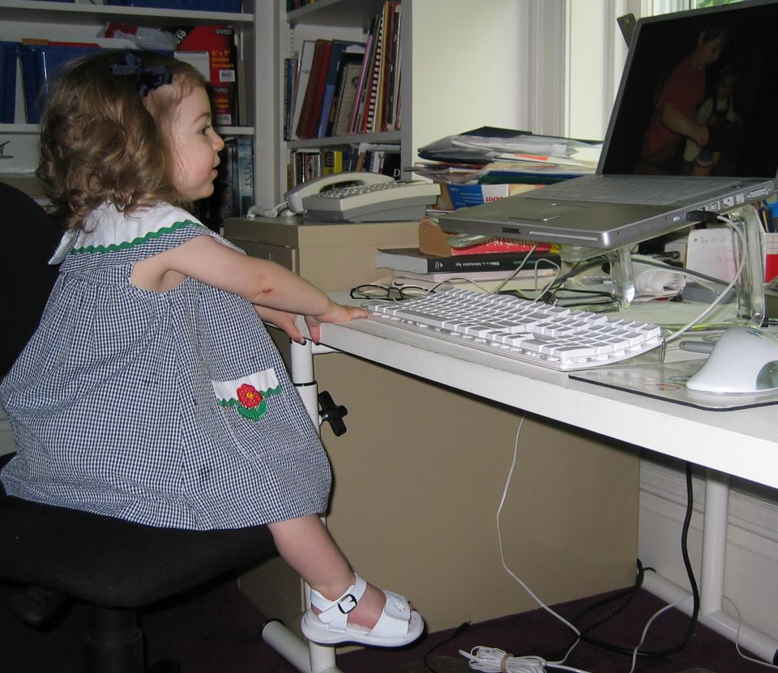
Bad question
Your web browser thinks this is a phishing web site. Do you want to go there anyway?
Don’t go there
Go there anyway
I don’t know what a phishing site is.
I really want to go to this site.
Of course I will go there anyway!

Slide 83
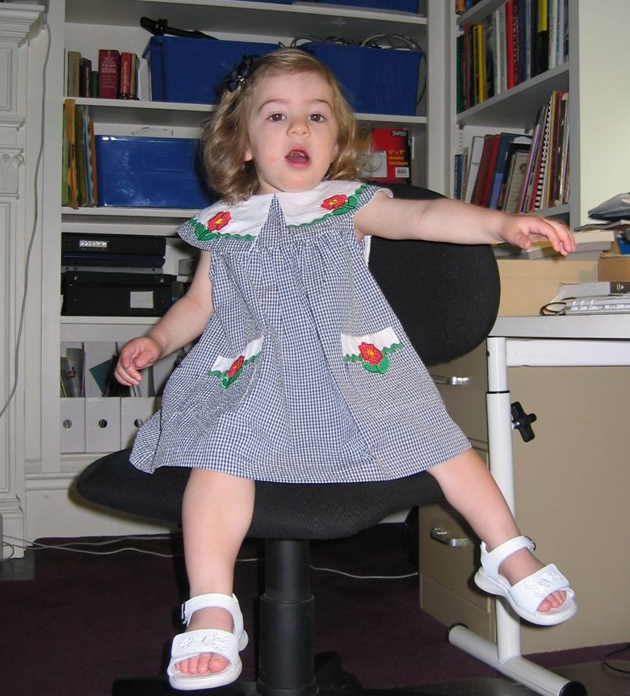
Better question
You are trying to go to evilsite.com. Do you really want to go there or would you rather go to yourbank.com?
Go to yourbank.com
Go to evilsite.com
Of course I want to go to yourbank.com!

Slide 84
What to do about hazards?

Slide 85
Best solution: remove hazard

Slide 86
Next best: guard against hazard

Slide 87
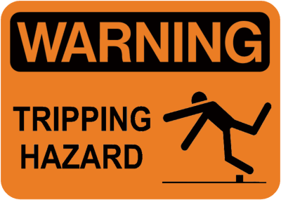
If all else fails: warn

Slide 88
